Slide 1
A Novel ‘Value-based’ Metric Framework to Measure the Impact of Scientific Publications
Avishek Palª, Heather Lang^{b}, Tom Rees^{b}
ªNovartis Pharma AG, Basel, Switzerland
^{b}Oxford PharmaGenesis, Oxford, UK

Slide 2
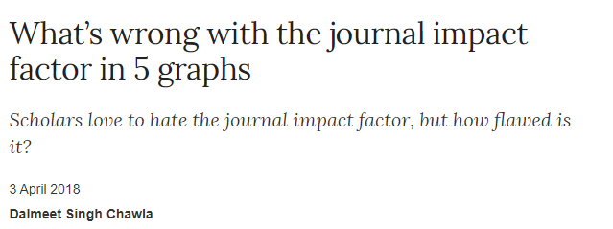


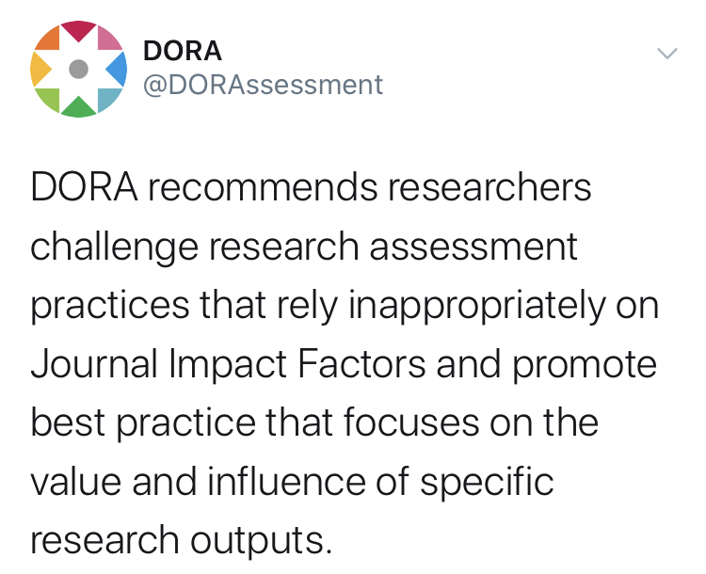

Movements against the traditional Impact Factor obsession are gaining momentum

Slide 3


Article-level metrics provide valuable insights but current scoring systems are not aligned to the needs of publication planners
What it is | Issues
Single number Aggregate, weighted measure Excludes some key metrics (Mendeley, citations) | Dominated by Twitter and news articles Weighting may not be aligned to publication planners’ priorities
5 categories by type of metric Aggregate, unweighted measures Includes all key metrics (including Mendeley and citations) | Some metrics are not universally available for all publications Categories may not be aligned to publication planner’s priorities
Altmetric Attention Score
Plum Print

Slide 4
Project objectives
Predict the likely long-term impact of publications using early indicators
Assess long-term value of publications, classified by the type of impact
Identify publications characteristics and enhancements that are associated with stand-out
long-term impact
Develop a value-based scoring framework for scientific publications
that will allow planners to:
Gather insights to refine the publication strategy

Slide 5












We included both traditional and alternative metrics to develop a holistic framework
Facebook likes
Citescore
Journal citations
Tweets
F1000 mentions
Policy citations
Blog posts
Mendeley saves
Guideline citations
News mentions
Wikipedia mentions
Impact factor

Slide 6




Summary of approach
Data analysis
Sample of nearly 3,000 Phase III articles between 2016-2019.
Relationship between different existing metrics explored using descriptive statistics, Spearman correlation (r_{s}) and factor analysis.
Conceptualisation
Identify key comments of scoring system
Construct the initial framework
Workshop validation
A cross-functional team including Scientific Communications, Medical, Commercial, Launch Strategy, and Analytics
Provided value assessments for the different metrics from a Novartis standpoint
Benchmarking and predictor metrics
Scale to reference benchmark to define a ‘good’ score
Create predictor metrics using linear regression

Slide 7
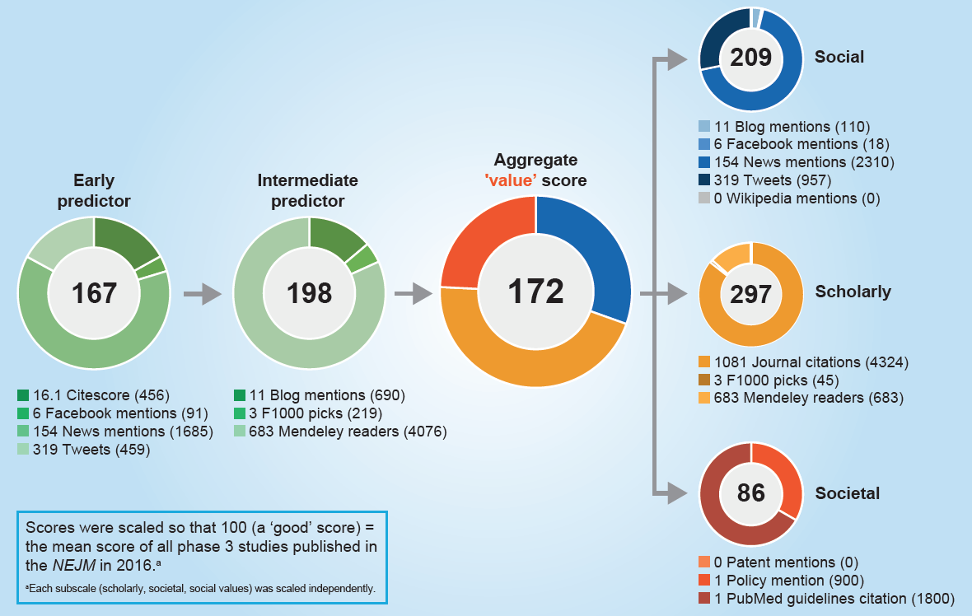
Definitions within the conceptual framework
* Each subscale (Scholarly, Societal, Social values) was scaled independently.

Slide 8
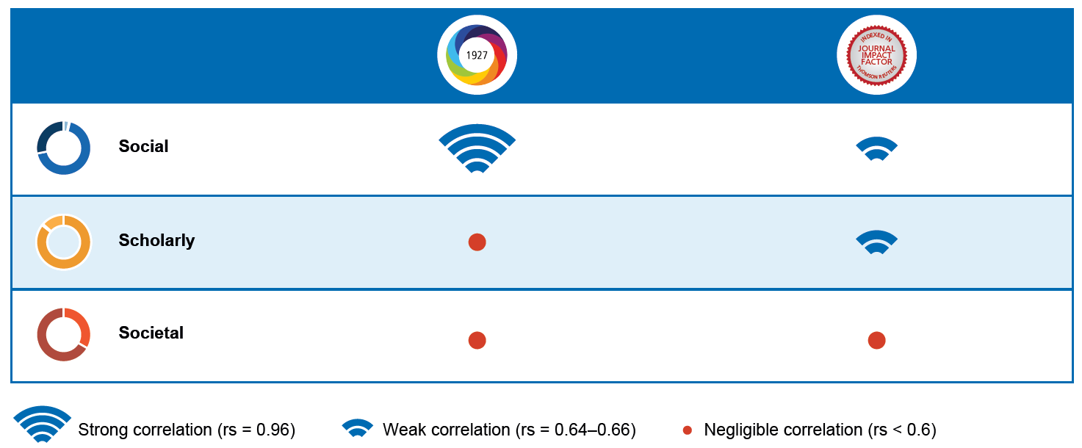

The aggregate value subscores provide richer information than the Altmetric Attention score or Impact Factor

Slide 9
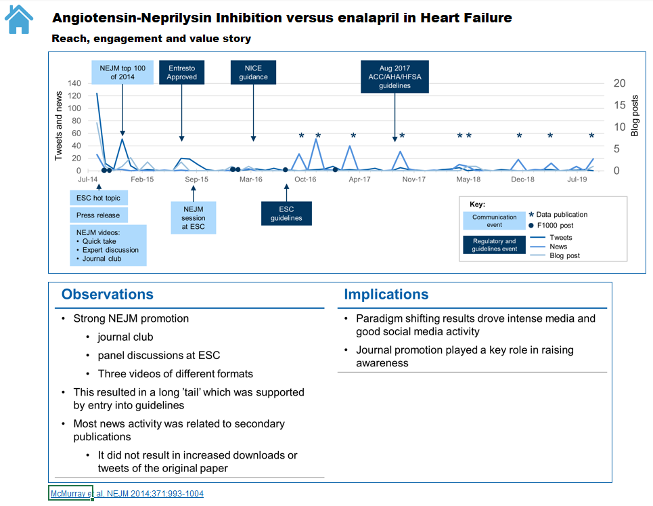
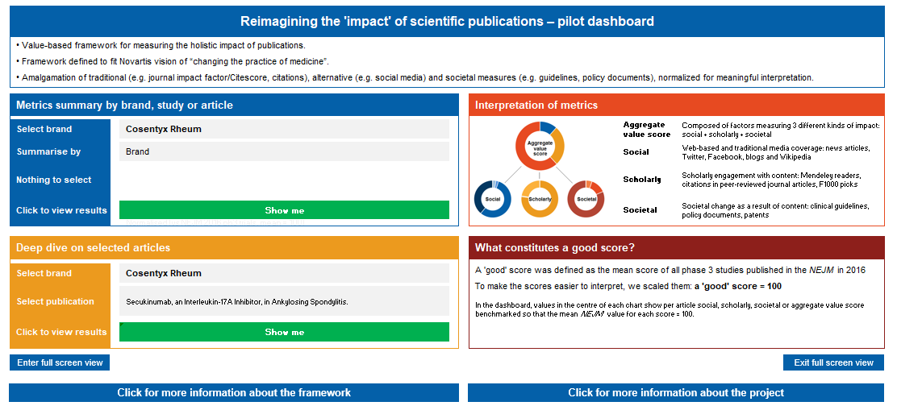
Dashboard and deep-dive

Slide 10
Conclusions
This multi-component framework:
  Provides a richer assessment of publication value versus standalone traditional and alternative metrics
  Provides an early assessment of likely future impact
  Enables publication planners to easily assess the nature of their publications’ impact
Potential value of this approach:
  Understand the characteristics of stand-out publications
  Help assess the effectiveness of publication enhancement solutions

Slide 11
Acknowledgements
We would like to acknowledge the invaluable support provided by:
  Simon Thibault (Novartis Pharma AG) for project management
  Rohitbhai Kachhadiya (Novartis Healthcare Pvt. Ltd.) for expert programming support
  Josh Gredell (Altmetric) and Patty Smith (Altmetric) for data extraction.
Funded by Novartis Pharma AG.

