Slide 1
LIQUID MICROBIAL FUEL CELLS (L-MFC)

Slide 2
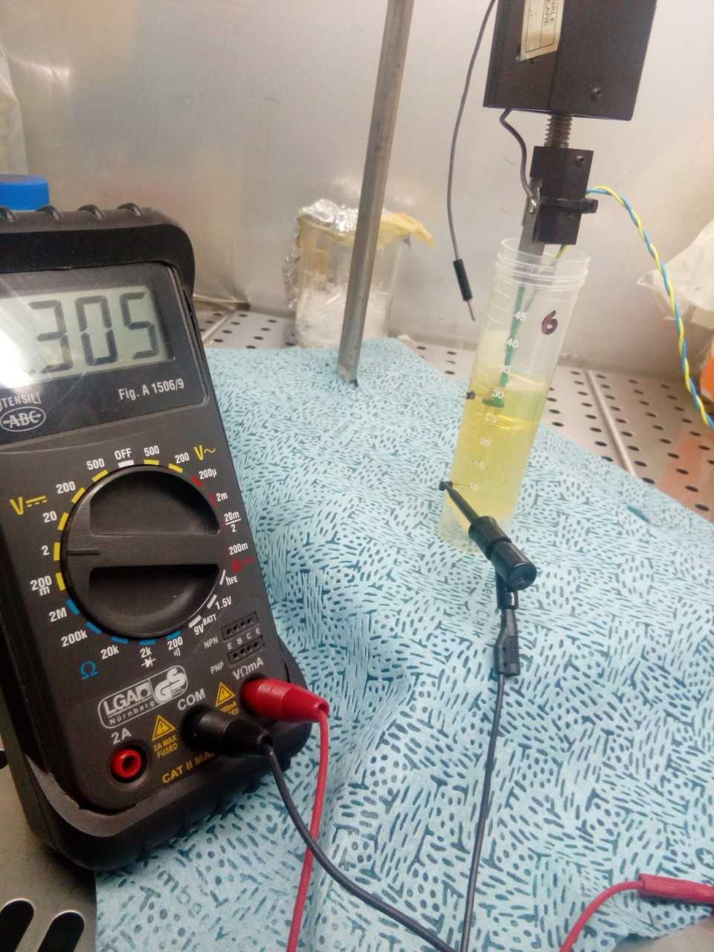
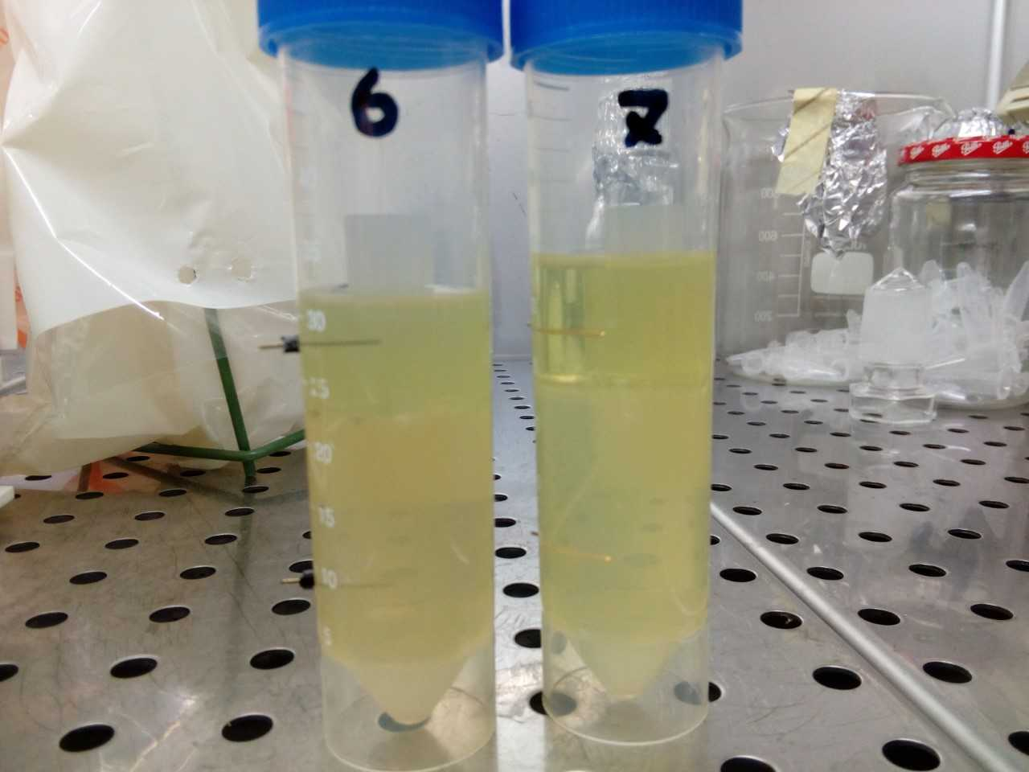
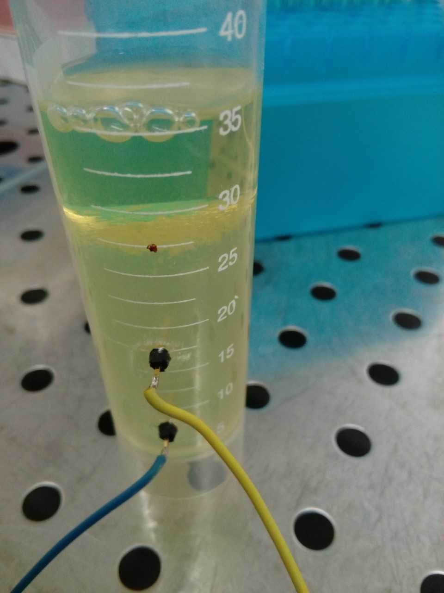

Slide 3
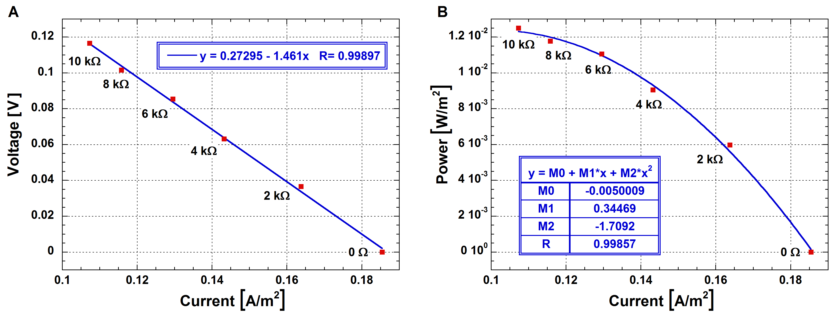
ELECTRICAL CHARACTERIZATION OF L-MFC
In order to obtain a complete electrical characterization of the L-MFC, a custom electronic analyzer dedicated to microbial fuel cells was used. This measuring instrument allows to set up a complete electrical characterization of the cell, performing and analyzing complete charge and discharge phases of L-MFCs, with accurate determination of the values of voltage, current and loads. The instrument allows to perform the cell characterizations using resistive loads in the range between 0 Ω (short circuit measurement) and 10 kΩ.
Polarization (A) and power (B) curves of the liquid microbial fuel cell (L-MFC). The red symbols refer to the experimental data, while the blue equations and lines represent the fitting curves of the results. The area of the anode electrode is 1.1 cm². These graphs are obtained performing a real-time measurement constituted by charge and discharge phases, alternatively. In particular, a set of 6 resistive loads have been used, including 10 kΩ, 8 kΩ, 6 kΩ, 4 kΩ, 2 kΩ and 0 Ω. The duration of each charge phase is 2 minutes, which is sufficient to reach again the pseudo-steady-state of the cell after the discharge phase, while the duration of each discharge is 0.5 seconds.

Slide 4
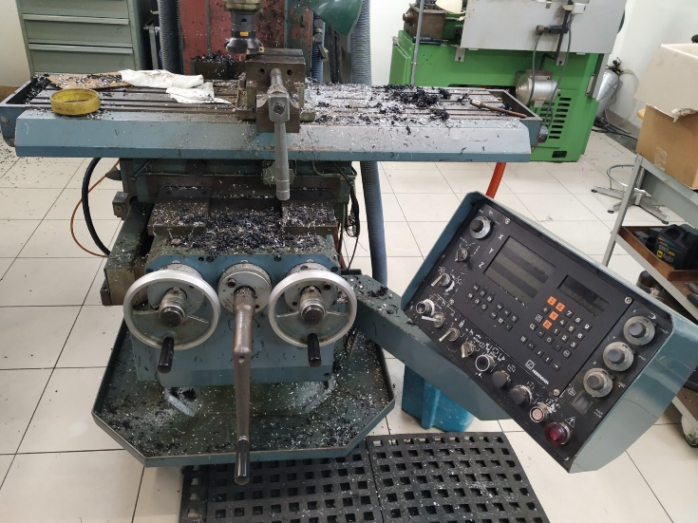
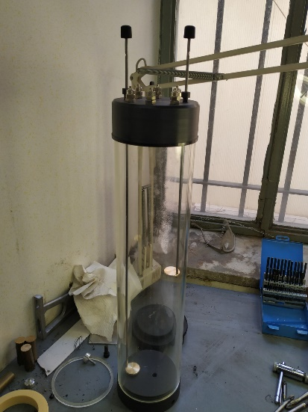
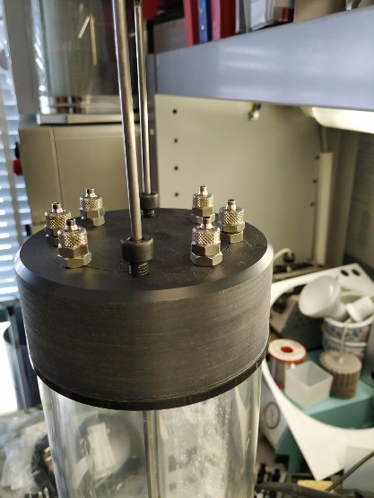
L-MFC PROTOTYPE
A prototype of L-MFC that simulated the passage of current in the water column was built inside the mechanical workshops of the laboratories of the Istituto Superiore di Sanità in Rome.

Slide 5
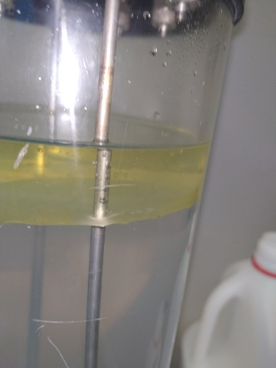
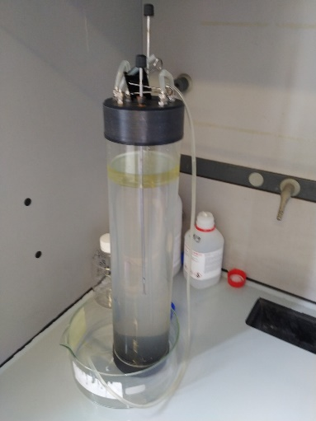
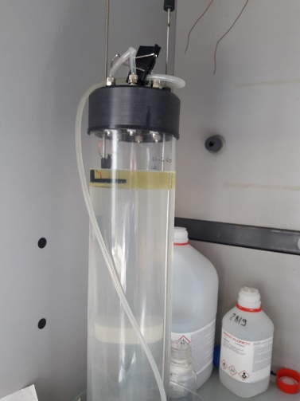
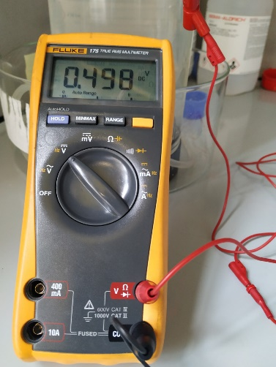
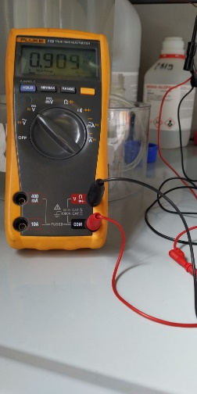
To have easy access to the water column of microcosm during RP, O2 and pH measurements a L-MFC prototype of 3 liters was built for this study. The PMMA (polymethylmethacrylate) tube was equipped with two caps of PVC (Polyvinylchloride). The top cap was equipped with six brass nozzles to allow the entry of liquids and the insertion of 0.5 cm diameter pipes to regulate the gas exchanges in the tank. Two holes with adjustable ring nut allowed the sliding and fixing of two hollow steel rods. The bottom cap hole was connected to a brass nozzle for draining the tank. The hollow steel rods at one end were connected to two annular ABS (Acrylonitrile butadiene styrene) supports of where the electrodes were housed. Each electrode was soldered to the end of a copper wire which was closed and insulated with plastic, inside the hollow steel rods. The copper wires in the upper end were connected to the equipment used for RP measurements. The vertical movement of the hollow steel rods made it possible to move the electrodes in the L-MFC water column to the height desired by the operator. RP readings were obtained by placing one electrode on the biofilm (anode) and the other in the solution containing the bacteria (cathode). For this study two carbon or gold plates of about 5 cm₂ were used as electrodes for redox measurement.

