Slide 1
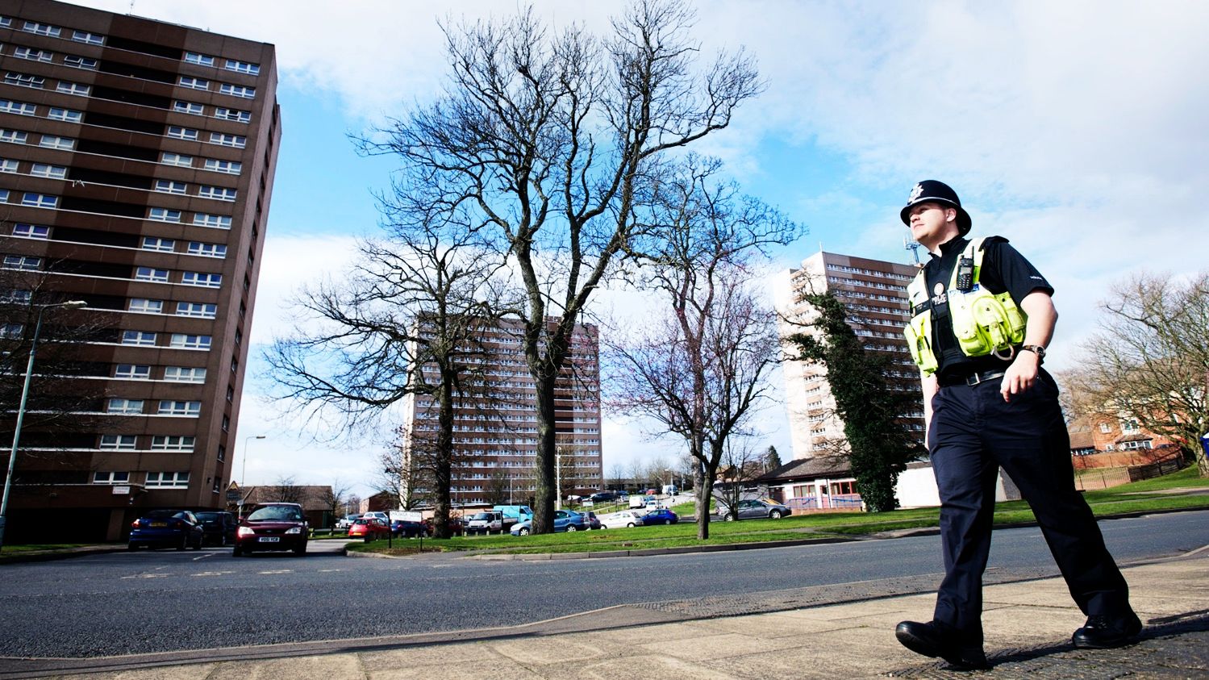
Hot spots how they form and ways to analyse them Dr Matt Ashby
JILL DANDO INSTITUTE OF SECURITY & CRIME SCIENCE
Image: West Midlands Police

Slide 2
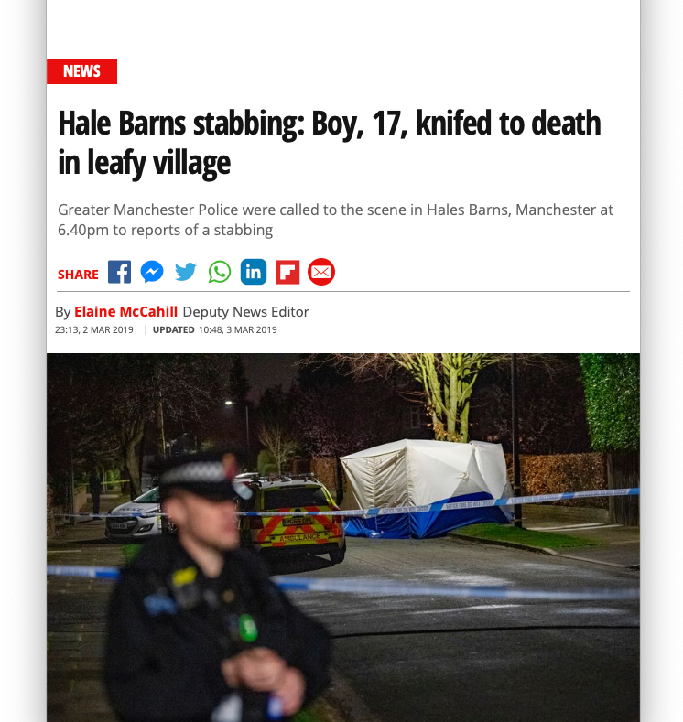
Crimes can happen anywhere …
2

Slide 3
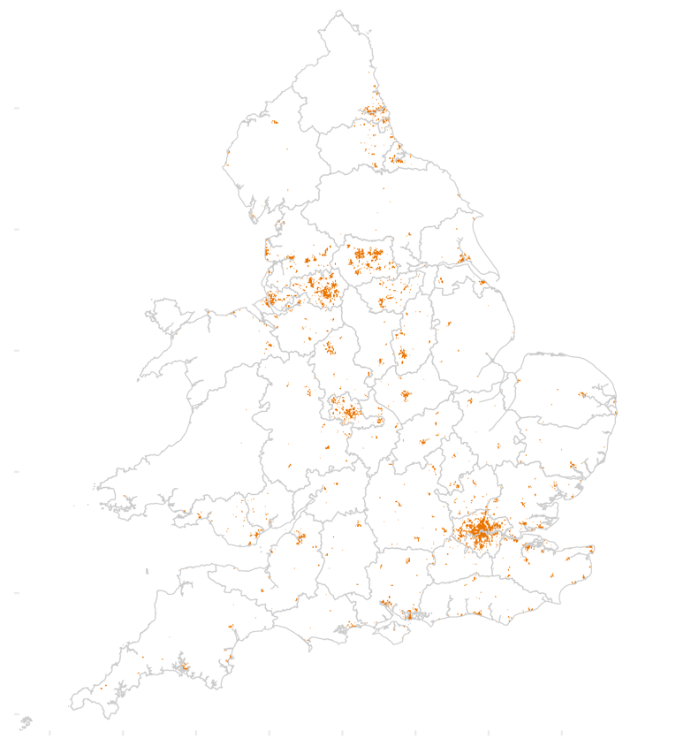
… but they usually happen in the same few places

Slide 4
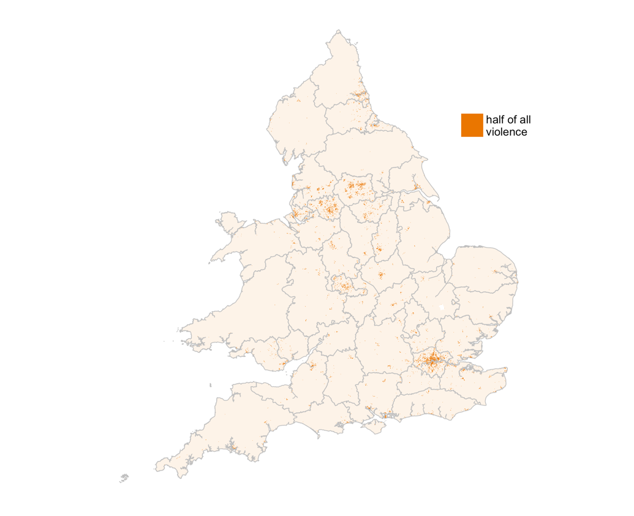
England & Wales
Half of violent and sexual crime recorded by police happens in 1% of areas
Data: www.police.uk, 2018

Slide 5
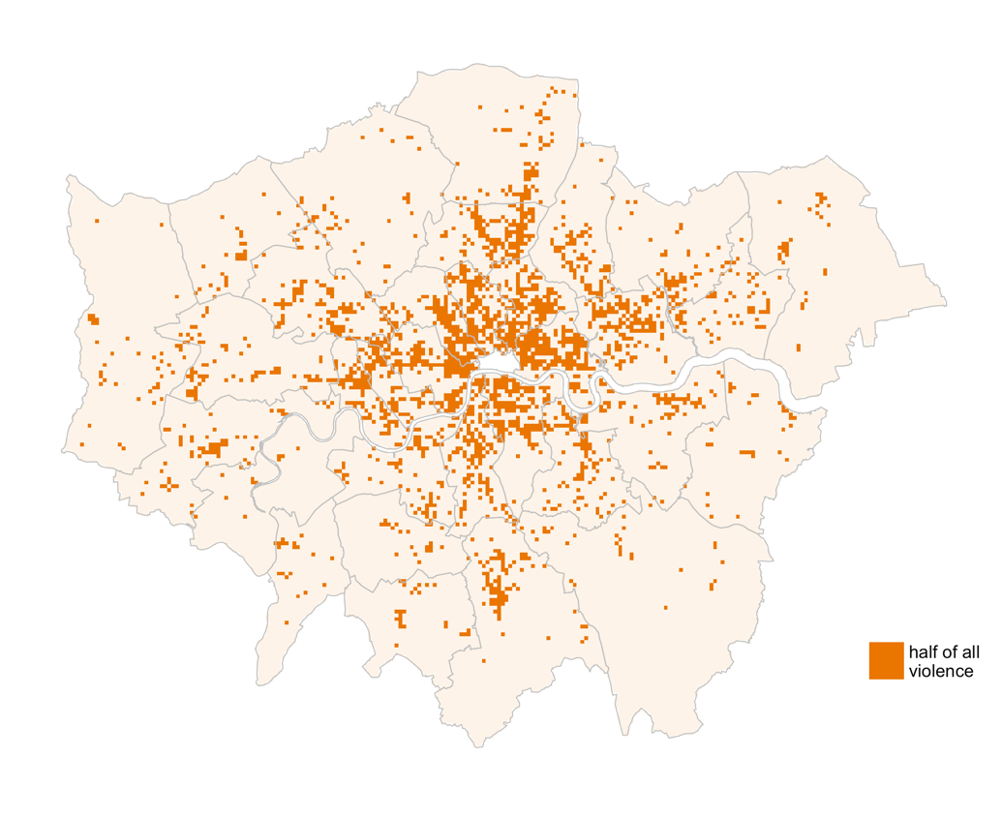
London
Half of violent and sexual crime recorded by police happens in 10% of areas
Data: www.police.uk, 2018

Slide 6
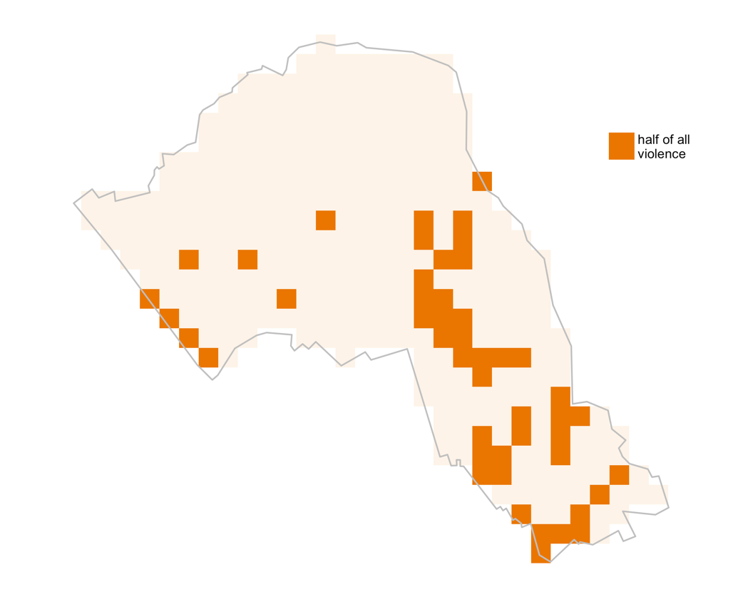
Camden
Half of violent and sexual crime recorded by police happens in 13% of areas
Data: www.police.uk, 2018

Slide 7
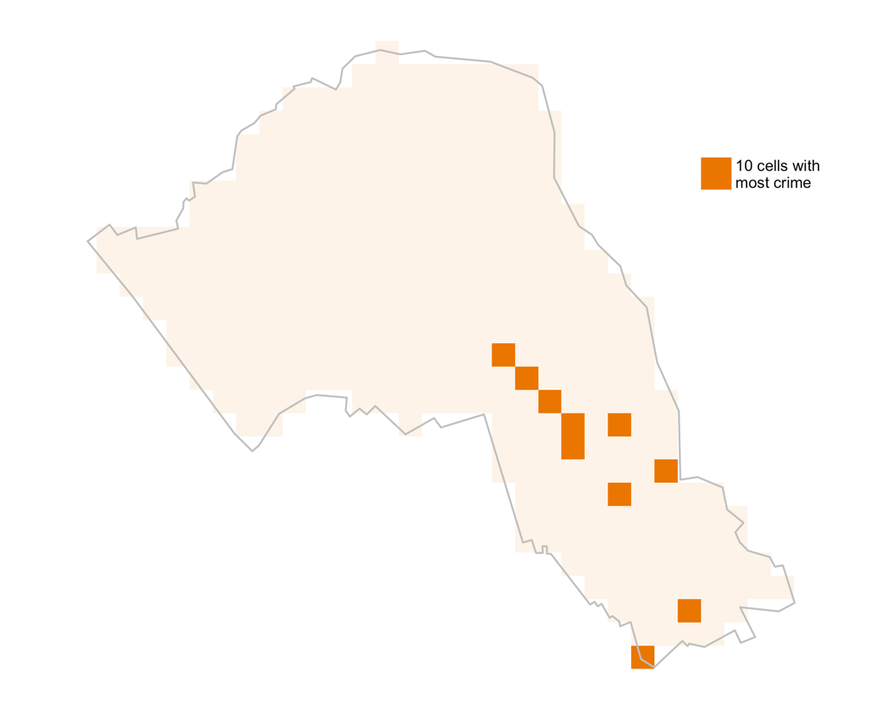
Camden
The top 10 grid cells contain 23% of all violent and sexual crime recorded by police
Data: www.police.uk, 2018

Slide 8
Half of incidents occur in ~5% of street segments
Study | Area | Half of incidents in …
Andresen & Linning (2012) | Ottawa, Canada | 1.7%
Weisburd et al. (2012) | Seattle, USA | 4.7–6.1%
Weisburd & Amran (2014) | Tel Aviv, Israel | 4.5%
Weisburd et al. (2014) | New York, USA | 5%
de Melo et al. (2015) | Campinas, Brazil | 3.7%
Steenbeek & Weisburd (2016) | The Hague, Netherlands | 6.3–7.3%
Gill et al. (2017) | Brooklyn Park, USA | 2%
Source: C W Telep & D Weisburd. 2018. Crime concentrations at places. In: Oxford Handbook of Environmental Criminology.

Slide 9
How do hotspots form?

Slide 10
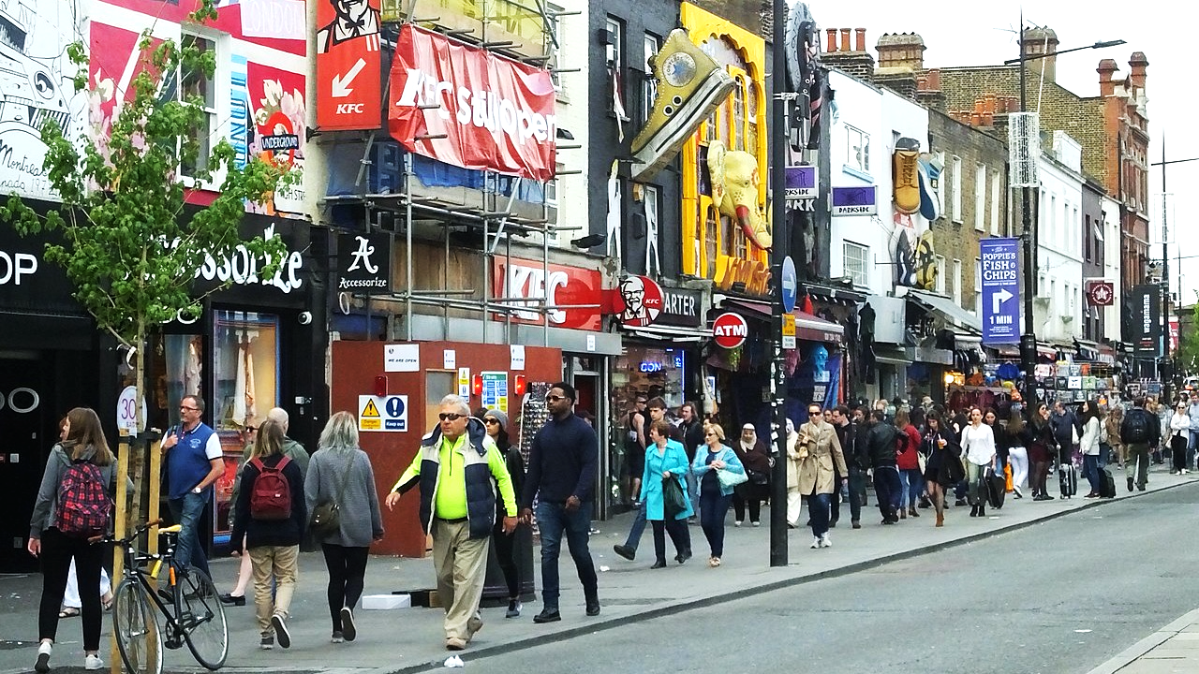
Places shape activities …
Image: Clem Rutter

Slide 11
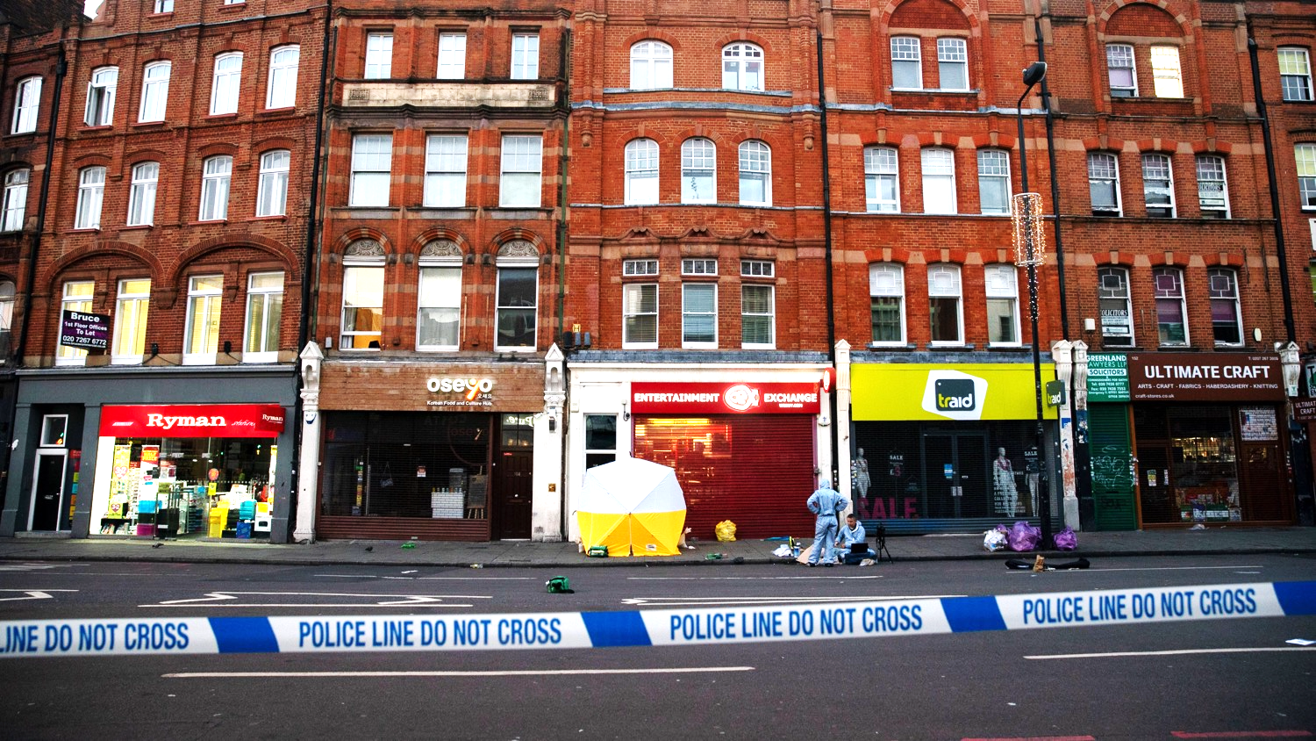
… and activities shape opportunities for crime
Image: Metro.co.uk

Slide 12
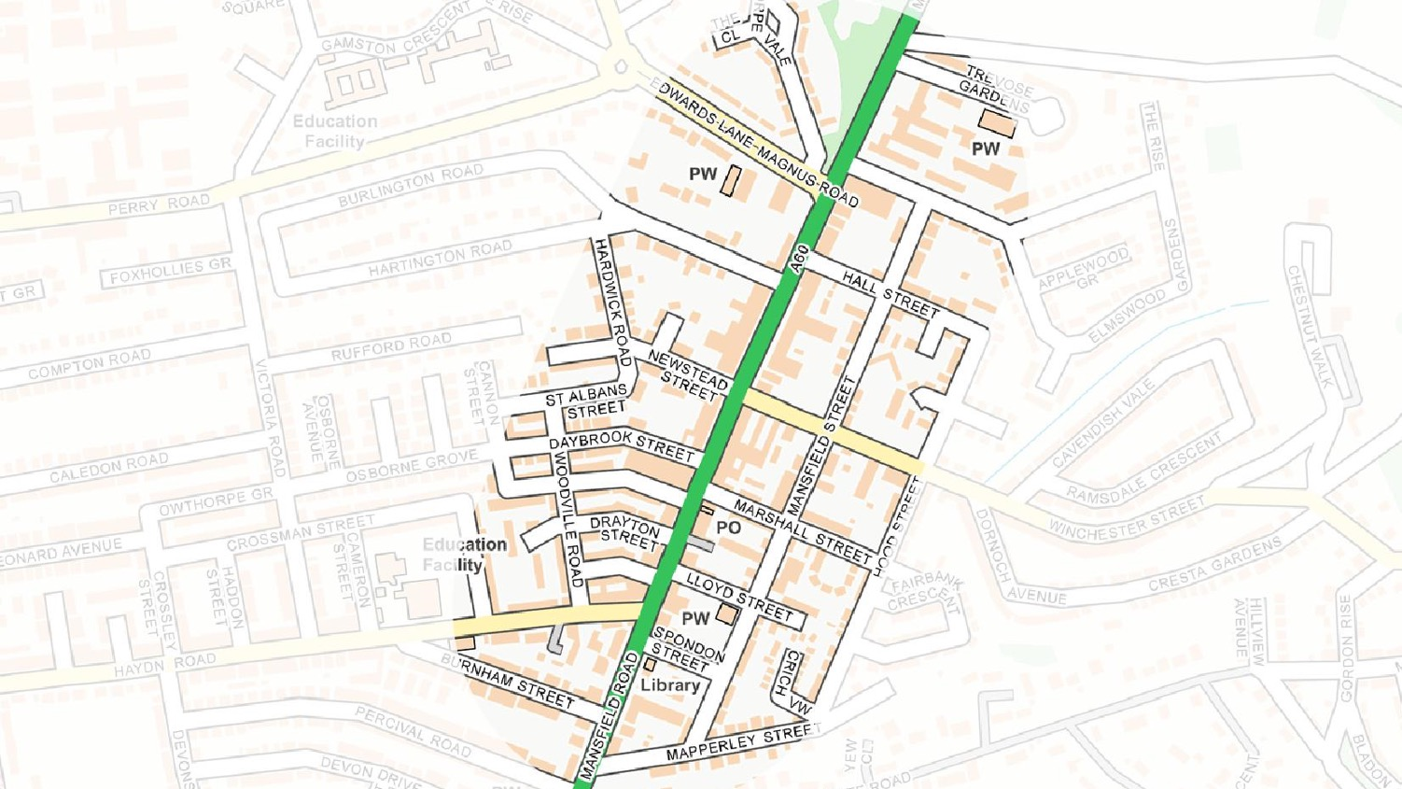
Where is the best place to deal drugs in this area?
A
B
C
Source: Tarkhanyan, L. 2015. Urban Design and Drug Crime. London: UCL.
Data: Map data Crown Copyright © used under the Open Government Licence

Slide 13
offender
offender
oxygen
target
place
heat
CRIME
CRIME
FIRE
target
place
fuel

Slide 14
Awareness space
Nodes where people do everyday things
Paths between nodes
Awareness space where people can be involved in crime
Source: W Bernasco. 2018. Mobility and Location Choice of Offenders. In G Bruinsma & S Johnson: The Oxford Handbook of Environmental Criminology. OUP.

Slide 15
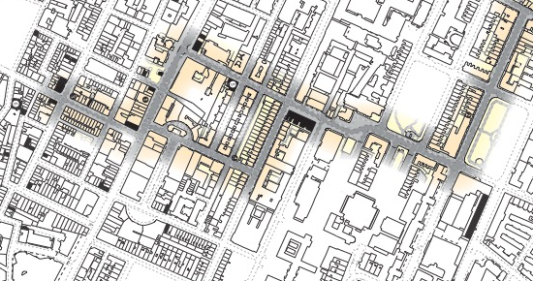
I can offend here because I know and spend time here
I’d be unlikely to offend here because I’m not aware of opportunities here

Slide 16
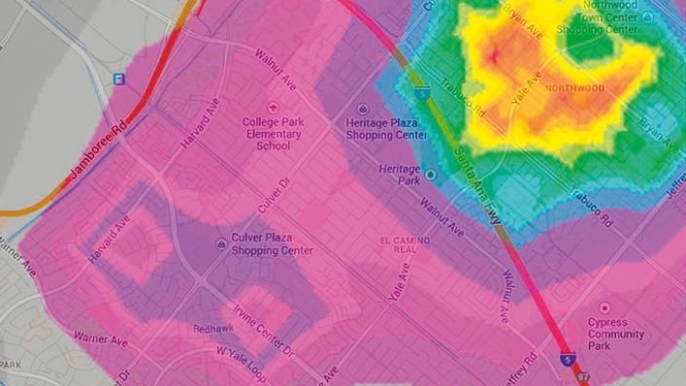
Geographic profiling
Image: J Medeiros. 2014. How geographic profiling helps find serial criminals. Wired.

Slide 17
offender
offender
oxygen
target
place
heat
CRIME
CRIME
FIRE
target
place
fuel

Slide 18
Risky facilities
“a small proportion of any specific type of facility will account for the majority of crime and disorder problems”
Source: R V Clarke & J Eck. 2007. Understanding Risky Facilities. POP Center.

Slide 19
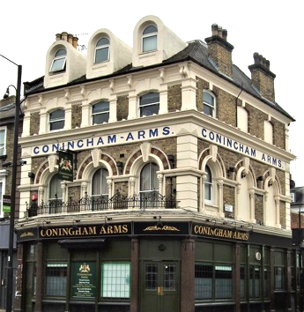
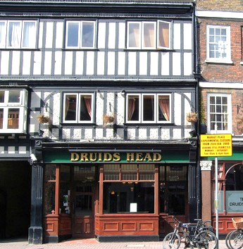
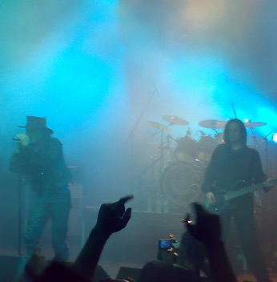
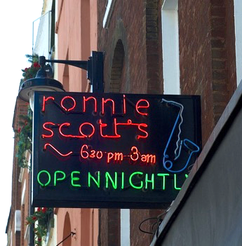
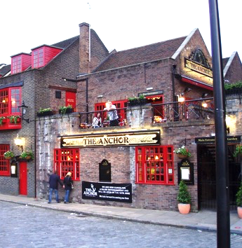
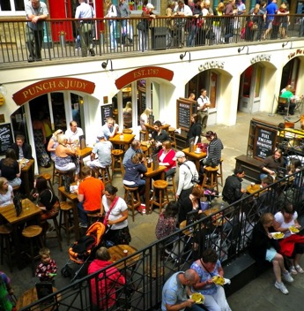
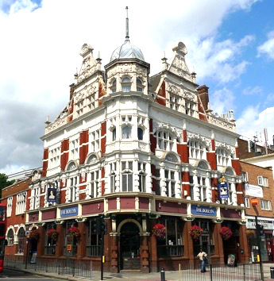
Images: Jason DaPonte, Jim Linwood, Jim Linwood, Ministry of Sound, Tom Morris, Ewan Munro, Ewan Munro

Slide 20
offender
offender
oxygen
target
place
heat
CRIME
CRIME
FIRE
target
place
place design
fuel
place management

Slide 21
Design of places influences criminal opportunities
Crime in a place
Territoriality
Access control
Surveillance
Target hardening
Image
Activity support
Source: P Cozens & T Love. 2015. A Review and Current Status of Crime Prevention through Environmental Design (CPTED). Journal of Planning Literature 30(4):393–412.

Slide 22
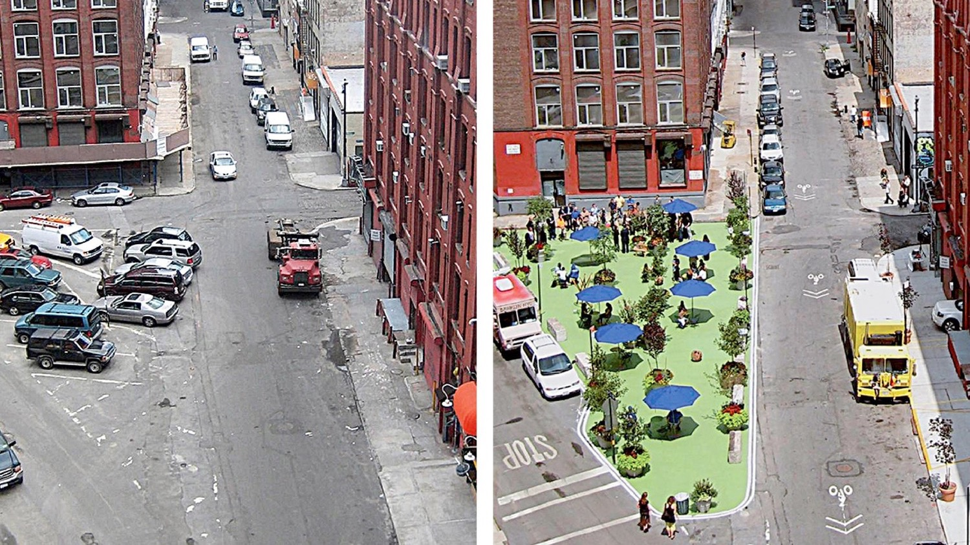
Place management invites or prevents hotspot crime
Image: New York Times

Slide 23
Some tips for analysing hotspots

Slide 24
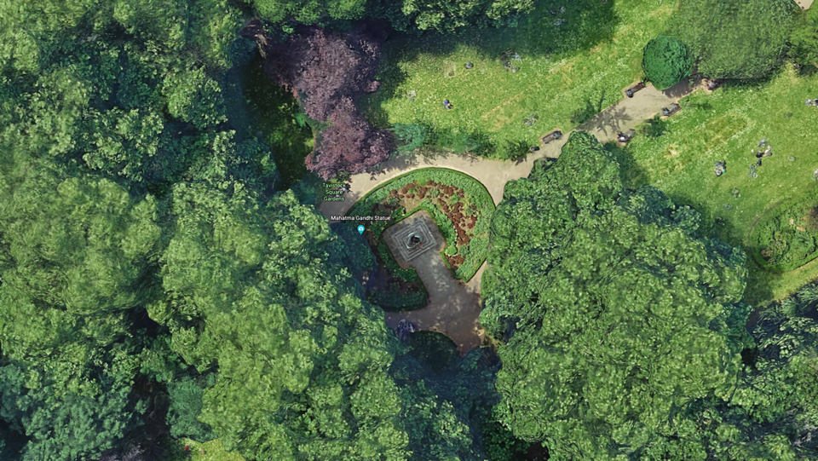
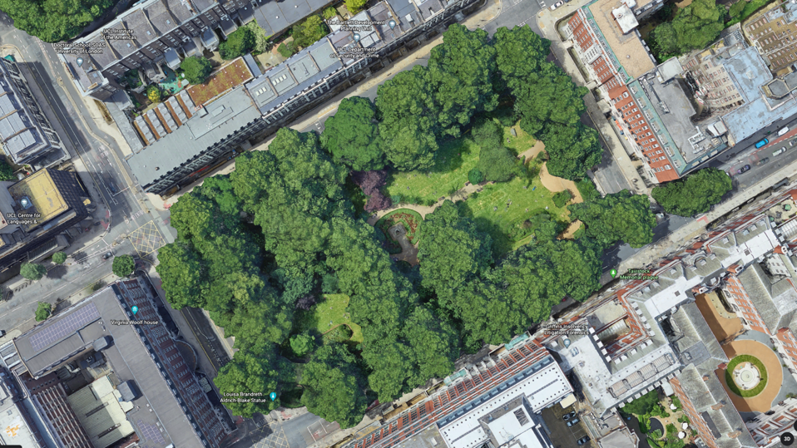
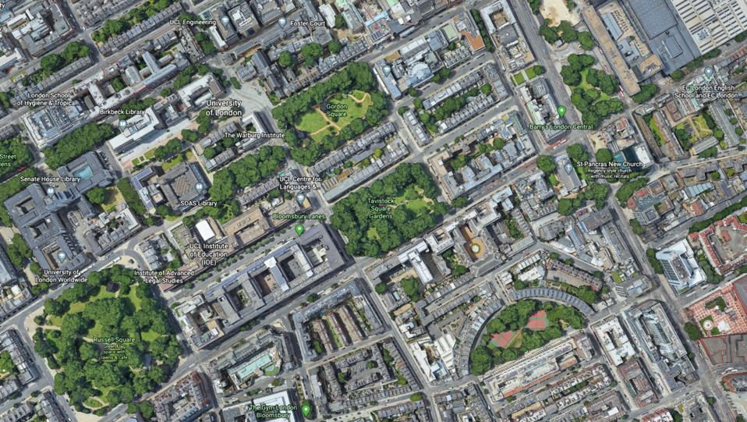
Keep hotspots small
Map data: Google

Slide 25
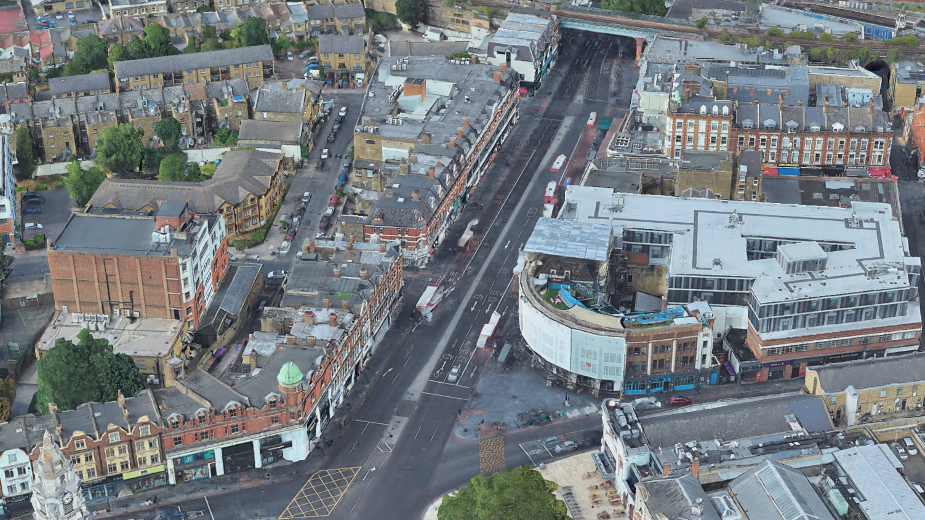
Analyse different problems separately

Slide 26
Generate and test hypotheses
Summarise the problem
Choose 3–5 hypotheses to test
Analyse those hypotheses
Draw conclusions
Source: Chainey, S. 2012. Improving the explanatory content of analysis products using hypothesis testing. Policing 6(2):108–121.

Slide 27
What is a hypothesis?
“If [cause] were causing [crime problem], we’d expect data to show [effect]”

Slide 28
Go out and walk around the hotspot!

Slide 29
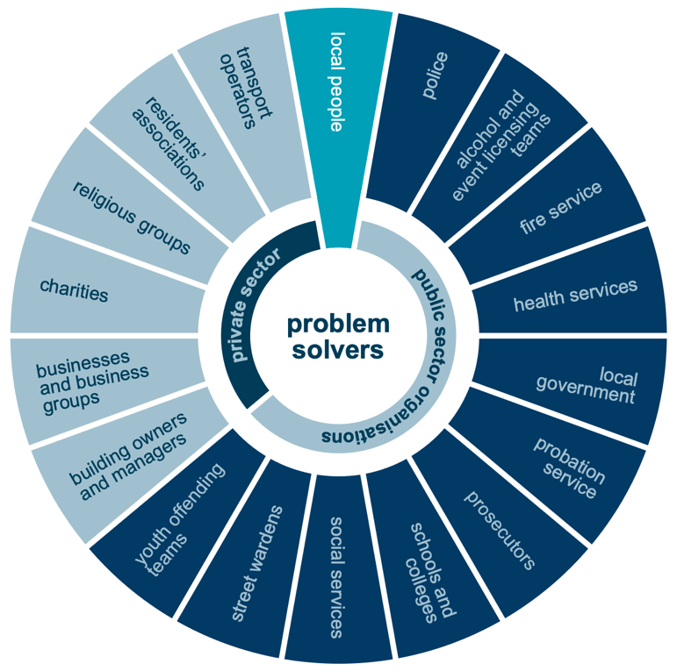
Speak to people who know the hotspot
Source: M Ashby & S Chainey. Problem Solving for Neighbourhood Policing. London: UCL.

Slide 30
Slides: lesscrime.info/talk/npcc-hotspots Contact: matthew.ashby@ucl.ac.uk or @lesscrime
JILL DANDO INSTITUTE OF SECURITY & CRIME SCIENCE
Image: West Midlands Police

