Slide 1
Shapes applications and tools ISWC 2020 Tutorial
Jose Emilio Labra Gayo
WESO Research group
University of Oviedo, Spain

Slide 2
Contents
Shapes applications and use cases
Data portals
Wikidata and wikibase
Other use cases
Tools: challenges and perspectives
Validating with shapes
Validation usability
Continuous integration
Other applications of shapes
UIs
Generating code
Inference and rules
Transforming data
Obtaining shapes
Shapes ecosystems

Slide 3
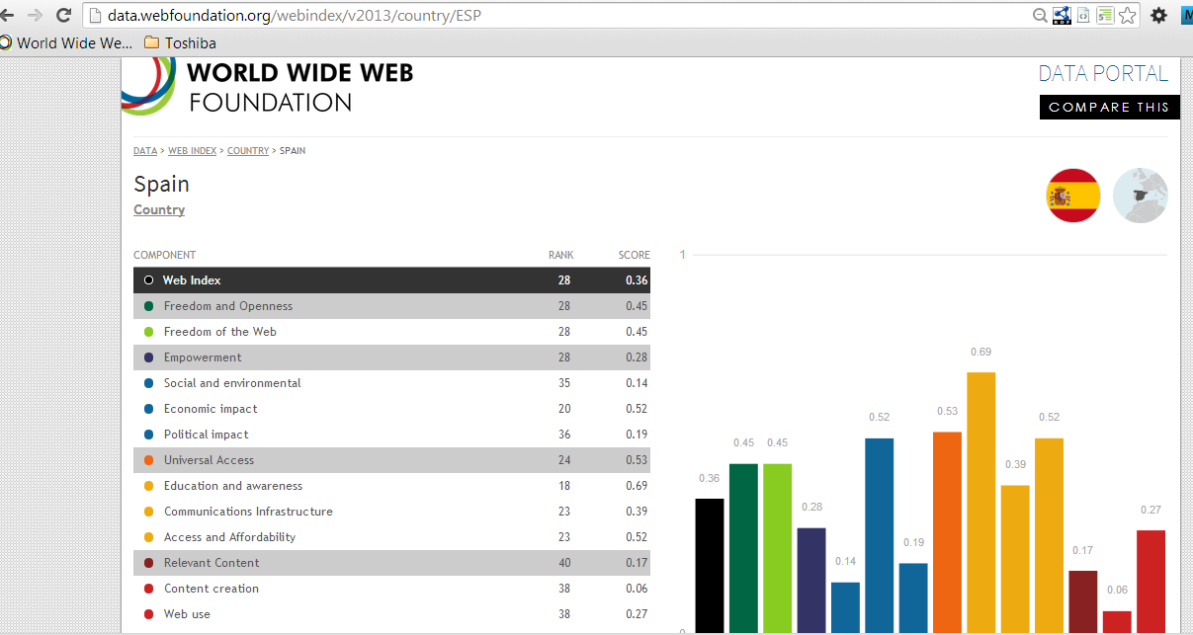
Data portals
In 2013, at WESO, we were hired to develop some data portals
Examples: WebIndex (Web Foundation)
One of the first applications of ShEx
Measure WWW's contribution to development and human rights by country
Developed by the Web Foundation
Content of data portal = statistical observations
We employed RDF Data Cube vocabulary (qb:Observation)

Slide 4
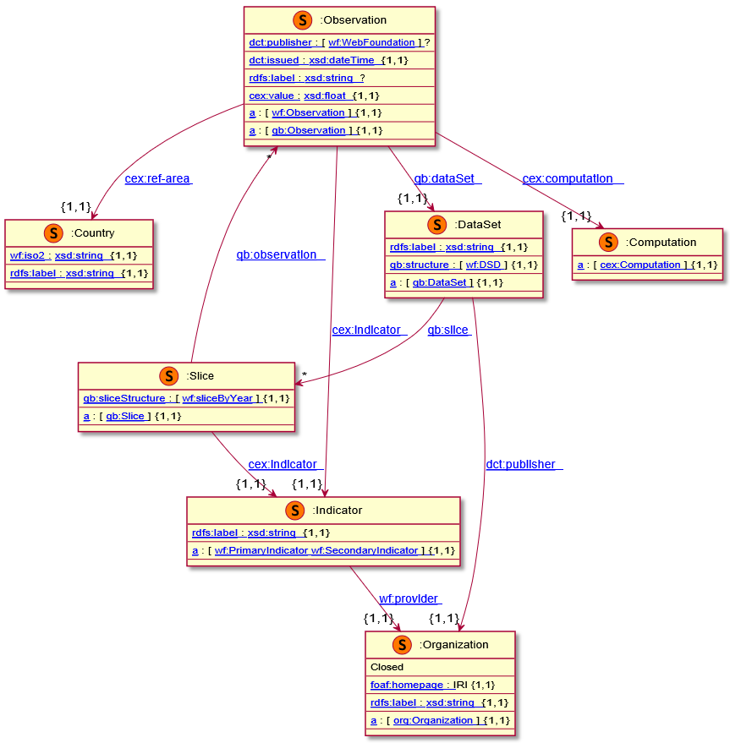
Simplified WebIndex data model

Slide 5
Lessons learnt from ShEx usage at WebIndex
Documentation of linked data portal
Human-readable, machine processable
Team communication
Communicate the developers which shapes they had to generate
Validation
For example: check if a value of type qb:Observation had shape <Observation>
Reuse
Another data portal was later developed for http://landportal.org base on observations
Easy to reuse and adapt the data model
Same types (qb:Observation) but different structure
http://weso.github.io/wiDoc
http://weso.github.io/landportalDoc/data/

Slide 6
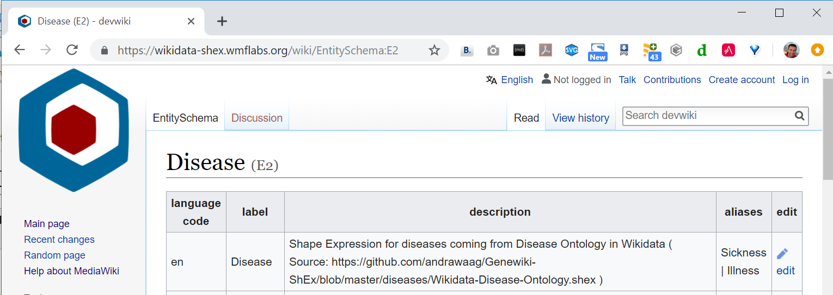
Wikidata and wikibase
In May, 2019, Wikidata announced ShEx adoption
New namespace for schemas
Example:
https://www.wikidata.org/wiki/EntitySchema:E2
Wikibase also contains entity schemas
Online demo: wikishape

Slide 7
Solid project
SOLID (SOcial Linked Data): Promoted by Tim Berners-Lee
Goal: Re-decentralize the Web
Separate data from apps
Give users more control about their data
Internally using linked data & RDF
Shapes needed for interoperability
Shape
A
App
1
Data
pod
Shape
B
App
2
Shape
C
App
3
"...I just can’t stop thinking about shapes.", Ruben Verborgh
https://ruben.verborgh.org/blog/2019/06/17/shaping-linked-data-apps/

Slide 8
Other use cases
HL7 FHIR.
Example: https://www.hl7.org/fhir/observation.html
ELI validator
SHACL shapes obtained from Excel sheets: https://webgate.ec.europa.eu/eli-validator/home
SHACL adoption supported by Top Quadrant
See: https://www.topquadrant.com/technology/shacl/
More info:
Chapter 6 of Validating RDF data: http://book.validatingrdf.com/bookHtml012.html

Slide 9
Tools: challenges and perspectives
Validating with shapes
Obtaining shapes
Other applications of shapes
Shapes ecosystems

Slide 10
Validating with shapes
Libraries and command line validators
Online demos
Integrated in ontology editors
Continuous integration with Shapes

Slide 11
Libraries and command line validators
Examples at WESO
SHaclEx
RDF validation
Generic schemas: ShEx/SHACL
Converter ShEx ↔ SHACL
ShEx-s
Scala implementation of ShEx
Supports ShEx 2.1 (testsuite)
SHACL-s
Scala implementation of SHACL
Supports SHACL core (testsuite)
SRDF
Simple RDF - Generic RDF interface
Implementation for RDF4j and Apache Jena
All libraries are available at: https://github.com/weso/

Slide 12
Online demos
Web Demos and playgrounds
Client
Server
RDFShape-Client
http://rdfshape.weso.es
React app (Javascript)
RDFShape
Validation server
http4s library (Scala)
API Rest
SHaclEX
WikiShape
http://wikishape.weso.es
React app (Javascript)
ShEX-s
SHACL-s
SRDF
Example RDFShape: https://tinyurl.com/shqrban

Slide 13
Integrating shapes with other tools
TopBraid Composer
https://www.topquadrant.com/technology/shacl/
Ontology editors
SHACL plugin for protégé: https://github.com/fekaputra/shacl-plugin
ShEx plugin for protégé: https://github.com/weso/protegeShEx

Slide 14
Continuous integration with Shapes
Coexistence between ontologies/shapes
Shapes can validate the behaviour of inference systems
Shapes pre- and post- inference
TDD and continuous integration based on shapes
Gene Ontology Shapes:
https://github.com/geneontology/go-shapes
Continuous
Integration
server
Ontology
engineer
Ontological infrastructure
Control version system (git)
Endpoint
SPARQL
Ontologies
Triple
Store
Ontology publication
system
Shapes library
Test data

Slide 15
Continuous integration with Shapes
Ontolo-ci: https://github.com/weso/ontolo-ci
Developed as part of HERCULES-Ontology
Test-Driven-Development applied to Ontologies
Input:
- Ontologies
- Shapes
- Test data
- Input shape map (SPARQL competency question)
- Expected result shape map

Slide 16
Text-based editors
YaSHE: Forked from YASGUI: http://www.weso.es/YASHE/
Syntax highlighting
Auto-completion

Slide 17
Creating shapes
Shapes editors
Text-based editors
Visual editors and visualizers
Obtaining shapes from...
Spreadsheets
RDF data
Ontologies
Other schemas (XML Schema)
?
Shapes

Slide 18
Shapes author tools
Top Braid Composer
UnSHACLed
ShEx-Author
Shapes

Slide 19
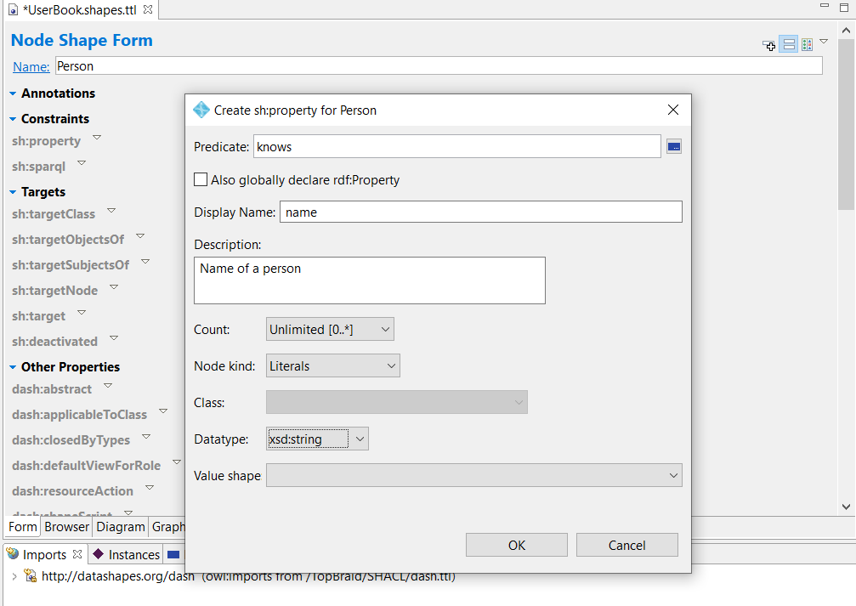
Shapes author tools: Top Braid Composer
Form based editor
Integrated with Top Braid product

Slide 20
Shapes author tools: UnSHACLed
Visual SHACL Editor in Javascript
B. De Meester, P. Heyvaert, A. Dimou, and R. Verborgh, “Towards a Uniform User Interface for Editing Data Shapes,” in Proceedings of the 4th International Workshop on Visualization and Interaction for Ontologies and Linked Data, 2018, vol. 2187.

Slide 21
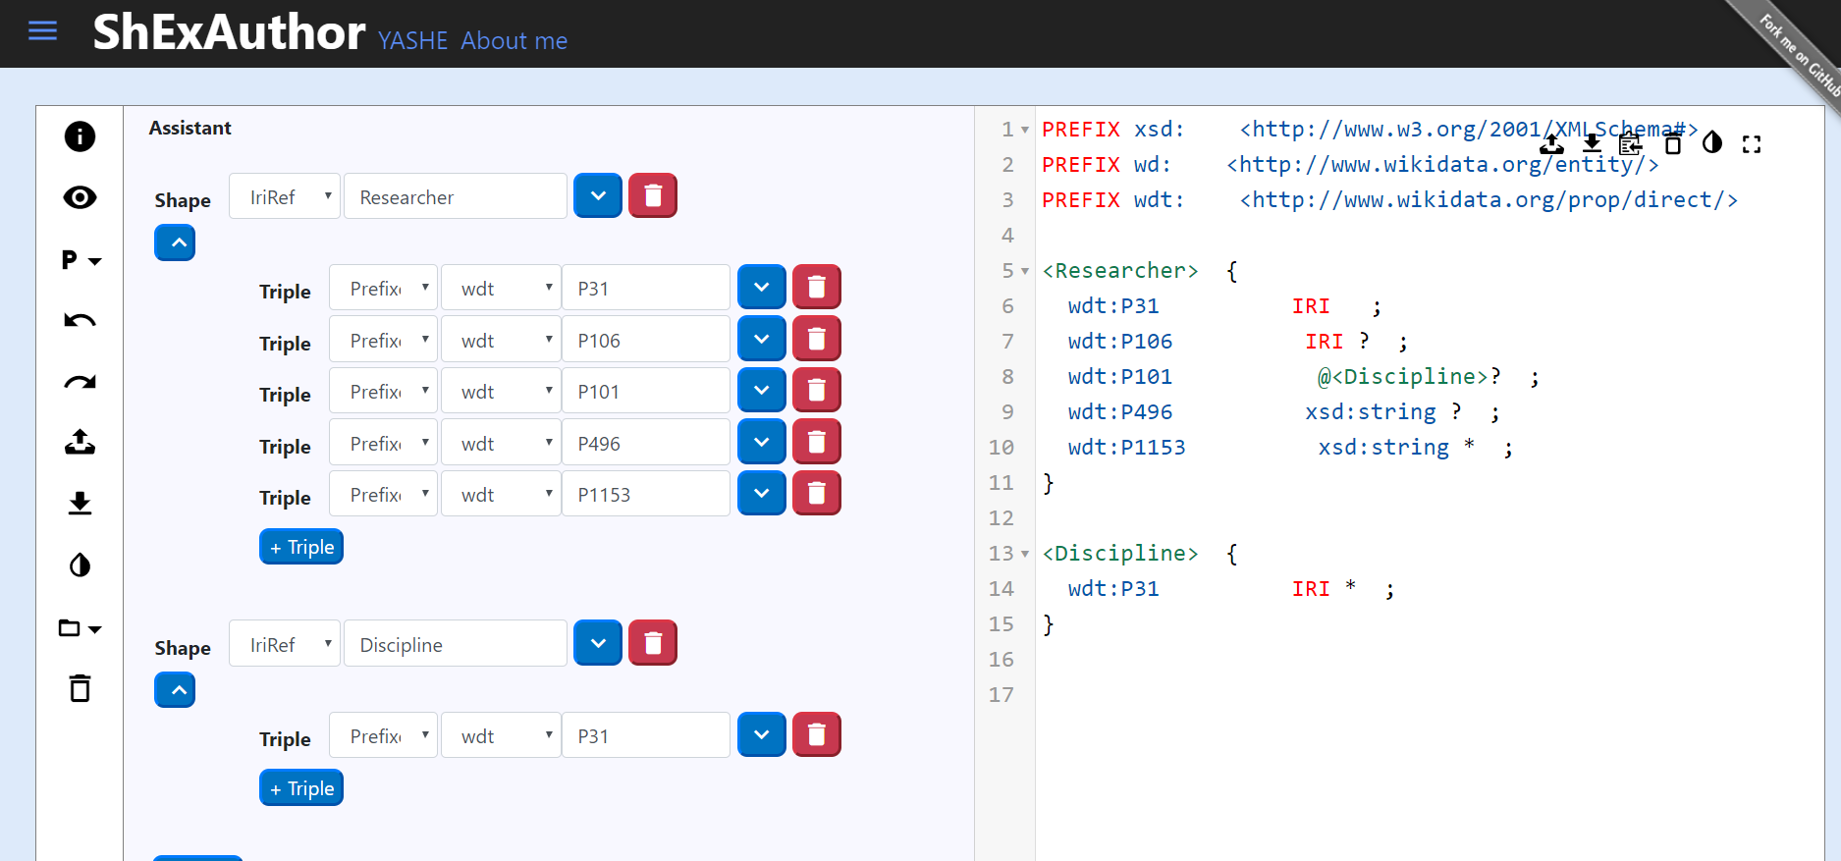
Shapes author tools: ShEx Author
ShEx-Author: Inspired by Wikidata Query Service
2 column: Visual one synchronized with text based

Slide 22
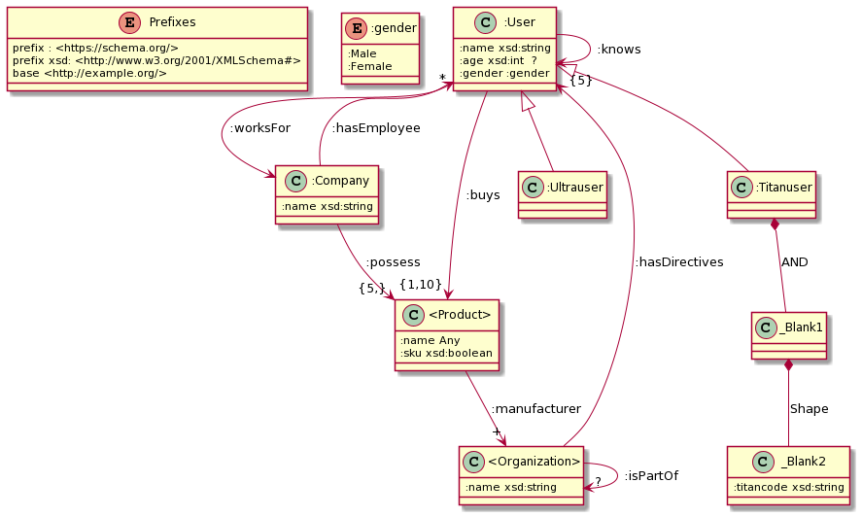
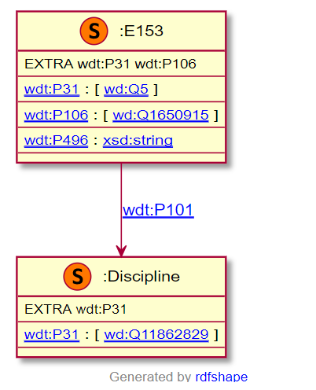
Shapes visualization
Integrated in RDFShape/Wikishape
UMLSHaclEX UML diagrams for ShEx
ShUMLex: Conversion to UML through XMI

Slide 23
Shapes from spreadsheets
SKOS-Play was used at ELI to generate SHACL shapes from Excel
ShExstatements: https://shexstatements.toolforge.org/
ShExCSV: CSV representation of Shapes
Hermes: ShExCSV processor, https://github.com/weso/hermes
Shapes

Slide 24
Generating Shapes from RDF data
Useful use case in practice
Some prototypes
sheXer: http://shexer.weso.es/
RDFShape: http://rdfshape.weso.es
ShapeDesigner: https://gitlab.inria.fr/jdusart/shexjapp
Shapes
Try it with RDFShape:
https://tinyurl.com/y8pjcbyf
infer
RDF data

Slide 25
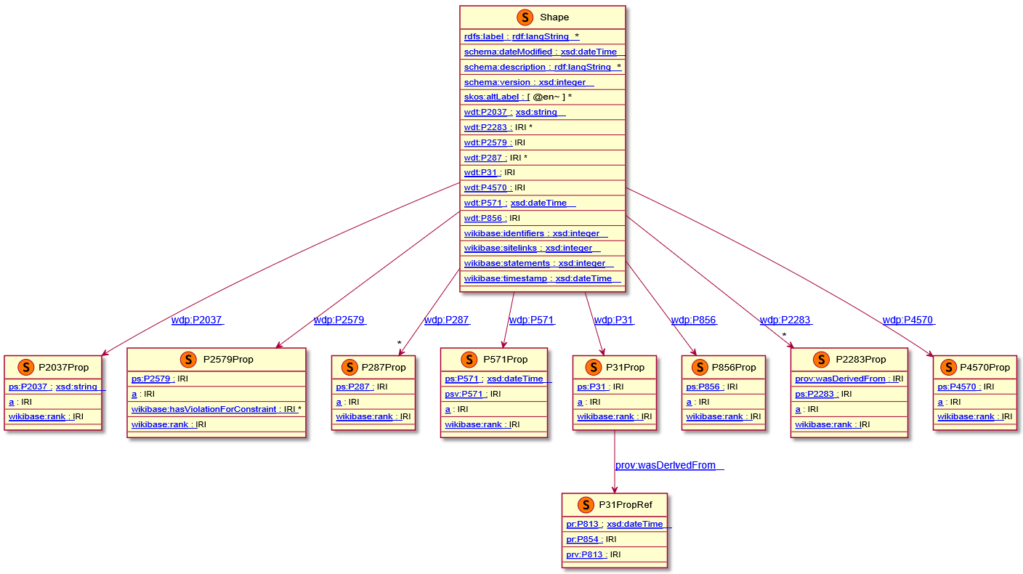
Shapes from data: RDFShape
RDFShape/Wikishape implement a basic prototype to derive Shapes from RDF data
Shape Expression
generated for
wd:Q51613194

Slide 26
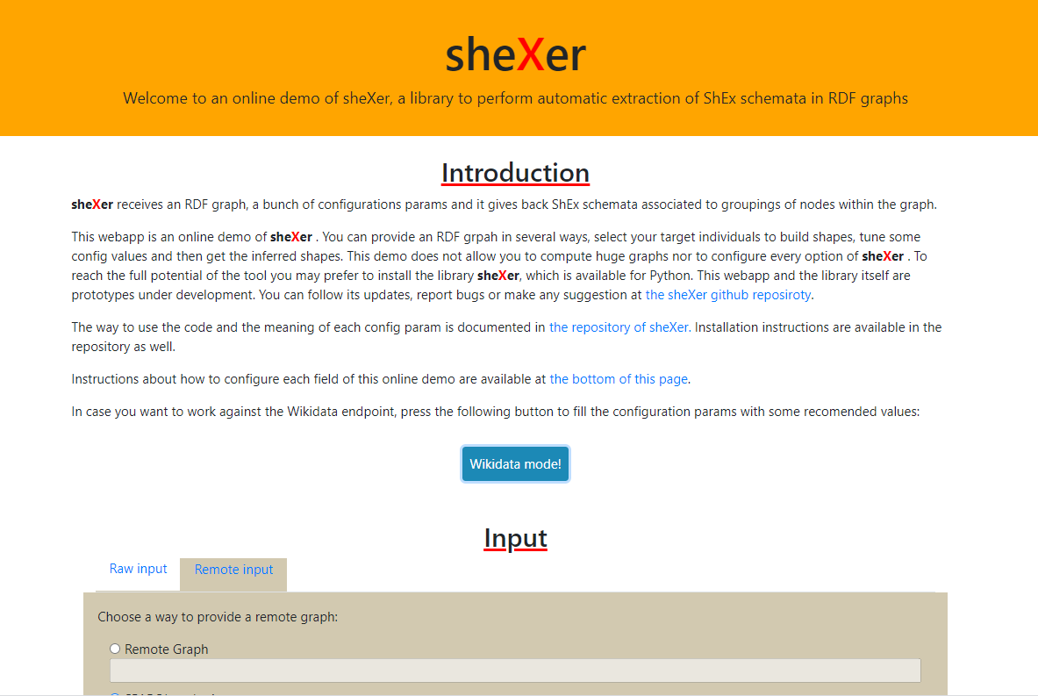
Shapes from data: sheXer
sheXer: http://shexer.weso.es/
Implemented in Python
Configuration options

Slide 27
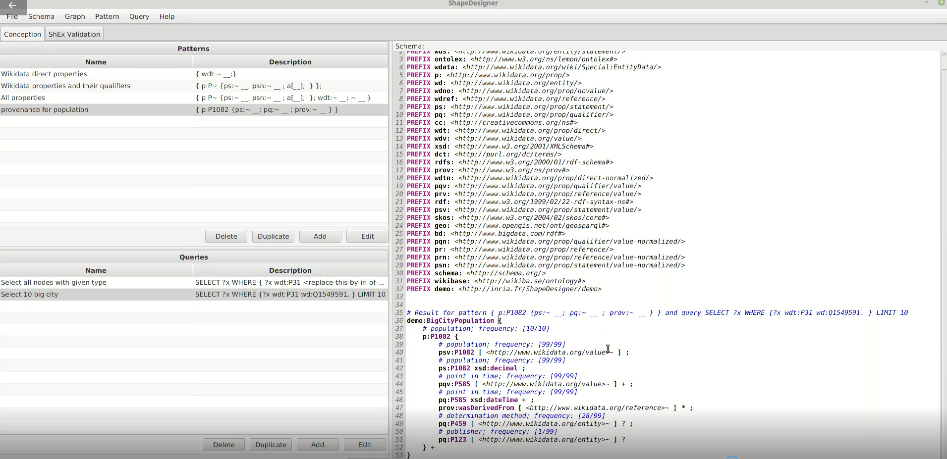
Shapes from data: ShapeDesigner
https://gitlab.inria.fr/jdusart/shexjapp

Slide 28
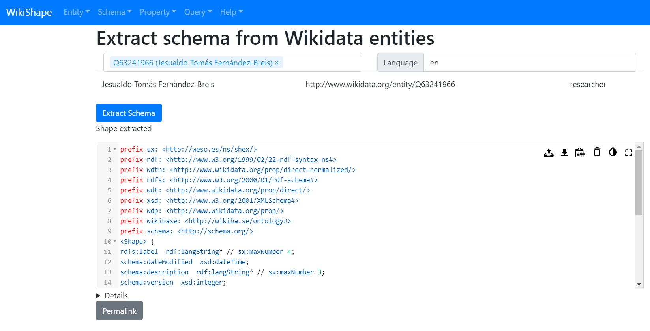
Shapes from RDF data
RDFShape allows to infer basic shapes automatically

Slide 29
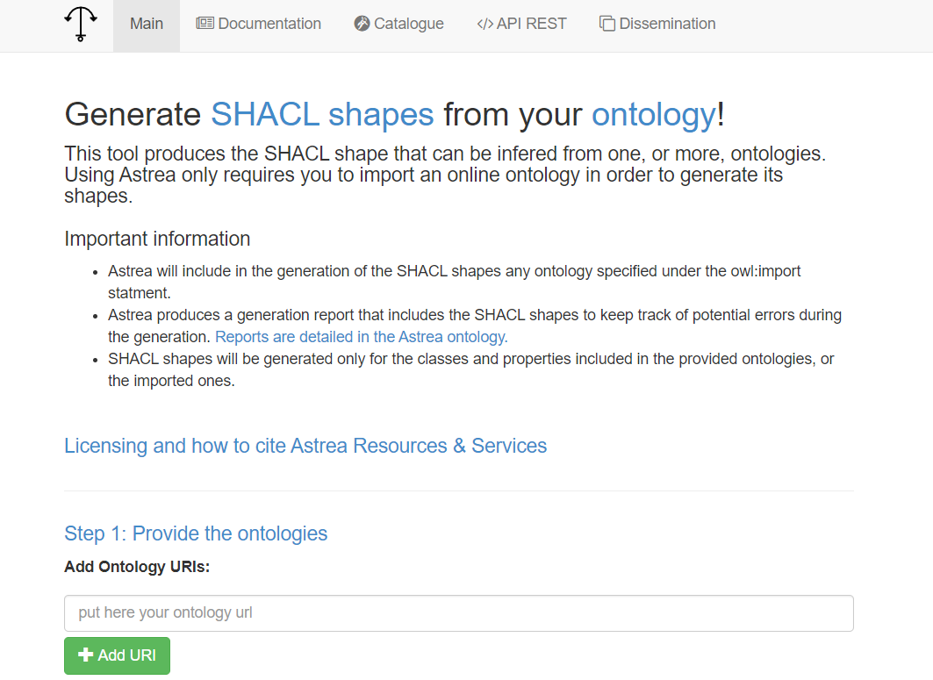
Shapes from ontologies
Astrea*: https://astrea.linkeddata.es/
Generates SHACL shapes from OWL ontologies
Mappings between ontology construct patterns to SHACL
*Cimmino, A., Fernández-Izquierdo, A., & García-Castro, R. (2020). Astrea: automatic generation of SHACL shapes from ontologies. In European Semantic Web Conference

Slide 30
Other uses of Shapes
UIs and shapes
Generating code from Shapes
Shapes and rules

Slide 31
UIs and shapes
Shapes can provide hints to generate user interfaces/forms
SHACL core defines a basic vocabulary: sh:group, sh:order, ...
ShEx annotations can also be used to define UI declarations

Slide 32
UIs and Shapes: ShExPath and ShEx-Forms
ShEx Path can be used to point to parts of a ShEx schema
https://shexspec.github.io/spec/ShExPath
ShEx generated forms demo:
https://ericprud.github.io/shex-form/?manifestURL=examples/manifest.json

Slide 33
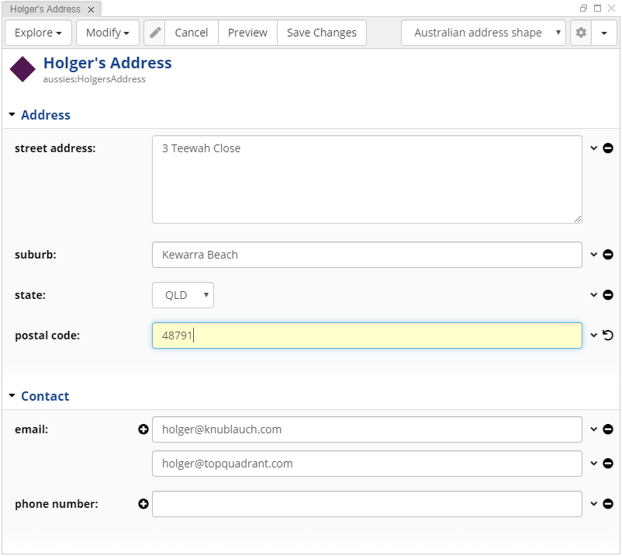
UIs and shapes: TopQuadrant
Form generation from SHACL
DASH vocabulary: http://datashapes.org/forms.html

Slide 34
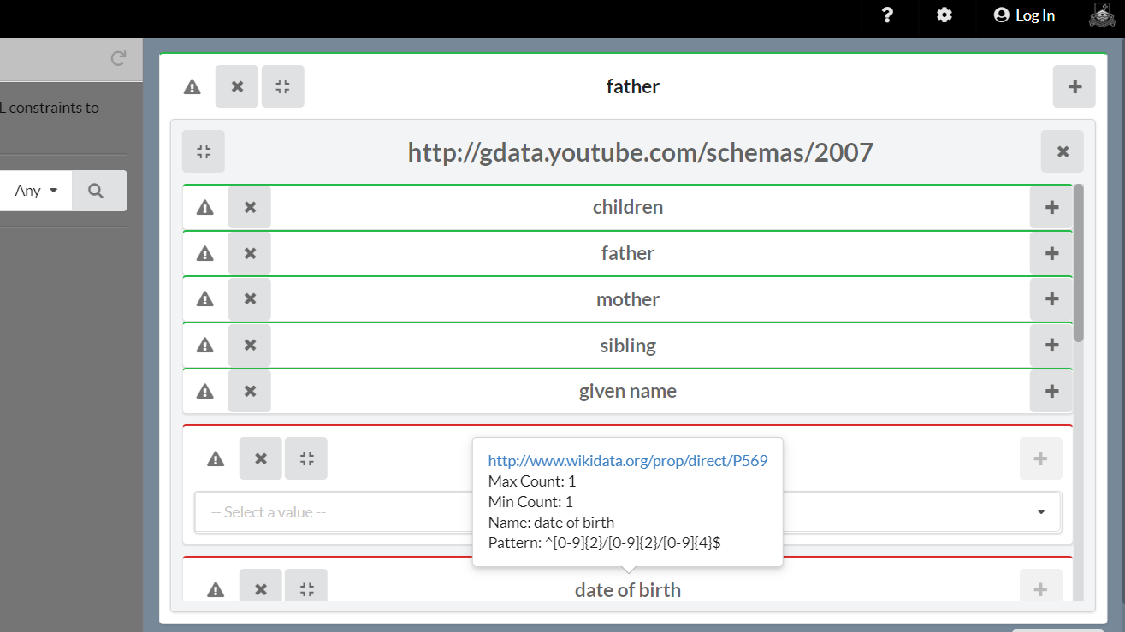
UIs and shapes: Schímatos
http://schimatos.org/
It will be presented at ISWC20

Slide 35
Generating code from shapes
Generate domain model from shapes
Entities (pseudo-shapes) defined with Excel (Google spreadsheets)
Shapes generation from those templates
Java code generation (POJOs) from those shapes
Shape
A
hermes
Simplified Shapes version
Compatible with ShEx/SHACL
CSV (Excel) → ShEx
ShExLite
Code generation from Shapes
ShEx → POJO (Java)
Java
Shape
B
Shape
C
Shapes library

Slide 36
Generating code from shapes
Domain model based on Shapes
Clean architecture pattern
Domain model as central element
Simple classes (POJO): Plain Old Java Objects
Shapes synchronization
Application logic and services based on domain model
UML
Diagrams
Semantic architecture
Ontological infrastructure
Domain
model
Shapes
library
Syncrhonization

Slide 37
Shapes and rules
SHACL Advanced Features describes SHACL rules
:Rectangle a rdfs:Class, sh:NodeShape ;
rdfs:label "Rectangle" ;
sh:property [ sh:path :height ;
sh:datatype xsd:integer ;
sh:maxCount 1 ; sh:minCount 1 ;
sh:name "height" ] ;
sh:property [sh:path :width ;
sh:datatype xsd:integer ;
sh:maxCount 1 ; sh:minCount 1 ;
sh:name "width" ; ] ;
sh:rule [ a sh:TripleRule ;
sh:subject sh:this ;
sh:predicate rdf:type ;
sh:object :Square ;
sh:condition :Rectangle ;
sh:condition [
sh:property [
sh:path :width ;
sh:equals :height ;
] ; ] ; ] .
:I a :Rectangle .
:N a :Rectangle ;
:height 2 ;
:width 3 .
:S a :Rectangle ;
:height 4 ;
:width 4 .
:S a :Square .

Slide 38
Shapes for data integration
XMLSchema2ShEx: Convert XML Schemas to shapes
ShExML: Domain specific language to convert data to RDF
Input formats: CSV, XML, JSON, SQL
XSD
XMLSchema2ShEx
ShEx
conforms
XML
conforms
CSV
ShExML
RDF
JSON
SQL

Slide 39
Shapes ecosystems
Wikidata provides a whole ShEx ecosystem
Entity schemas can evolve and relate between each other
Directory: https://www.wikidata.org/wiki/Wikidata:Database_reports/EntitySchema_directory
Different schemas for the same entities?
Some schemas stress some aspects while others stress others
Evolution of schemas
Searching entity schemas

Slide 40
Conclusions
ShEx and SHACL have had a great level of adoption
Tools and requirements have appeared from this adoption
Towards shapes ecosystems
New tools and challenges
Theoretical results about recursion and negation
Could help ShEx/SHACL conciliation

Slide 41
Acknowldgments
People have contributed to this list of ShEX/SHACL implementations:
https://github.com/validatingrdf/validatingrdf.github.io/wiki/Updated-list-of-implementations
Special thanks to Vladimir Alexiev for starting it
People from ShEx community group: Tom Baker, Kat Thornton, Andra Waagmeester,...

