Slide 1
Three quarters of new criminological knowledge is hidden from policy makers Dr Matt Ashby
SECURITY AND CRIME SCIENCE
Image: Martin Adams

Slide 2
“committed to free and open access to knowledge … and to sharing sources of those findings whenever possible”

Slide 3
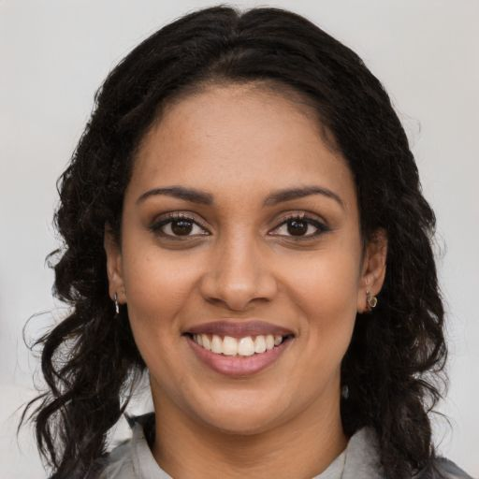
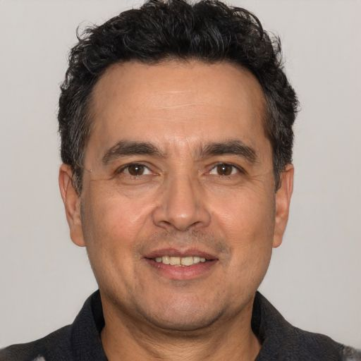
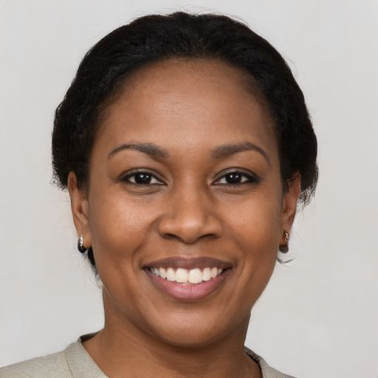
Priya
Juan Carlos
Lindsay
Images: Generated Photos

Slide 4
😲

Slide 5
Open access publishing
“when anyone can read, download, copy, distribute, print, search for and search within the information, or use it in education or in any other way within the legal agreements”
Source: openaccess.nl

Slide 6
97 criminology journals
12,541 articles, 2017–19
Unpaywall.org
Green
Gold
Bronze
Closed

Slide 11
You almost certainly have the right to release a version of your papers online for anyone to read, completely free
How? bit.ly/stop-hiding-research

Slide 12
Images: Generated Photos

Slide 13
These slides:
lesscrime.info/talks/crimcon-2020
Full paper, data and code:
lesscrime.info/publication/criminology-oa
Questions? matthew.ashby@ucl.ac.uk
@lesscrime

