Slide 1
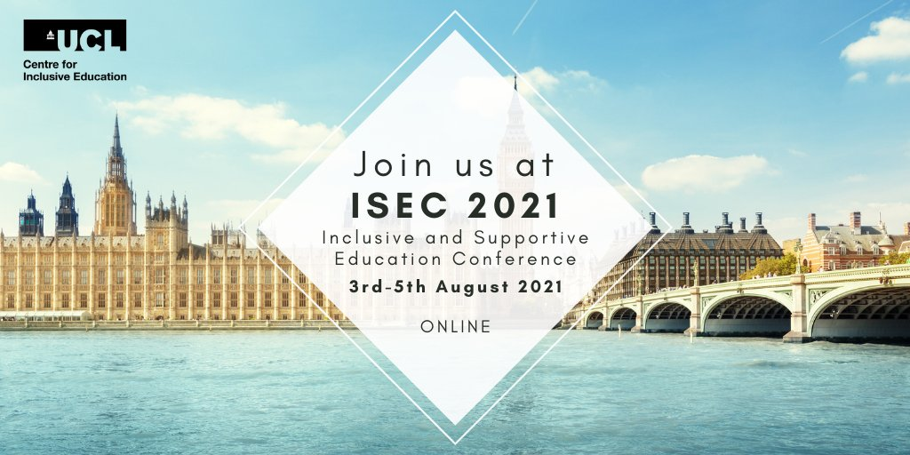

Keynote
Rebuilding our schools: where do we start?
Education in Times of Uncertainty: What Have We Learned?
Dr Keri Wong
UCL Institute of Education
5 August 2021
keri.wong@ucl.ac.uk @DrKeriWong
#ISEC2021
Notes:
You can follow me on the following social media.

Slide 2
Where are we at?
What is the impact of COVID19’s on Mental Health?
Where do we start?
#ISEC2021
Notes:
You can follow me on the following social media.

Slide 3
Where are we at?
What is the impact of COVID19’s on Mental Health?
Where do we start?
#ISEC2021
Notes:
You can follow me on the following social media.

Slide 4

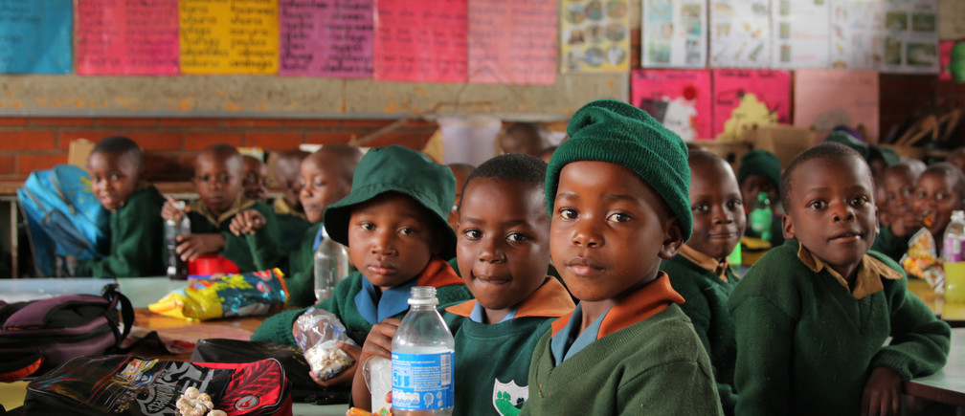
COVID-19: Where are we at?
Globally
  Worldwide, 250 million children were already out of school, with 1.6 billion children out of school during the pandemic may never return (World Economic Forum Dec 2020).
  Eastern & Southern Africa: 32 million out of school because of pandemic closures or having failed to return once their schools opened earlier this year. In addition to an 37 million children who were out of school before the pandemic (UNICEF, 27 July 2021).
  Issues of poverty, access to technology, safety, availability of trained female role models, sociocultural practices.
Notes:
post-COVID landscape for SEND learners – such as the issue of ‘pandemic stress’, COVID-19, and international students, and managing sudden shifts to remote learning.

Slide 5
COVID-19: Where are we at?
Globally
  Worldwide, 250 million children were already out of school, with 1.6 billion children out of school during the pandemic may never return (World Economic Forum Dec 2020).
  Eastern & Southern Africa: 32 million out of school because of pandemic closures or having failed to return once their schools opened earlier this year. In addition to an 37 million children who were out of school before the pandemic (UNICEF, 27 July 2021).
  Issues of poverty, access to technology, safety, availability of trained female role models, sociocultural practices.
Notes:
post-COVID landscape for SEND learners – such as the issue of ‘pandemic stress’, COVID-19, and international students, and managing sudden shifts to remote learning.

Slide 6
COVID-19: Where are we at?
Globally
  Worldwide, 250 million children were already out of school, with 1.6 billion children out of school during the pandemic may never return (World Economic Forum Dec 2020).
  Eastern & Southern Africa: 32 million out of school because of pandemic closures or having failed to return once their schools opened earlier this year. In addition to an 37 million children who were out of school before the pandemic (UNICEF, 27 July 2021).
  Issues of poverty, access to technology, safety, availability of trained female role models, sociocultural practices.
Notes:
post-COVID landscape for SEND learners – such as the issue of ‘pandemic stress’, COVID-19, and international students, and managing sudden shifts to remote learning.

Slide 7
COVID-19: Where are we at?
Globally
  What works?
  Work closely with local leaders and offer teacher education of mental health.
  Develop holistic social and fiscal policy by harmonizing data across industries (Marelize Gorgens, World Bank Feb 2021)
  Much complex issue of bridging the research, practice, access gap.
Notes:
post-COVID landscape for SEND learners – such as the issue of ‘pandemic stress’, COVID-19, and international students, and managing sudden shifts to remote learning.

Slide 8
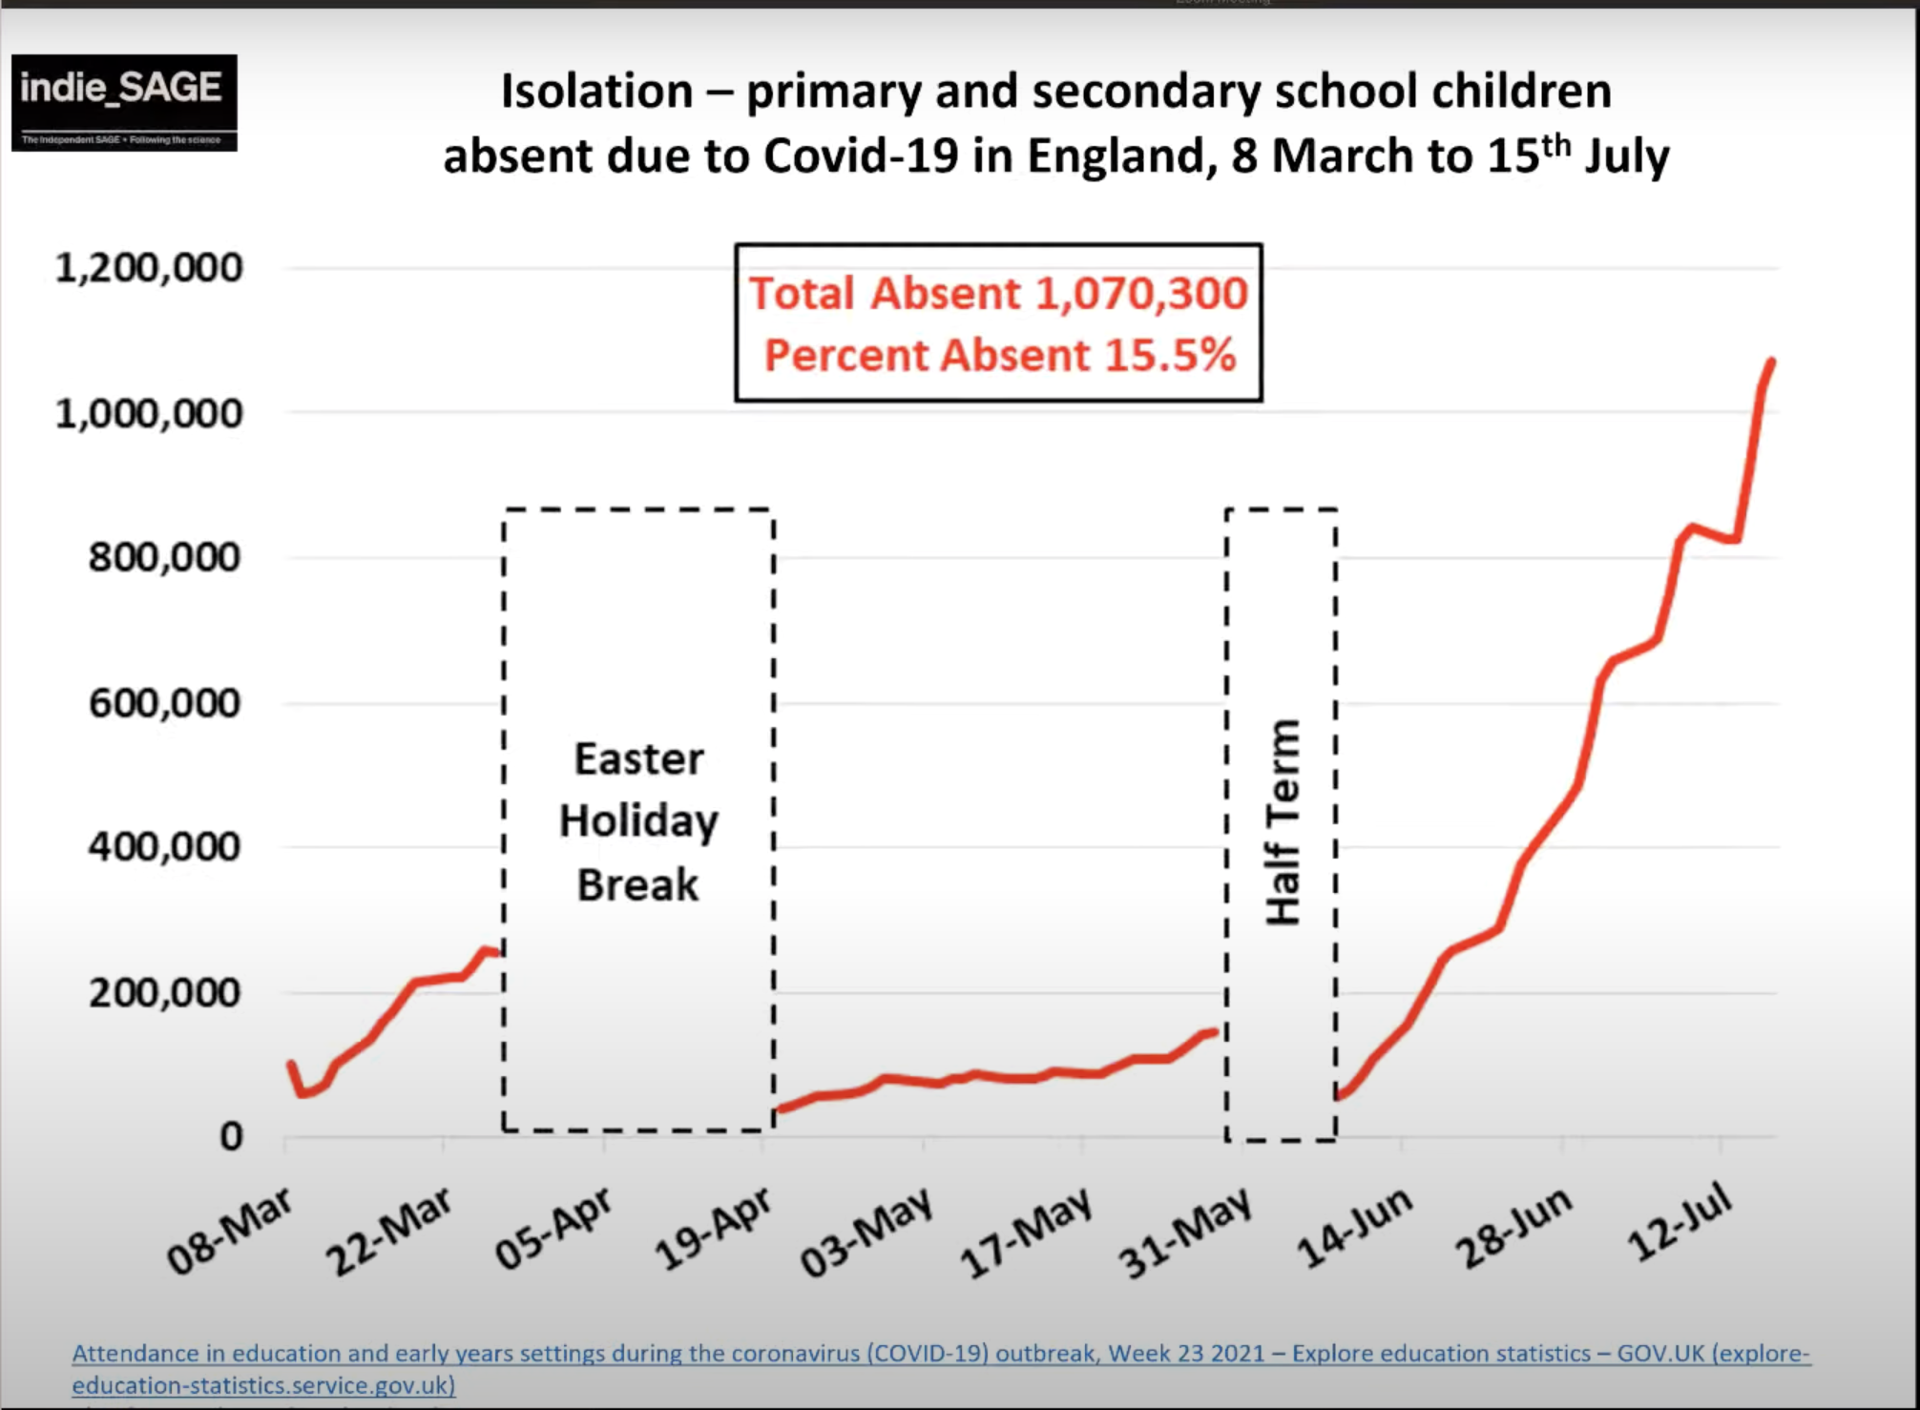
COVID-19: Where are we at?
UK / England
  87M doses given (55.4-65.8% fully vax).
  In England, over 1 million(15.5%) primary and secondary school children were absent in the week leading up to the 15 July 2021 (DfE data, 30 July Independent Sage briefing)
  In that last week, 29.6% absent in the North-East and 11.3% in London.
Source: Prof. Christina Pagel - https://www.independentsage.org/category/weeklynumbers/
Notes:
post-COVID landscape for SEND learners – such as the issue of ‘pandemic stress’, COVID-19, and international students, and managing sudden shifts to remote learning.

Slide 9
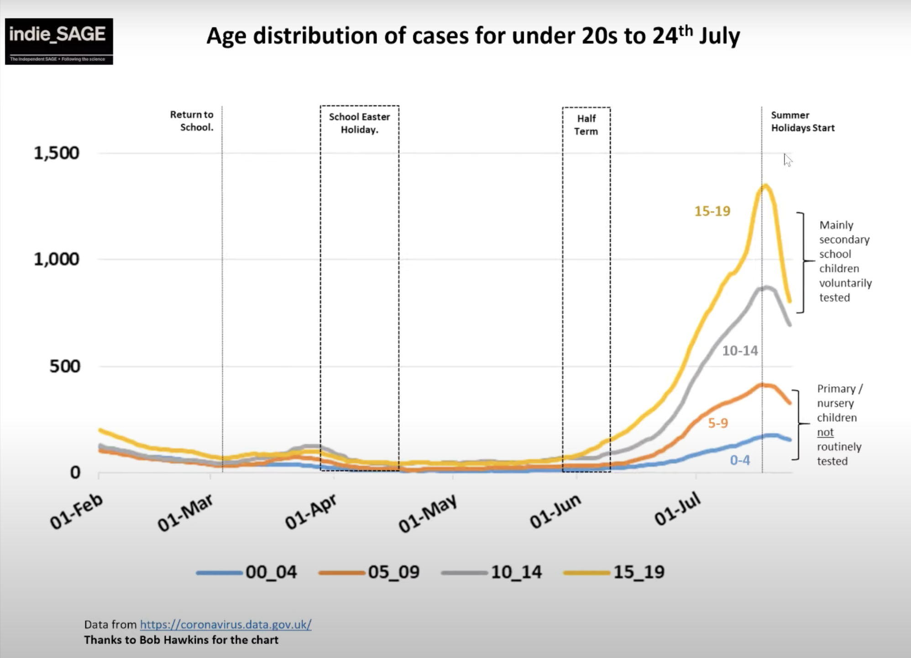
COVID-19: Where are we at?
England
  School holidays can reduce the transmissions of Delta variant.
  But isolating = fewer tests as reflected in the decreases seen in 10-19yo (yellow & grey lines).
  Long covid
Source: Prof. Christina Pagel - https://www.independentsage.org/category/weeklynumbers/
Notes:
England
School holidays can reduce transmissions of Delta variant, but isolating = fewer tests.

Slide 10
Where are we at?
What is the impact of COVID19’s on Mental Health?
Where do we start?
#ISEC2021
Notes:
You can follow me on the following social media.

Slide 11

COVID has negatively impacted everyone’s mental health
Teaching and other educational professionals (n = 319) vs general population (n = 1117).
No difference on levels of:
Anxiety, depression, stress, sleep quality, aggression
controlling for site, gender, age
© UCL-Penn Global COVID Study

Slide 12
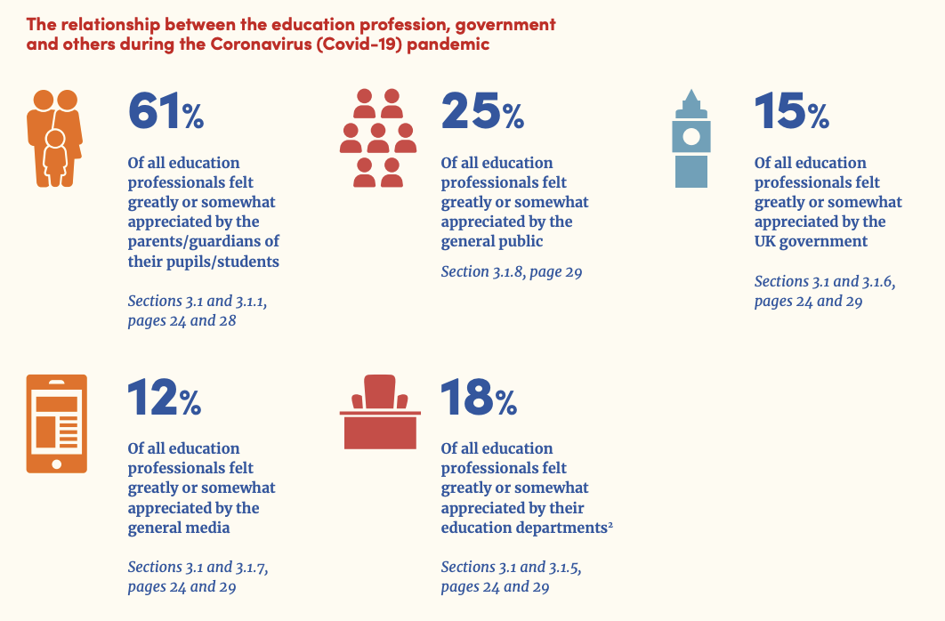
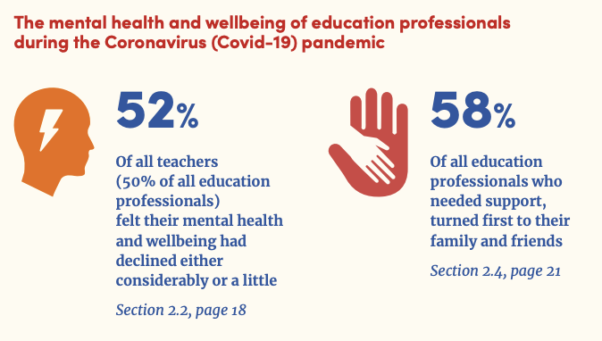
COVID has negatively impacted teacher’s mental health
2020
Education Support Report & YouGov online survey between 24 Jun-16 Jul of education professionals (N = 3,034)
Notes:
Covid-19 and the classroom: Working in education during the coronavirus pandemic The impact on education professionals’ mental health and wellbeing

Slide 13
COVID has negatively impacted teacher’s mental health
2021
Education Support survey between 25 Feb – 16 Mar of teaching professionals (N = 1,059)
82%
46%
teachers report being stressed from work
mental health and wellbeing have caused them to consider leaving the profession altogether
Notes:
Source: https://www.educationsupport.org.uk/about-us/media-centre/mental-health-decline-schools-could-push-more-teachers-leave

Slide 14
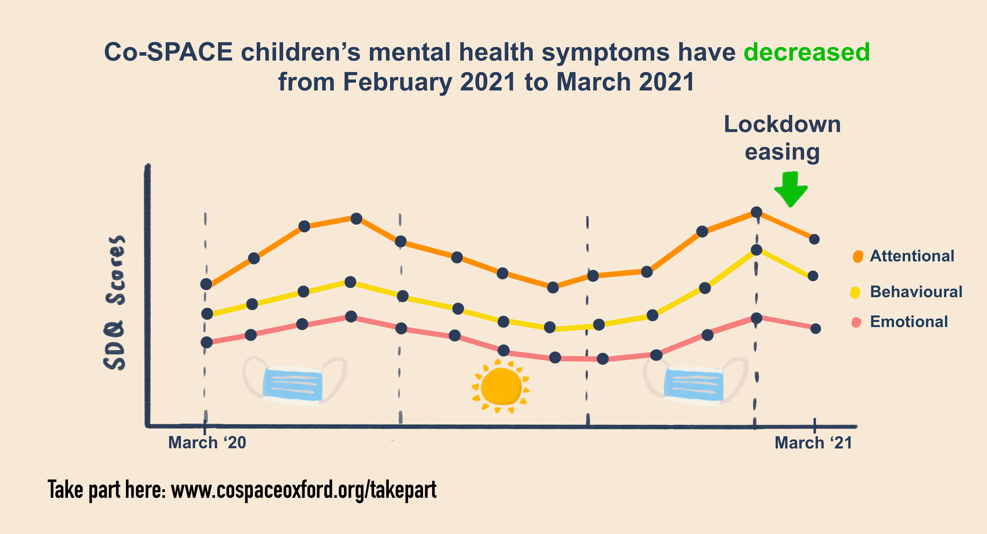
COVID has negatively impacted young people’s mental health
Oxford’s Co-SPACE (2021)
parent-reports on children (N = 8,225)
http://cospaceoxford.org/findings/report-10-changes-in-childrens-mental-health-throughout-one-year-of-the-covid-19-pandemic/
Notes:
On average, behavioural, emotional, and attentional difficulties decreased as COVID-19 related restrictions eased from February to April 2021. They remained relatively stable between April and June (the month-to-month change was not statistically significant).
The decrease in symptoms since February was especially pronounced for primary school aged children (4-10 years old).
On average, children with SEN/ND and those from low-income households have not shown this post-lockdown recovery and have continued to have elevated mental health symptoms.

Slide 15






UCL-Penn Global COVID Study
Notes:
What have we found?

Slide 16






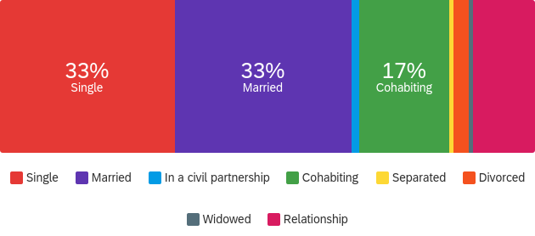
GlobalCOVIDStudy.com
@GlobalC19Study osf.io/fe8q7/
17 Apr
COVID study starts
Cases: 4,965
7-day: 4,415
14 Jul
Cases: 1,240
7-day: 718
13 Nov (peak)
Cases: 27,301
7-day: 24,430
WHO declares
pandemic
39.3%
11.5%
9.0%
11.4%
Year
COVID reported in Asia
Ethics
Wave 1
17 Apr-14 Jul
(N = 2,276, n = 1,829)
<34 (54%, M = 36.4, SD = 13.5, F = 70.5%, 18-89y), Single (45%), Masters (39%), <£40K (50%)
Wave 2
17 Oct-31 Jan
(N=1,283, new=523)
2020
UK National Lockdown 1
UK Easing of Lockdown
UK National Lockdown 2
Participant characteristics | %
Age (18-89 years) | <34y 54.5%
Ethnicity | White (35.8%) Other white (28.6%) Chinese (11.2%)
Education | Masters (38.5%) Bachelors (26.8%) Highschool (11.6) PhDs (11.3%)
Income | < 40K (50%), rest are 40K to 150K+
44.6%
8.1%
8.1%
11.4%
2021
<34 (54%, M = 37.6, SD = 13.7, F = 74.3%, 18-89y), Single (33%), <£40K (54.5%)
Wave 3
17 Apr-31 Jul
(N = 900, n =45)
UK National Lockdown 3
UK Easing of Lockdown
Jan
Feb
Mar
Apr
May
Jun
Jul
Aug
Sep
Oct
Nov
Dec
6 Jan (peak)
Cases: 62,322
7-day : 57.702
14 Jan
Vaccine
roll-out
6 Apr
Cases: 2,762
7-day: 3,493
© UCL-Penn Global COVID Study

Slide 17
Q1: What stressors have people been experiencing?
Q2: What do you need to recover from the pandemic?
Notes:
Poll question

Slide 18
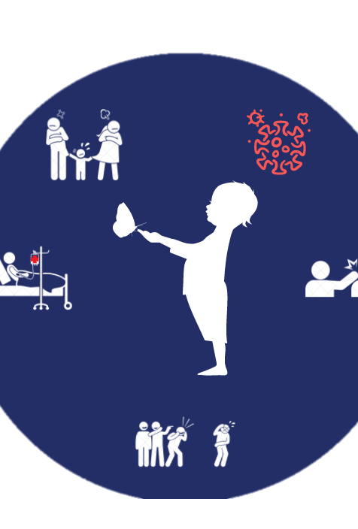
Q1. Short & longer-term stressors
More stressful than 12-months ago
Mental Health (35% → 44.1%)
Physical health (22%→37.1%)
Work (30% → 40.4%)
Marriage and/or romantic relationships (16%→ 20%)
Less
The uncertainty surrounding COVID-19 (56%→50.7%)
Other people not wearing face masks (50%→45.3%)
Government COVID-19 guidelines (48%→32.3%)
Same
Future plans (51.8%~)
Boredom and Loneliness (32.6%~)
Other people not social distancing (58.2%~)
© UCL-Penn Global COVID Study

Slide 19

Q2. What support would you/your family need in the next 6 months to thrive and recover from the pandemic?
© UCL-Penn Global COVID Study

Slide 20
Thematic analysis (N = 889)
5 key themes
36% feel ok
© UCL-Penn Global COVID Study

Slide 21

Vaccines, freedom to travel, seeing people (40%)
THEME 1
Numbers to go down so my kids can go back to school, children’s vaccines.
Require proof of vaccination for older students returning to school/university. Allow 12 years olds and younger kids to be vaccinated!
I would need a greater percentage of the world population to be vaccinated so that global travel can really open up again and I can go and see my family.
(N = 889)
© UCL-Penn Global COVID Study

Slide 22
Assurances from employers an financial support and help (23.4%)
THEME 2
Allowance of a flexible work routine. It feels like we have been working non-stop since March 2020.
How work handle things will be key - I really want flexible working to remain, it's been life changing.
(N = 889)
© UCL-Penn Global COVID Study

Slide 23
Access and continued access to mental health services
(19.6%)
THEME 3
We are applying for Early Help. We have an appointment with CAMHS. Time and space to continue doing these things. Not lots of catch-up work / lessons from school.
My son to continue having support and fun with young carers and to start counselling.
(N = 889)
© UCL-Penn Global COVID Study

Slide 24
Clarity in government guidelines and messaging
(11.7%)
THEME 4
To feel safe when out - ie. it would be nice to know that masks will be kept beyond June 21, I think the idea of this and all other barriers against COVID going could be really overwhelming.
Will need the government’s COVID-19 guidelines to make sense.
(N = 889)
© UCL-Penn Global COVID Study

Slide 25
Understanding from others and personal support (5.3%)
THEME 5
Being able to grieve my grandad together.
Proper vaccination, determination, optimism.
I would love to have just some time away from work, away from others to clean and organize my home, paint walls, and really deep clean.
Babysitting! My wife and I haven’t had a date night in over a year.
(N = 889)
© UCL-Penn Global COVID Study
Notes:
Vaccination of 12 yo with pre-existing conditions, and above is taking place, 16-17yo in the UK. This is already taking place in the USA, France, China/Hong Kong.

Slide 26
Where are we at?
What is the impact of COVID19’s on Mental Health?
Where do we start?
#ISEC2021
Notes:
You can follow me on the following social media.

Slide 27



To recover fairly…
Relationships
  Ease into social life, particularly important for young children
  Address self-perceived loneliness, reduce fear/anxiety in the return to school, develop trust.
Mental health and access is a priority
  ‘Health catch-up’ alongside academic catch-up to reduce longer term economic/social cost.
  Continued access at all levels – access to school-based low intensity therapies.
  Clear school/government guidelines.
Bereavement and coping with loss
  Recognise COVID positive (29%→72.3%) & loss (27.8%→ 88.7%) cases
  Empathy, Cruse Bereavement Care course
EMPATHY
BEING KIND
© UCL-Penn Global COVID Study

Slide 28
To recover fairly…
Relationships
  Back-to-school anxiety. Address self-perceived loneliness, opportunities to develop trust, safe spaces.
  Ease into social life, growth mindset, no quick fix
Mental health and access is a priority
  ‘Health catch-up’ alongside academic catch-up to reduce longer term economic/social cost.
  Continued access at all levels – access to school-based low intensity therapies.
  Clear school/government guidelines.
Bereavement and coping with loss
  Recognise COVID positive (29%→72.3%) & loss (27.8%→ 88.7%) cases
  Empathy, Cruse Bereavement Care course
EMPATHY
BEING KIND
© UCL-Penn Global COVID Study

Slide 29
To recover fairly…
Relationships
  Back-to-school anxiety. Address self-perceived loneliness, opportunities to develop trust, safe spaces.
  Ease into social life, growth mindset, no quick fix
Mental health and access is a priority
  ‘Health catch-up’ alongside academic catch-up to reduce longer term economic/social cost.
  Continued access at all levels – access to school-based low intensity therapies.
  Clear school/government guidelines.
Bereavement and coping with loss
  Recognise COVID positive (29%→72.3%) & loss (27.8%→ 88.7%) cases
  Empathy, Cruse Bereavement Care course
EMPATHY
BEING KIND
© UCL-Penn Global COVID Study

Slide 30
To recover fairly…
Relationships
  Back-to-school anxiety. Address self-perceived loneliness, opportunities to develop trust, safe spaces.
  Ease into social life, growth mindset, no quick fix
Mental health and access is a priority
  ‘Health catch-up’ alongside academic catch-up to reduce longer term economic/social cost.
  Continued access at all levels – access to school-based low intensity therapies.
  Clear school/government guidelines.
Bereavement and coping with loss
  Recognise COVID positive (29%→72.3%) & loss (27.8%→ 88.7%) cases
  Empathy, Cruse Bereavement Care course
EMPATHY
BEING KIND
© UCL-Penn Global COVID Study

Slide 31




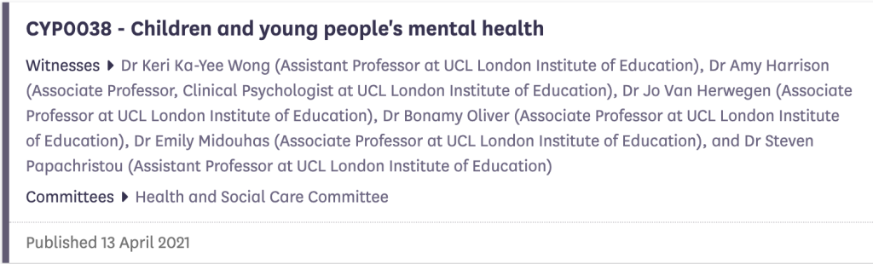
Engage with policymakers
Wong et al. (April 2021):
Increase teacher training and ensure referral process is easy.
Regular assessments of MH in early development (Wong et al., 2014).
School interventions (e.g., whole-school approaches bullying interventions to change school culture).
No one size fits all.
Collect time-sensitive data now.

Slide 32
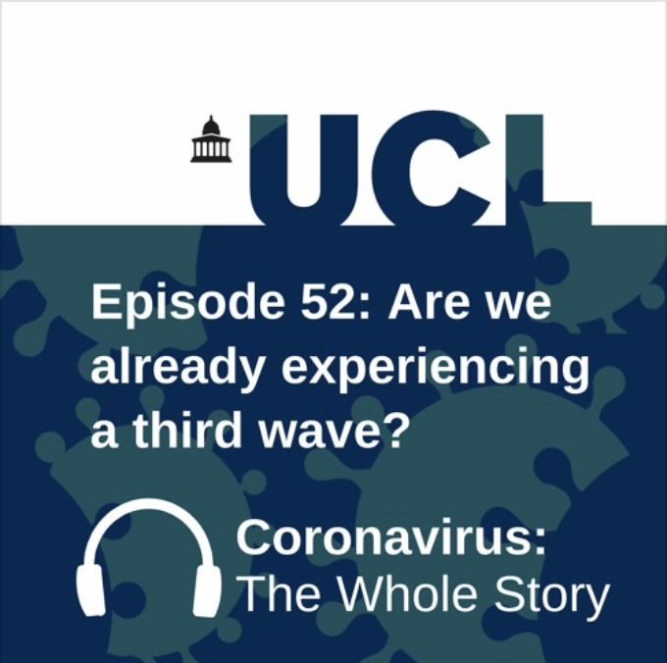

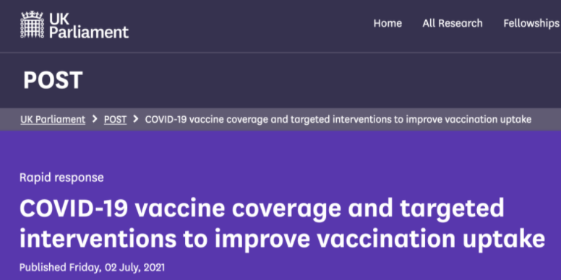
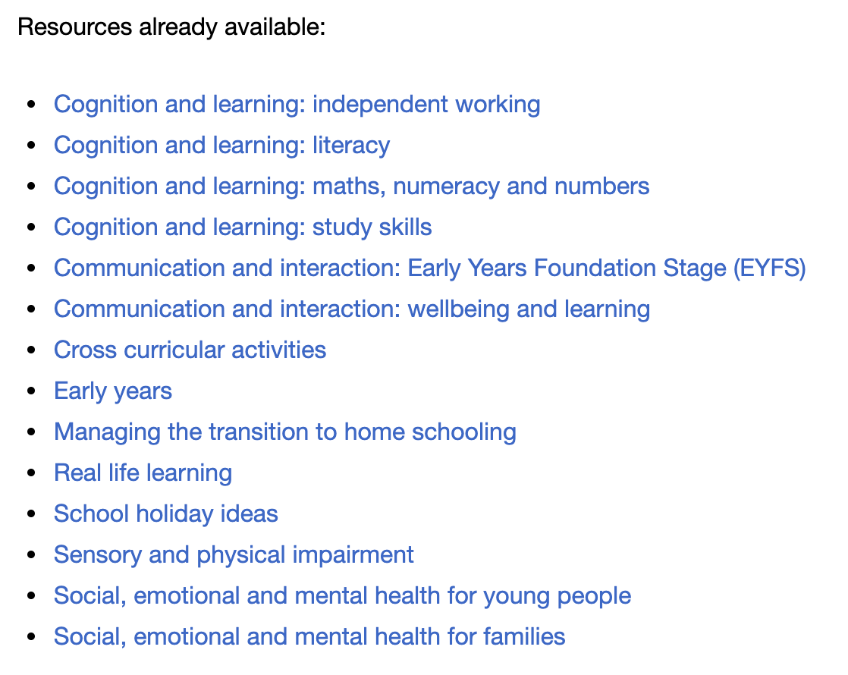

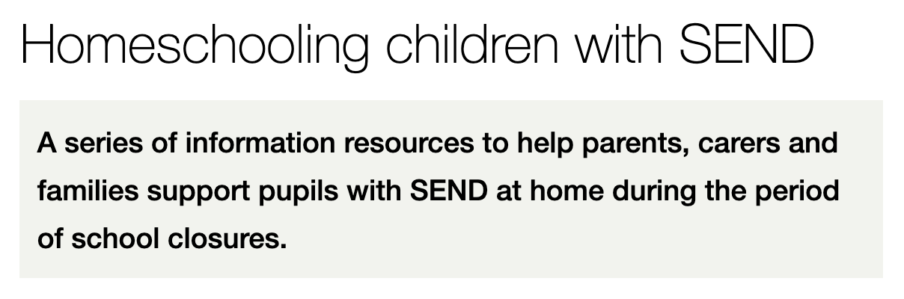
Access and share what works

Slide 33
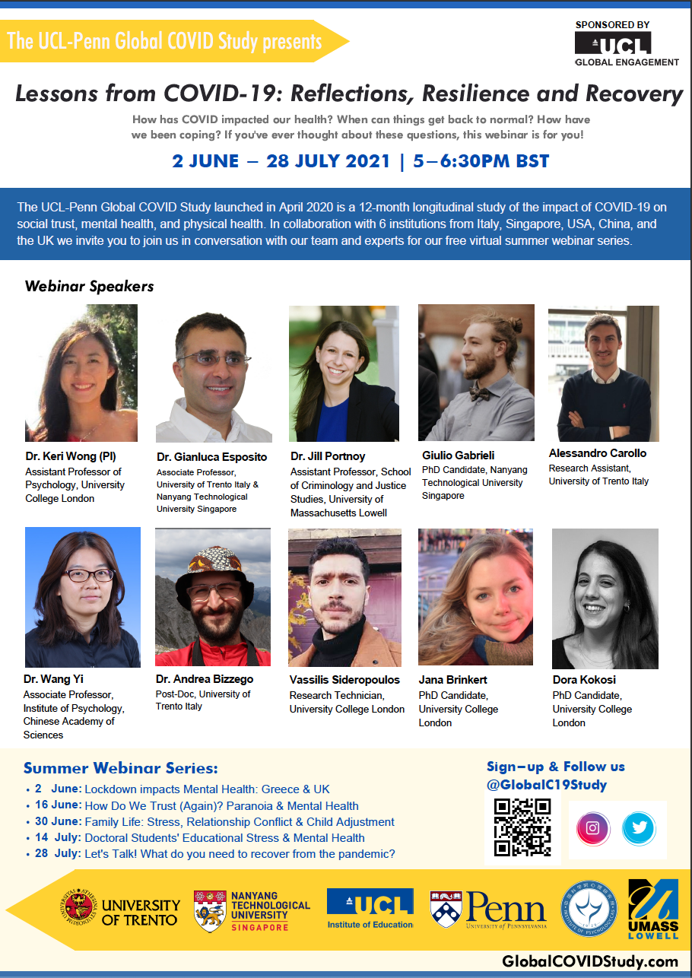





Continue the conversation!
Special series to be published in the new UCL Press open science journal – End of the year 2021
More info:
ucl.scienceopen.com

Slide 34
Keynote
Rebuilding our schools: where do we start?
Education in Times of Uncertainty: What Have We Learned?
Dr Keri Wong
UCL Institute of Education
5 August 2021
keri.wong@ucl.ac.uk @DrKeriWong
@GlobalC19Study
#ISEC2021
Notes:
You can follow me on the following social media.

