Slide 1
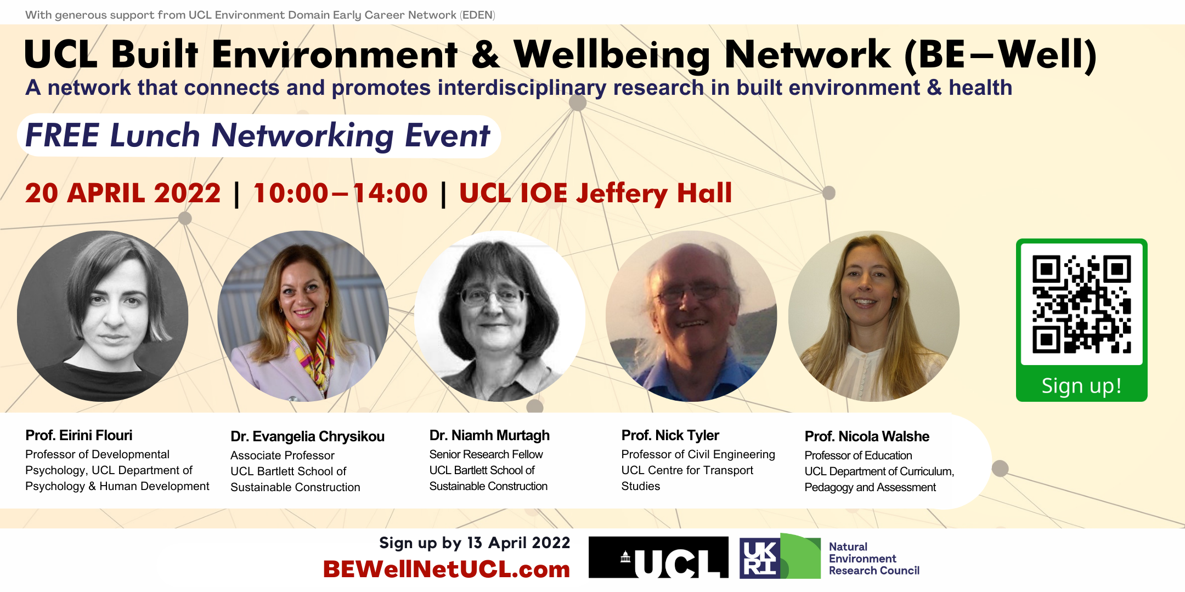

Slide 2
The BE-Well Network aims to
connect, facilitate, and sustain research collaborations
Collaborate
Communicate
Create

Slide 3
Menti.com
4968 5783

Slide 4
BE-Wellbeing Research: Overview of Funding Landscape for Interdisciplinary Research Collaborations
Wednesday 20 April 2022
Jacob Leveridge
Deputy Director of Research Facilitation (SLASH & IOE)
UCL Research, Innovation & Global Engagement (RIGE)
j.leveridge@ucl.ac.uk

Slide 5
Focus
UKRI/Research Councils
Wellcome Trust
Leverhulme Trust
Nuffield Foundation
National Institute for Health Research (NIHR)
Notes:
4

Slide 6
UKRI/Research Councils
AHRC, EPSRC, ESRC, MRC (plus BBSRC, NERC, STFC)
Cross-Council Remit Agreement for responsive-mode research grant or fellowship applications
Submit to ‘Lead Council’, min 51% of remit/scope
If research remit/scope min 10% other Council remits, project deemed to be cross-Council/cross-remit
Lead Council will select appropriate mix of peer reviewers, from across relevant research domains
Research grants most obvious scope for interdisc research collaborations as can have co-Is from other disciplines, typically up to £1m for up to 5 yrs
Impact beyond academy important consideration
Look out for cross-Council calls for research on particular topics
Notes:
5

Slide 7
Wellcome Trust
Large charitable funder of health-related research with potential to improve human life, health, wellbeing
Funds ‘discovery’ research in any health-related field/discipline, also occasional specific opportunities in mental health, climate & health, infectious disease
Under discovery research programme, early-career awards (max 5 yrs, salary + £400k research expenses), career dev awards (max 8 yrs, salary if needed + expenses), discovery awards (max 8 yrs, research expenses), different career stages, 2-3 calls per year
Early-career & career dev awards for individuals, with or without research team as appropriate to career stage & discipline
Discovery awards for those leading research programmes, can be for collaborations & interdisciplinary
Current funding calls in mental health domain to improve mental health interventions for anxiety, depression, psychosis (up to £5m, 8 yrs, 24 May prelim deadline), plus mental health data prize with focus on anxiety & depression in young people (10 multidisc teams £40k, 5 teams £100k, 3 teams £500k), 6-18 months, 5 June deadline
Notes:
6

Slide 8
Leverhulme Trust
Large charitable funder of research in any field or discipline except ‘studies of disease, illness and disabilities in humans and animals’ or ‘research that is intended to inform clinical practice or the development of medical applications’
Keen on funding interdisc/multidisc research, can be a bit wary of funding health-related research but has been known to show some interest as long as not clinical/medical research
Bottom line impact on academic scholarship, impact beyond academy not important, won’t fund research which driven by/sets out to inform policy
Research project grant scheme for PIs typically with perm post, can be collaborative though no more than 3 co-applicants, plus their research team(s)
Up to £500k for up to 5 yrs
2-stage app process, no deadlines 1st stage
Notes:
7

Slide 9
Nuffield Foundation
Charitable funder of research in three core domains: Education, Justice, Welfare
Under Education domain, interests include educational disadvantage, including special educational needs, physical disabilities, mental health issues, socio-economic disadvantage, geographical disadvantage & looked after children
Under Welfare domain, interested in people’s welfare at all stages of life
‘Motivated by how certain individuals and groups are potentially vulnerable to adverse outcomes, and how those risks can be mitigated, or channelled more positively’
Research, development, & analysis fund, up to £750k 2 deadlines per year, £750k-3m, for more strategic projects, once per year
Research to inform policy, in UK context

Slide 10
National Institute for Health Research (NIHR)
Several programmes, incl Public Health Research (PHR) Programme
This funds research to generate evidence to inform delivery of non-NHS interventions, intended to improve health of public and reduce inequalities in health
Primary aim of programme is evaluation of practical interventions which have potential to be delivered at scale, in order to generate evidence to support public health decision making and lead to sustainable population level change
Both primary (evaluative) research & secondary research (evidence synthesis)
Researcher-led & commissioned workstreams
No limits on amount of funding that can be applied for
Applications to researcher-led workstream can be made at any point, with three cut-off dates throughout year

Slide 11
Thank you!
j.leveridge@ucl.ac.uk

Slide 12
Accepting submissions
ucl.scienceopen.com
Ian Caswell (i.caswell@ucl.ac.uk)
Journals Manager, UCL Press

Slide 13
The journal’s scope covers environment-related studies linked to:
Past, present, and future environmental processes and characteristics viewed from a theoretical, observational, or experimental perspective.
The planet’s environments, including those in which people live
Interactions between the environment and people’s wellbeing and health, including the impacts and management of pollution or disease mediated via the environment
Policies, decisions, behaviours, mechanisms, and approaches to the way the environment and its resources are managed, including those dealing with the evidence linked to global challenges such as Climate Change, Biodiversity Loss and overall Environmental Degradation as well as to international endeavours related to the One Health, Planetary Health/Limits and Sustainable Development
Research methods and approaches, the development and management of databases and the development and work of networks.
Read more here https://ucl-about.scienceopen.com/aims-and-scope
Free for UCL staff to publish in!
Is a new, open and transparent, open access journal where high-impact disciplinary and multidisciplinary research is published that showcases radical and critical thinking on real-world issues, with the overall aim of benefitting humanity.

