Slide 1
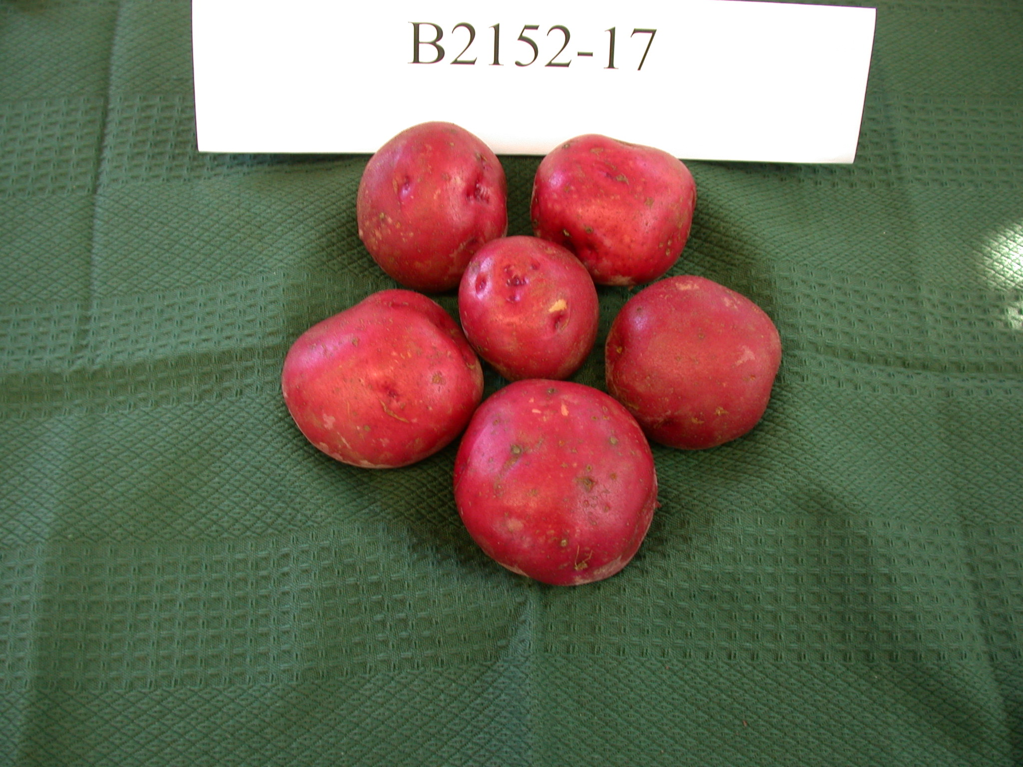
Potato ‘Little Ruby’
Potato ‘Little Ruby’ is an early maturing variety. Tubers are small, round, fairly smooth, red-skinned and have shallower eyes than most red-skinned varieties. Because of its small size, marketable yields have been considerably less than standard red-skinned varieties and yields decrease even more so under warmer growing environments. Specific gravity of ‘Little Ruby’ has been slightly higher than other standard red-skinned varieties. Flesh color is light yellow. The carotenoid content of ‘Little Ruby’ tubers has averaged 66% of Yukon Gold. External and internal defects have been minimal. ‘Little Ruby’ is being released primarily for the ‘baby red’ market.
Protected through PVPC #2016-00262.
For licensing information contact: Jim Poulos, jim.poulos@ars.usda.gov.

Slide 2
Kiwi ‘Tango’ & ‘Hombre’
Tango’ produces fruit of high quality and of significantly larger size than the currently-grown cold hardy species A. arguta and A. kolomikta. Fruit flesh tends towards a "golden" color (yellow-green 153D, Royal Horticulture Society, London) at harvest changing to greyed yellow 160A eating ripe (12 to 18 degrees brix). ‘Tango’ and its pollinator, ‘Hombre’, are recommended as worthy cultivars for more extensive testing as valuable kiwifruit vines for production in the colder regions of the U.S., in areas up to USDA Plant Hardiness zone 6a, that currently are not suitable for the cultivation of A. chinensis or A. deliciosa.
Patent pending.
For licensing information contact: Jim Poulos, jim.poulos@ars.usda.gov.

Slide 3
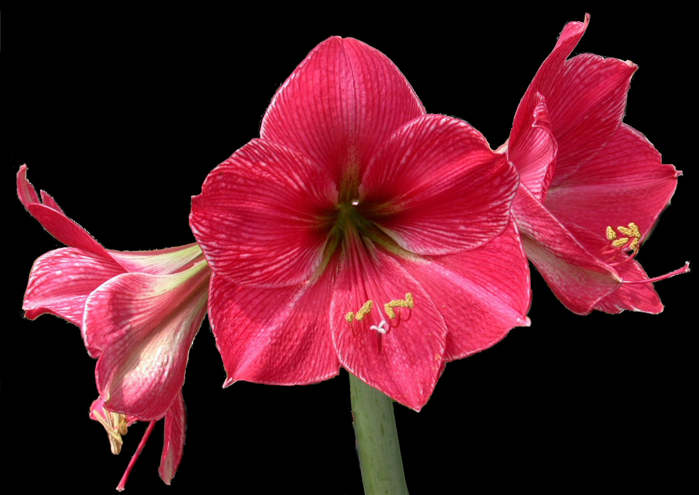
Hippeastrum x hybridum (amaryllis) ‘Boca’
Amaryllis ‘Boca’ is a new and distinct triploid (2n=33) Hippeastrum interspecific hybrid plant particularly characterized by "butterfly" shape flowers, measuring approximately 13-14 cm and 15-16 cm long, approximately 12-13.5 cm and 14-15 cm wide laterally, approximately 14-16 cm and 16-18 cm wide dorsal-ventrally, The flowers are densely striated purple pink (approximately red purple RHS 57A) on their inner surfaces, with an irregular marginal white RHS 155D picotee and a faint white RHS 155D keel on the outer lateral segments; the outer surfaces are more lightly striated with infusions of green RHS 149B and maroon RHS 178B along the keels. The female parent is an Fl interspecific hybrid (H. ambiguum x H. papilio clone 4-16, unpatented). The pollen parent is an unpatented selection from the complex cross (H. ambiguum x H. papilio ) x (H. lapacense x H. papilio) with the breeder's code 35-2. Over the course of seven years of evaluation, ‘Boca' has shown excellent heat resistance grown under ambient conditions in Miami, Fla. under 50% shade, and resistance to Red Scorch fungus (Staganospora curtisii).
Protected through US PP 25,788 P2.
For licensing information contact: Joe Lipovsky, joe.lipovsky@ars.usda.gov.

Slide 4
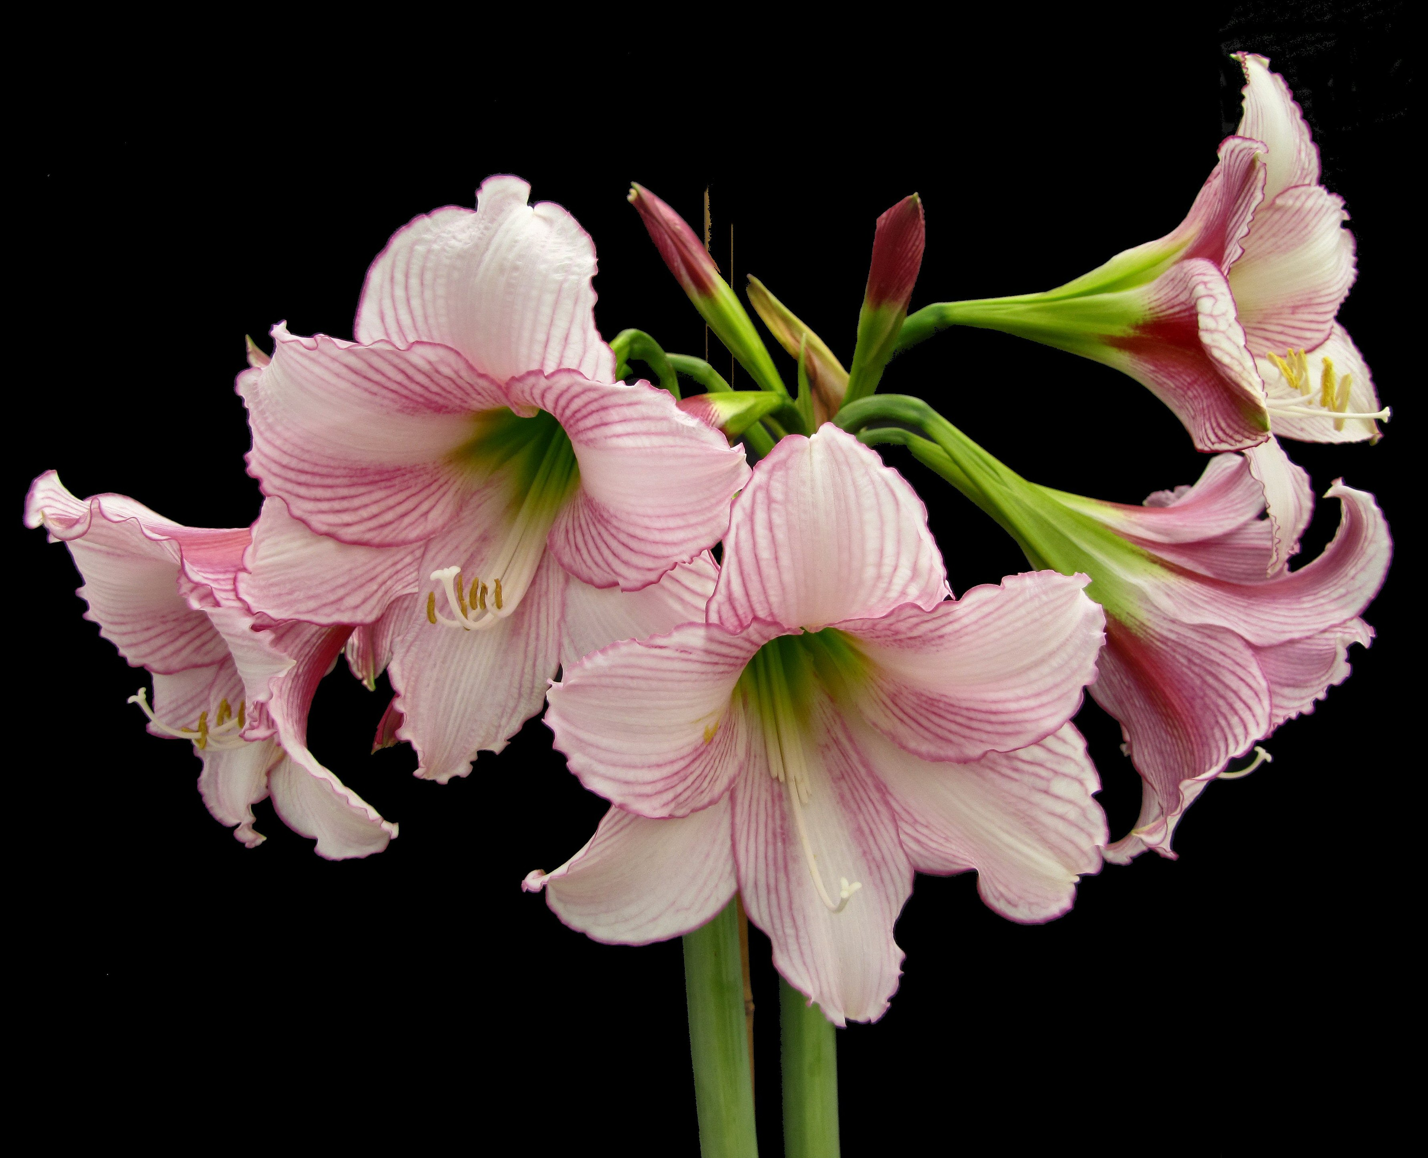
Hippeastrum x hybridum (amaryllis) ‘Jax’
Amaryllis ‘Jax’ is a new and distinct diploid (2n=22) Hippeastrum interspecific hybrid plant particularly characterized by 4-6 semi-pendant trumpet-shaped flowers, measuring approximately 15-16 cm long, approximately 12-13.5 cm wide laterally, approximately 4-16 cm wide dorsal-ventrally, and with a unique color pattern of lightly striated amethyst (closest RHS Color Chart is red-purple 73A) on a white (RHS 155D) background, most prominently on the lateral inner tepals, with a picotee of the same color. The female parent is an Fl interspecific hybrid (H. ambiguum x H. papilio clone 4-16, unpatented). The pollen parent is an unnamed plant of H. brasilianum. Over the course of seven years of evaluation, 'Jax' has shown excellent heat resistance, as has its parents, grown under ambient conditions in Miami, Fla. under 50% shade, and resistance to Red Scorch fungus (Staganospora curtisii).
Protected through US PP #25,786 P2.
For licensing information contact: Joe Lipovsky, joe.lipovsky@ars.usda.gov.

Slide 5
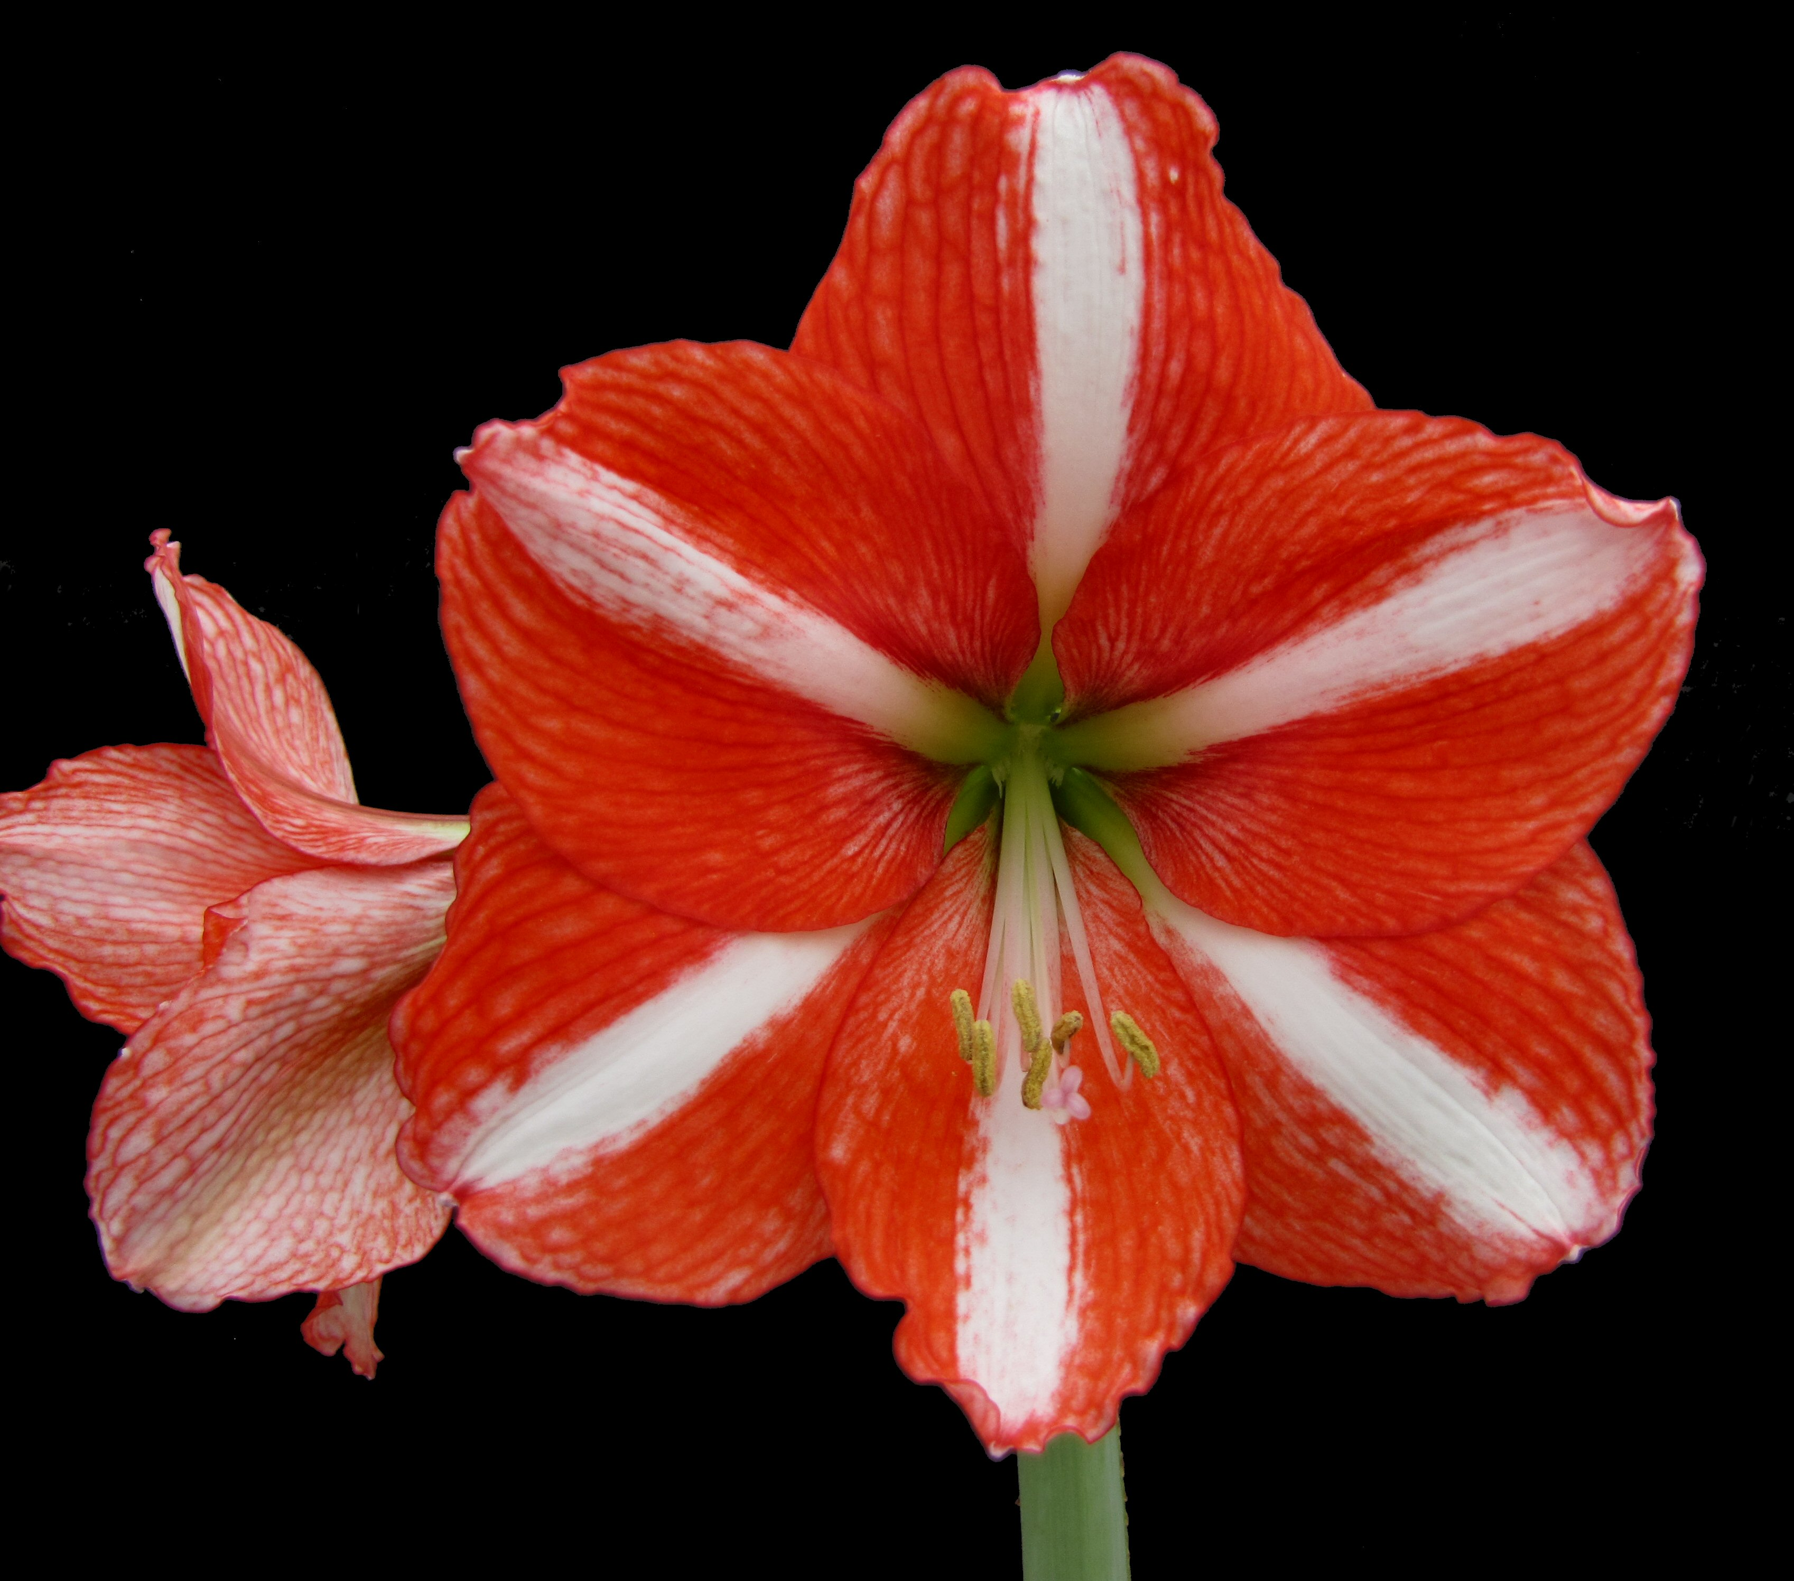
Hippeastrum x hybridum (amaryllis) ‘Miami’
Amaryllis ‘Miami’ is a new and distinct tetraploid (2n=44) Hippeastrum interspecific hybrid plant particularly characterized by its intense orange red color contrasted by a broad median white stripe on the tepals. The four flowers measure approximately 11-14 cm long, approximately 14-16 cm wide laterally, 16-17.5 cm wide dorsal-ventrally. The flowers are densely striated orange red (approximately RHS Orange Red 33A) on their inner surfaces, with a sharp white RHS 155C keel. The female parent is Hippeastrum 'Mount Blanc' x [(H. ambiguum x H. papilio) x H. 'Bouquet'] labeled with the breeder's code 609-04-1. The pollen parent is a proprietary selection of the cross [(Hippeastrum ambiguum x H. papilio) x H. brasilianum] x ' Wonderland' named 'Orlando‘ (US PP 25,940 P2). Over the course of seven years of evaluation, ‘Miami’ has shown excellent heat resistance grown under ambient conditions in Miami, Fla. under 50% shade, and resistance to Red Scorch fungus (Staganospora curtisii).
Protected through US PP 25,939 P2.
For licensing information contact: Joe Lipovsky, joe.lipovsky@ars.usda.gov.

Slide 6
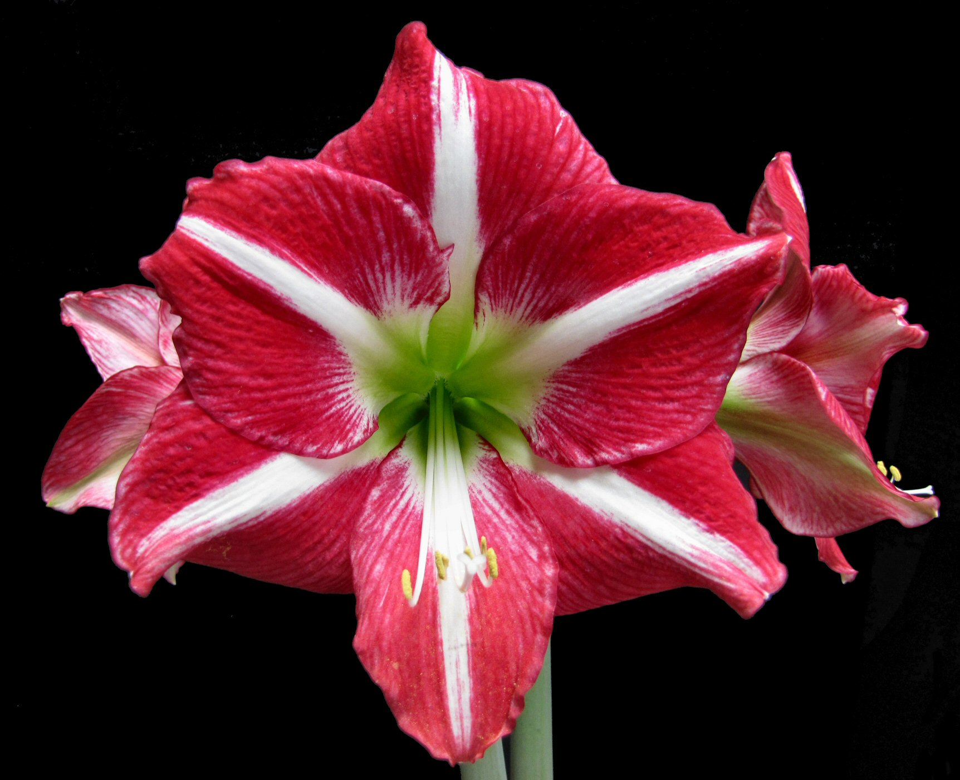
Hippeastrum x hybridum (amaryllis) ‘Orlando’
Amaryllis ‘Orlando’ is a new and distinct aneuploid (2n=43) Hippeastrum interspecific hybrid plant particularly characterized by its four large flowers per stem, measuring approximately 13-14.5 cm long, approximately 14-16 cm wide laterally, approximately 17-19 cm wide dorsal-ventrally. The flowers are densely striated cerise pink-purple (approximately RHS Red Purple 66A) on their upper surfaces, with a broad pure white RHS 155D keel. The female parent is a selection of the complex cross (Hippeastrum ambiguum x H. papilio) x H. brasilianum labeled with the breeder's code 101-5. The pollen parent is the non-patented commercial Hippeastrum 'Wonderland'. Over the course of seven years of evaluation, ‘Orlando’ has shown excellent heat resistance grown under ambient conditions in Miami, Fla. under 50% shade, and resistance to Red Scorch fungus (Staganospora curtisii).
Protected through US PP 25,940 P2.
For licensing information contact: Joe Lipovsky, joe.lipovsky@ars.usda.gov.

Slide 7
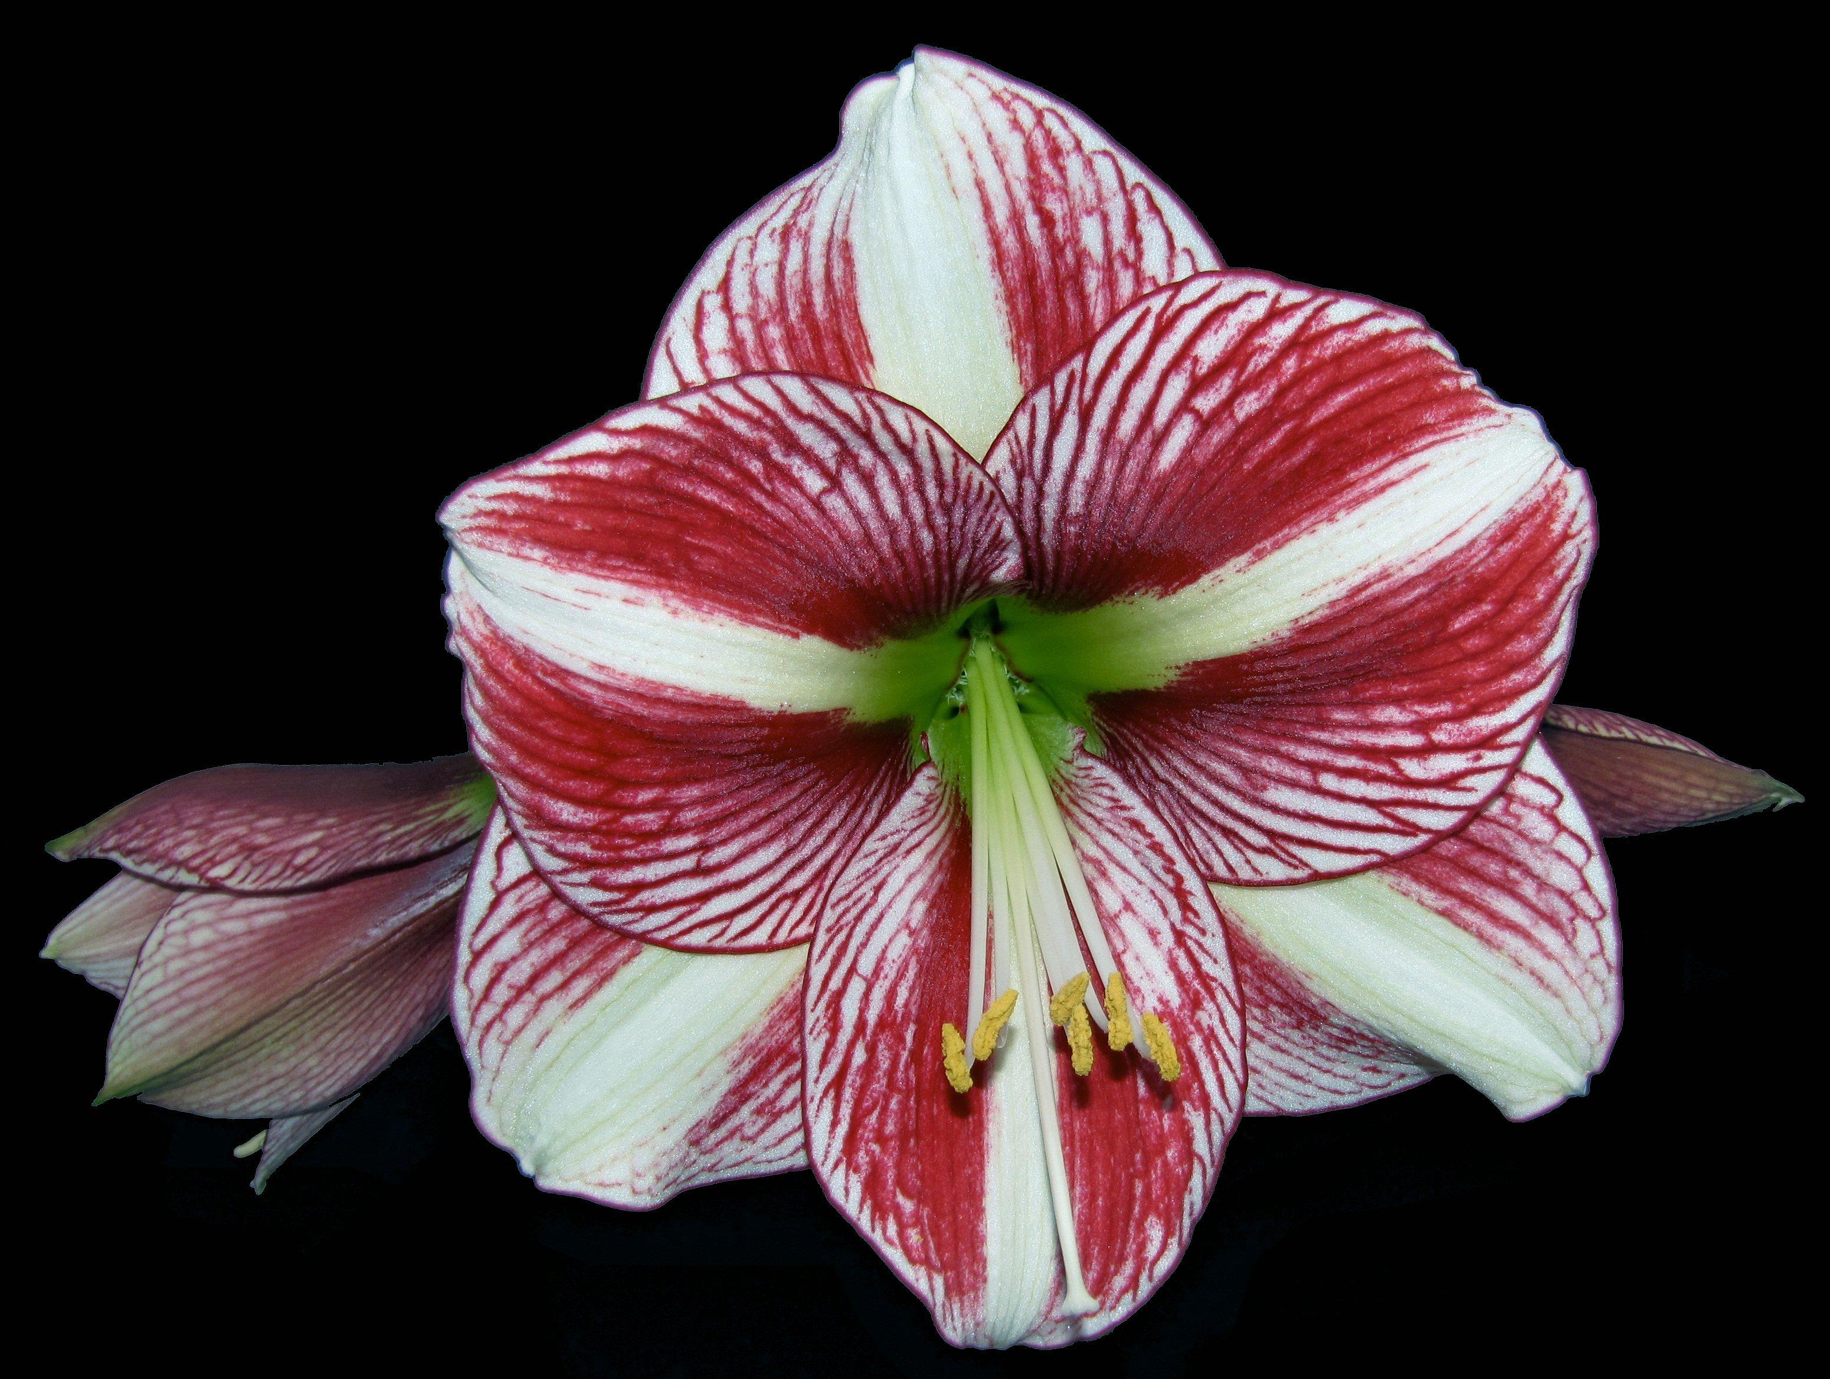
Hippeastrum x hybridum (amaryllis) ‘Tampa’
Amaryllis ‘Tampa’ is a new and distinct aneuploid (2n=43) Hippeastrum interspecific hybrid plant particularly characterized by 4-6 funnel-shaped flowers, measuring approximately 13-17 cm long, approximately 13-14 cm wide laterally, approximately 16-17 cm wide dorsal-ventrally. The flowers are densely striated purple (approximately RHS Red Purple 60A) on their inner surfaces, with a broad white RHS 155D keel. The female parent is Hippeastrum 'Mount Blanc' x [(H. ambiguum x H. papilio) x H. 'Bouquet'] labeled with the breeder's code 609-04-1. The pollen parent is a proprietary selection of the cross [(Hippeastrum ambiguum x H. papilio) x H. brasilianum] x 'Wonderland' named 'Orlando' (US PP 25,940 P2). Over the course of five years of evaluation, ‘Tampa’ has shown excellent heat resistance grown under ambient conditions in Miami, Fla. under 50% shade, and resistance to Red Scorch fungus (Staganospora curtisii).
Protected through US PP 25,787 P2.
For licensing information contact: Joe Lipovsky, joe.lipovsky@ars.usda.gov.

