Slide 1
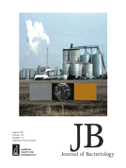
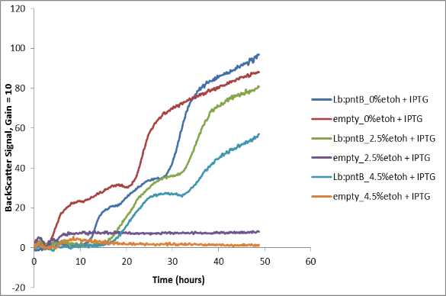
Increased Alcohol Tolerance Using the pntAB Gene
A strain of Lactobacillus buchneri was isolated from a commercial ethanol production plant. The strain was found tolerant to up to14% ethanol. Complete genome sequence of the strain and further comparison analyses with Oenococcus oeni genome led to the identification of the pntAB locus as the functional element in this tolerance. The pntAB genes also confer ethanol tolerance traits in other microbes as included in the invention.
Docket No: 195.16
Contact: Renee.Wagner@ars.usda.gov
Benefits
Robust alcohol tolerance genes can be introduced in other microbes to confer alcohol tolerance trait and increase survival in alcohol related stress environmental conditions
Could result in higher product concentrations and improve product recovery
Applications
Developing microbes with increased ethanol tolerance particularly in wine making and in industrial ethanol fermentation. Strains that tolerate higher alcohol concentrations can reduce production cost and increase production efficiency for industrial fermentation

Slide 2
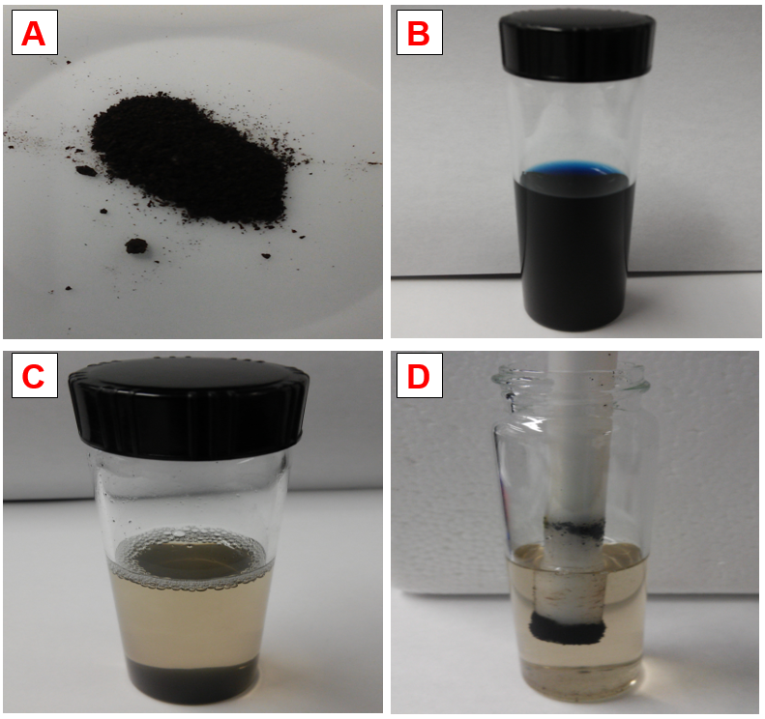
Hemoglobin/Iron Oxide Composite for the Removal of Organic Dye
A novel hemoglobin/iron oxide composite for the removal of organic dyes and other contaminants from wastewater. The composite has high removal efficiency for all the different classes of dyes studied. It possesses the extra advantage of being easily recovered after use using a magnet. The used composite can be regenerated and re-used many times.
Docket No: 177.16
Contact: Jim.Poulos@ars.usda.gov
Benefits
Easy synthesis
Re-usable
Minimization of agricultural waste
Low cost
Applications
Removal of dyes and other contaminants from industrial process water

Slide 3
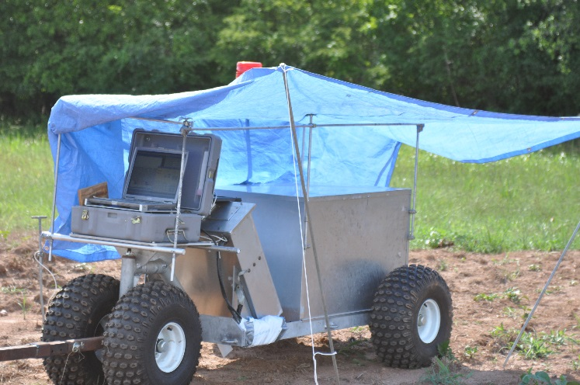
System for Non-invasive Measurement of Soil Chlorine
A device for making non-invasive measurements of chlorine elemental content in situ from the surface of the soil. The device is a portable field unit using a neutron generator positioned on the surface of the soil to generate fast neutrons that penetrate the soil. The device makes measurements in a large volume of soil and can determine the Cl content regardless of chemical component present. Results are generated immediately following scanning. The device can be utilized for the remediation of contaminated soil for contaminates such as polychlorinated biphenyl (PCB) and perchlorate.
Docket No: 112.15
Contact: Joe.Lipovsky@ars.usda.gov
Benefits
Non-invasive measurements of CI content in soil
Large volume soil sampling and immediate results
Detection of any Cl containing contaminate without specific laboratory analysis
Applications
This device can be used to detect Cl containing contaminates without the costly soil sampling, preparation, and laboratory analysis normally required. The large sample volume reduces uncertainty from site sampling and immediate results facilitates planning for soil remediation.

Slide 4
System for Non-invasive Measurement of Nitrogen
A device for making non-invasive measurements of nitrogen (N) elemental content in situ of N containing material. The device is a portable field unit using a neutron generator positioned near the material. The device makes measurements in a large volume and can determine the N content regardless of chemical components present. Results are generated immediately following scanning. The device can be utilized for measuring N in manures or compost or can be used for the detection of large N containing objects such as explosives.
Docket No: 112.15
Contact: Joe.Lipovsky@ars.usda.gov
Benefits
Non-invasive measurements of N content in material
Immediate results without sample preparation or laboratory analysis
Detection of any N containing material without specific laboratory analysis, such as for explosives
Applications
Can be used to measure N content in materials without the costly laboratory analysis. Immediate results allows for no lag time resulting in timely determination of compost processing and N content for fertilizer application. Also, can be used to detect explosives and to determine the likely explosive material type.

Slide 5
Novel Ferulate Esterase Isolated from Lactobaccillus Fermentum
Benefits
Potential for mass production of purified and highly active ferulate esterase
Applications
Ferulate esterase is a critical enzyme in hydrolyzing lignocellulosic biomass materials
Can be used in the production of ferulic acid which is used in foods and skin care products because of antioxidant properties
The enzyme can be used for biomass degradation in various applications including fuels, animal feed, textile/ laundry, pulp, and paper industries
The cDNA and amino acid sequences of a ferulate esterase obtained from Lactobacillus fermentum NRRL B-1932 is determined. An expression vector for expression of the ferulate esterase gene is generated. Recombinant bacteria producing ferulate esterases are generate. The recombinant ferulate esterase gene and transcribed protein contains a linker sequence and 6x HIS tag for purification. Enzymatic activity of the recombinant protein is determined.
(Energy, Environmental, Life Sciences)
Docket No: 165.12
Contact: Renee.Wagner@ars.usda.gov

Slide 6
A Novel Clostridium Species that Converts Wheat Straw and Switchgrass Hydrolysates into Butyric Acid
Benefits
Sustainable production of butyric from renewable feedstocks
Applications
Animal feed supplement to reduce pathogenic bacterial colonization
Food and perfume additives, varnishes, pharmaceuticals and disinfectants
Production of plasticizers, surfactants and textile auxiliaries
A methods for producing butyric acid comprising fermenting a lignocellulosic biomass hydrolysate using a newly isolated Clostridium sp. under anaerobic conditions using dilute acid-pretreated hydrolysates of wheat straw, corn fiber, corn stover, rice hull, and switchgrass, for example.
(Energy, Environmental)
Docket No: 133.13
Contact: Renee.Wagner@ars.usda.gov

Slide 7
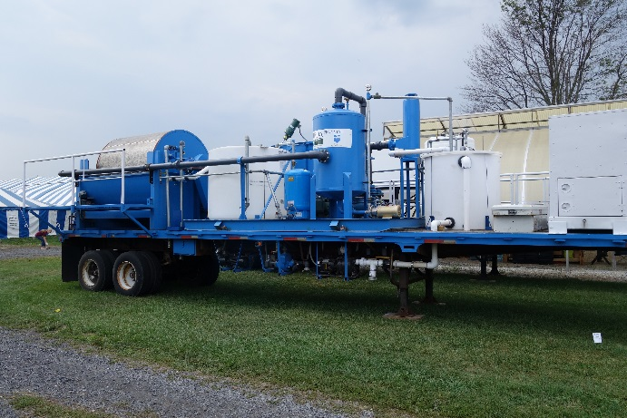
Processes and Treatment Systems for Treating High Phosphorus Containing Fluids
Benefits
Economical
The system can be compact and mobile
Applications
Efficiently remove livestock manure phosphorus from areas of excess to areas of shortfall
A process for treating manure slurries to concentrate manure particulate matter into solid form that is easily transportable. The process involves liquid-solid separation and chemical treatment where greater than 90% of the total phosphorous is concentrated into solid form while most of the nitrogen remains in the liquid.
(Environmental, Manufacturing)
Docket No: 45.14
Contact: Jim.Poulos@ars.usda.gov

Slide 8
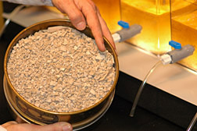
Compositions and Methods of Treating Animal Manure
Manure amendment and method for controlling ammonia emissions from poultry litter and reducing phosphorus runoff. The manure amendment is produced by adding various combinations/ratios of sulfuric acid, bauxite and water to alum mud, a waste product from manufacturing alum (aluminum phosphate).
(Environmental)
Docket No: 50.14
Contact: Joseph.Lipovsky@ars.usda.gov
Benefits
The manure amendment is economical to produce
Has many of the properties of aluminum sulfate
The exact formulation of the final product can be tailored to fit specific manure type
Applications
Controlling ammonia emissions from poultry houses and reducing phosphorus runoff
Treated manure lowers the concentration of ammonia in animal rearing facilities and improves environmental, health and/or animal performance

Slide 9
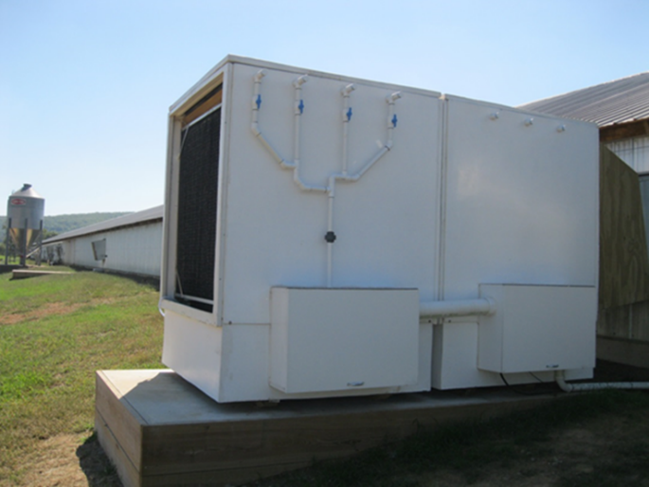
Nitrification Enhanced Ammonia Scrubber for Animal Rearing Facilities
Benefits
Nitrification-enhanced perpetual acid generator. The acid is used to scrub ammonia exhausted from animal rearing facilities
Resulting nitrogen-rich product solution can be used as fertilizer
Applications
Removal of ammonia and dust exhausted from animal rearing facilities, such as poultry and swine houses
Method and apparatus for controlling ammonia emissions from animal rearing facilities. The system is comprised of a dust scrubber in series with an ammonia scrubber which removes ammonia from the air. The ammonia is converted to nitrate by acid-tolerant nitrifying bacteria. The nitrification process produces acid, which reduces the pH of the scrubber solution in the ammonia scrubber, allowing the scrubber to capture additional ammonia.
(Environmental, Manufacturing)
Docket No: 102.09
Contact: Joseph.Lipovsky@ars.usda.gov

Slide 10
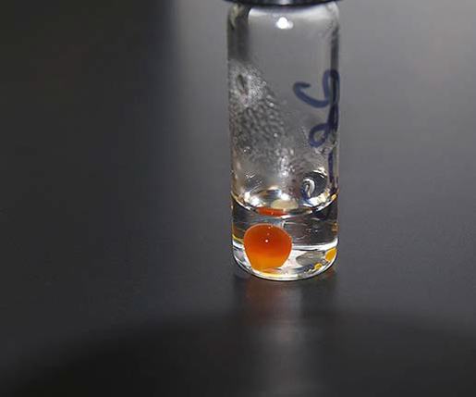
Heavy Metal Remediation Via Modified Bio-Oils
A process for the removal or extraction of metals, including heavy metals, precious metals and other metals, from a variety of solid, liquid or gas phase materials. Metal species are removed by contacting the material suspected of containing one or more metals with a fatty acid (or ester) for a period of time and under conditions effective for the sequestration of the metal species. The fatty acid or ester comprising of sequestered metal species is insoluble in water and may then be separated and recovered from the treated material.
(Environmental)
Docket No: 133.15 & 12.12
Contact: Renee.Wagner@ars.usda.gov
Benefits
Ability to conduct remediation in an environmentally friendly, bio-based manner
Simplicity of process to localized contaminations such as spills, offers a broader range of markets
Over 90% by weight of the metal species content, preferably 99% or more, can be removed from the material being treated
Applications
Removal of toxic metals from contaminated drinking water and other fresh water systems (such as lakes, ponds, estuaries, rivers and streams
Removal of toxic metals from waste discharge streams of agricultural, municipal sewage and from contaminated soil from agricultural
Removal of toxic metals from industrial or mining sites and from flue gases discharged from commercial or industrial sites

Slide 11
Automated Sampling System
A brief case sized field-portable chromatography instrument designed to test water samples. The automated sampling system floats in a body of water and continuously extracts and tests samples. The data gathered by the system is wirelessly transmitted to a shore-based date processing unit.
(Electronics & Hardware, Environmental)
Docket No: 49.15
Contact: Jim.Poulos@ars.usda.gov
Benefits
Collects real-time and accurate water quality data for long periods without maintenance or servicing
The instrument is portable, automated and not labor-intensive
Operates on solar or self-contained battery
The device can be submerged in water
Applications
Ion chromatograph to analyze dissolved anions or cations autonomously on site

Slide 12
Methods and Yeast Strains for Conversion of Lignocellulosic Biomass to Lipids and Carotenoids
The use of oleaginous yeast strains for producing lipids from pretreated lignocellulosic biomass. Additionally, some yeast simultaneously produces carotenoids, a value added co-product.
(Energy, Environmental, Materials)
Docket No: 166.13
Contact: Renee.Wagner@ars.usda.gov
Benefits
Lignocellulosic biomass is an attractive source of sugars for yeast lipid production because it is abundant, potentially low cost, and renewable
The lipid produced have fatty acid profiles similar to those of vegetable oils, making them attractive for production of biodiesels
Applications
Production of biodiesel and jet fuels from renewable biomass

Slide 13
Novel Yeast Strains
Using directed evolution, several strains of Scheffersomyces stipitis are generated that better utilize xylose and glucose for improved ethanol production. These improved strains are obtained by culturing the yeast on hydrolyzates of differing concentrations of xylose, ethanol, and by-products.
(Manufacturing, Energy)
Docket No: 183.11 & 54.16
Contact: Renee.Wagner@ars.usda.gov
Benefits
This is a native xylose-fermenting yeast that has not been genetically modified
Yeast strains are evolved and selected to be tolerant of diverse nutrient environments and inhibitory hydrolyzates of lignocellulosic biomass
Strains ferment both glucose and xylose in enzyme hydrolyzates produced from 20% solids loading acid or base pretreatments
Applications
These strains could be used to ferment both hexose and pentose sugars to produce ethanol from the lignocellulosic corn hull fiber generated in corn to ethanol plants or from corn stover
The strains can also be used to produce ethanol from base- or acid-pretreated switchgrass and other forms of herbaceous lignocellulosic biomass
Stains can also be used to produce ethanol from base or acid-pretreated woody biomass residues

Slide 14
Synthetic Promoter for Xylose-Regulated Gene Expression in Saccharomyces Yeasts
Benefits
These synthetic promoters will allow tunable control of gene expression for engineering Saccharomyces yeasts for efficient xylose fermentation
Applications
Lignocellulose-based processing where it is desirable to use a S. cerevisiae strain for ethanol, advanced biofuels or renewable chemicals production
Synthetic promoters for use in Saccharomyces yeast to control gene expression in response to the presence of xylose. Upon xylose availability, the prokaryotic DNA binding protein is released from the synthetic promoter, allowing gene expression.
(Manufacturing, Energy, Materials)
Docket No: 283.12
Contact: Renee.Wagner@ars.usda.gov

