Slide 1
DEEPER ROOTING 1 Gene
The shape of a plant’s root system impacts the resources it can access. The DEEPER ROOTING 1 (DRO1) gene assists in modulating the angle at which the roots grow. Knot-out mutations in the DRO1 gene lead to horizontal root growth, while plants that over-expressed DRO1 have more downward root growth.
Docket No: 106.15
Contact: Jim.Poulos@ars.usda.gov
Benefits
More downward root growth may lead to increased access to water at deeper soil layers
Potential for improving plant stability in soil
Applications
Trees and other plants with altered root system shape to better access soil resources such as water and nutrients, as well as potentially improved anchorage.

Slide 2
Xenorhabdus szentirmaii Metabolites, Trans-Cinnamic Acid, and Analogs as Enhancers of Fungicidal Activity
Untreated
Control
Synergistic
Suppression
By-products derived from a naturally occurring symbiotic bacterium (Xenorhabdus szentirmaii) and trans-Cinnamic acid (TCA, another natural compound) can suppress various fungal diseases that attack plants. When these the bacterial by-products or TCA are added to certain commercially available fungicides the combinations cause synergistic levels of suppression.
Docket No: 7.16
Contact: Joseph.Lipovsky@ars.usda.gov
Benefits
Provides broad suppression against diverse fungi including important plant pathogen genera such as Venturia, Monilinia, Glomerella and Rhizoctonia and may also be effective against Alternaria and Phytophthora
Could result in enhanced control of fungal diseases and a reduction in the use of fungicides in agriculture
Compatibility with low-impact or organic fungicides will lead to improved environmental sustainability
Applications
Safe and efficacious methodology to combat various plant diseases that affect diverse cropping systems

Slide 3
Chromobacterium phragmitis for Insect Control
Chromobacterium phragmitis is a newly discovered species of bacteria that has insecticidal activity against immature stages of both fly and moth pests. These bacteria are not insect pathogens, but produce compounds in culture that are toxic to the insects. This means that it is not necessary to maintain the viability of the bacteria in a product, and that the toxic compounds can be concentrated in post-fermentation processing.
Docket No: 109.15
Contact: Jim.Poulos@ars.usda.gov
Benefits
Cultures of C. phragmitis are more toxic to moth species than C. subtsugae
An alternative to Bacillus thuringiensis with a broader activity spectrum
Applications
Cultured C. phragmitis can be used as an organic insecticide with activity against lepidopteran and dipteran insect pests such as cabbage looper, diamondback moth, and seedcorn maggot

Slide 4
Chromobacterium Species with Insecticidal Activity
A novel species of Chromobacterium that selectively kills lepidopteran insect larvae (such as, gypsy moth, diamondback moth, tobacco hornworm larvae, and cabbage looper larvae). Compositions containing Chromobacterium spagni sp. strains and the use of these compositions to kill insect larvae are covered by the U.S. and PCT patent applications. These compositions kill the indicated larvae at least as well as or better than some C. subtsugae biocontrol agents.
Docket No: 33.15
Contact: Jim.Poulos@ars.usda.gov
Benefits
Biocontrol agent
Some species of lepidoptera have become resistant to currently used pesticides. Thus a need exists for new biocontrol agents
Applications
This invention covers an insecticidal bacterium that can be used to kill lepidopteran insect larvae without harming non-target insect larvae

Slide 5
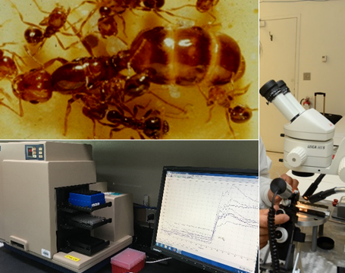
Bioactive Peptides Having Insecticide Activity
Novel bioactive peptides were discovered using a receptor screening process. The peptides are structurally very different from the natural ligand(s) for this receptor. Injection of the novel peptides into fire ants (our model system) resulted in mortality. Interestingly, several peptides displayed similar mortality effects when fed to ants in a sucrose solution, thus, a bait-station system could be used as a novel control method to add to the fire ant integrated management tool box. Fire ants are an annual 6 billion dollar problem in the U.S. The screening method can be applied to a wide variety of receptors and insect pests, providing versatility and likely target specificity.
(Life Sciences, Medical-Health)
Docket No: 244.12 + 135.17
Contact: Joseph.Lipovsky@ars.usda.gov
Benefits
The novel peptide ligands show mortality effects when fed to fire ants – a bait formulations and fire ant control.
Peptide selection method is readily adapted to other target receptors and insect pests.
The control method is targeted rather than general.
The peptides are expected to be an environmentally-friendly pest management tool.
Applications
Bioactive peptides discovered can be used directly and/or formulated to control the fire ant and other insect pests.
The technology for fire ant model, but the invention can be applied to any insect pest species.

Slide 6
Novel Nylanderia Fulva Virus
At least one novel virus capable of infecting crazy ants (Nylanderia fulva), along with polynucleotide sequences and amino acid sequences of the virus. The virus is capable of be used as a biopesticide to control populations of crazy ants.
(Life Sciences, Medical-Health)
Docket No: 36.14 & 47.16
Contact: Joseph.Lipovsky@ars.usda.gov
Benefits
This Nylanderia fulva virus is the first virus to be discovered from the invasive ant species N. fulva
Applications
Potentially the virus could be utilized as a biopesticide or biological control agent to eliminate or at least reduce the spread of Nylanderia fulva and their colonies
The virus could serve as a gene delivery system to study functional genomics in the ant

Slide 7
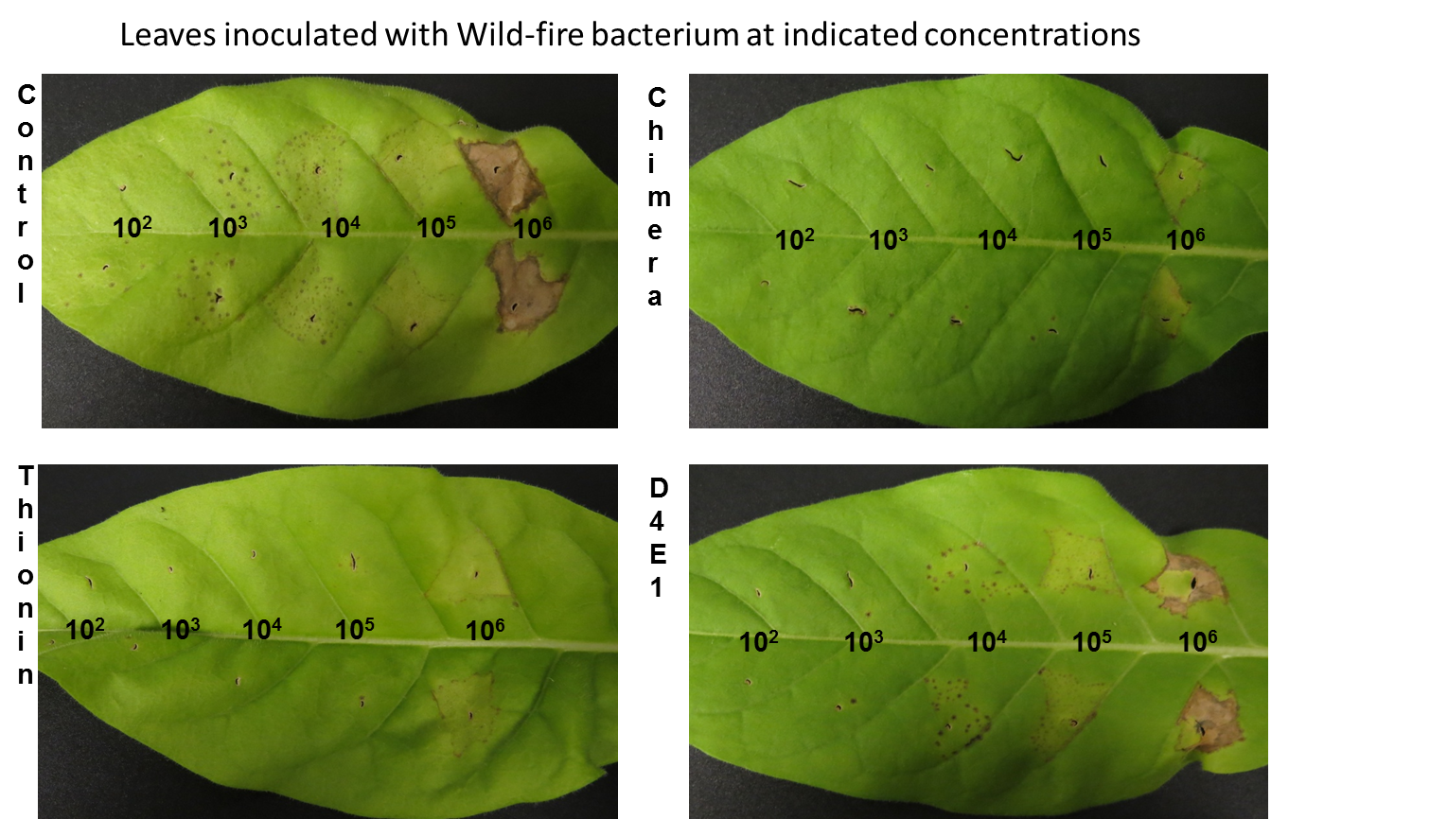
Antibacterial Peptides to Control Plant Diseases
Novel, antibacterial peptides have been designed that include both recognition and cleavage sequences, with high affinity for plant gram-negative bacterial pathogens, and more specifically, Xanthomonas citri spp. citri and Candidatus Liberibacter asiaticus. Genetically altered plants producing these peptides show remarkable resistance against citrus canker and HLB. U.S. Patent No. 9,725,734.
Docket No: 23.15 + 124.17
Contact: Joseph.Lipovsky@ars.usda.gov
Benefits
Provides broad protection against Xanthomonas citri spp. citri and Candidatus Liberibacter asiaticus
Applications
Prevent and reduce spread of citrus canker and HLB diseases

Slide 8
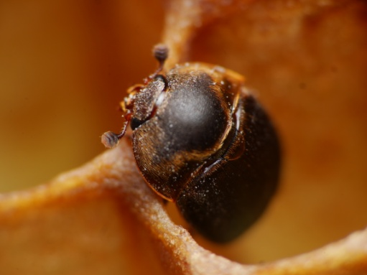
Small Hive Beetle Aggregation Pheromone
ARS has discovered and subsequently isolated and synthesized the small hive beetle aggregation pheromone. This pheromone serves as an effective attractant for adult beetles of both sexes. The pheromone may be placed within a trapping device for capturing adult small hive beetles.
Docket No: 11.16
Contact: Joe.Lipovsky@ars.usda.gov
Benefits
Efficient pheromone-based trapping systems are the key to population reduction
This system is cost effective and provides the necessary control measures for management or eradication of the small hive beetle
Applications
The trapping system can be employed within an apiary for monitoring and control of the small hive beetle.
This technology will help give control of this invasive species that is effecting honey bee survival throughout the United States

Slide 9
Methods of Attracting Drosophila Suzukii
A Method of attracting Drosophila suzukii, involving treating an object or area with a chemical attractant composition based on apple juice volatiles.
Docket No: 58.16
Contact: Jim.Poulos@ars.usda.gov
Benefits
The compound is a synthetic natural attractant based on fruits
The method provides a means of early detection and population monitoring of Drosophila suzukii on farms for quick management measures
Applications
Infestation detection and monitoring
Could potentially enable future development of mass trapping and mating disruption technologies for managing this pest

Slide 10
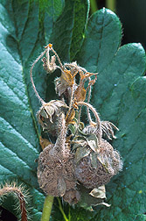
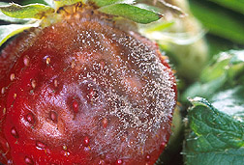
Method for Controlling Fungal Plant Pathogens Using a Combination of UV Radiation Followed by Antagonist Application and Dark Period
Strawberries are available throughout the year either from production in the field or from high and low tunnel culture. Diversity of production conditions results in new challenges in controlling diseases before and after harvest. ARS found that UV-C irradiation followed by a dark period kills two major pathogens of strawberry, Botrytis cinerea and Colletotrichum acutatum. The UV-C irradiation and dark period is followed by repopulation with beneficial biocontrol microorganisms. A mobile treatment apparatus was designed to provide the appropriately timed UV-C doses, dark period, and sprayable doses of biocontrol microorganisms.
Docket No: 119.17
Contact: Jim.Poulos@ars.usda.gov
Benefits
The UV-C dose and repeated exposure does not affect pollen germination or cause chlorophyll degradation in strawberry leaves.
Fruit can be harvested on a daily basis unlike when using fungicides
Minimizes the use of herbicides and fungicides
Applications
To kill strawberry pathogens in high tunnel and open field production
Provides opportunities to optimize the effectiveness of biocontrol agents

Slide 11
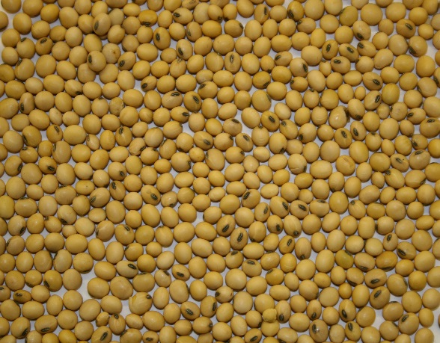
High Oleic Acid Soybean Seeds
A soybean plant containing chemically-induced mutations which cause the plant to produce more oleic acid in its seeds than a wild-type soybean plant produces. The mutations occur in the genes for delta-twelve fatty acid desaturase 2-1B enzyme (FAD2-1B) and delta-twelve fatty acid desaturase 2-1A enzyme (FAD2-1A).
(Life Sciences, Manufacturing)
Docket No: 31.15
Contact: Renee.Wagner@ars.usda.gov
Benefits
Improves seed oil composition for downstream industrial and food uses of soybean oil
Applications
The alleles could be used in combination with other alleles to generate new non-transgenic germplasm with high levels of oleic acid for the edible oil market

Slide 12
Double Stranded RNA Constructs for Aphid Control
Detailed are novel double stranded RNA constructs that target either Chloride Intracellular Channel (CLIC) or Sucrase gene expression in Aphids. The use of these constructs have shown increased mortality in aphid species, including but not limited to Diuraphisnoxia, Myzuspersicae, and Schizaphisgraminum. Also detailed are novel methods for pest management.
(Environmental, Life Sciences)
Docket Nos: 177.12 and 41.17
Contact: Jeffrey.Walenta@ars.usda.gov
Benefits
Reduce the use of noxious chemical pesticides
Broad application, effective against a range of aphid species
Not harmful to beneficial insect species.
Increased crop yields
Applications
The dsRNA construct can be used in conjunction with traditional baits in traps, applied topically to crops via a solution, or delivered to the target aphid population via a plant mediated delivery in a transgenic plant resistant to range of aphid species

Slide 13
Pseudomonas Species for Weed Suppression and Annual Grass Weed Management
Pseudomonas fluorescens strain ACK55 is a naturally occurring soil bacterium that selectively inhibits the root development of cheatgrass, medusahead, and jointed goatgrass. This biologically based herbicide reduces these annual grass weeds, over time, in cropland, turf, rangeland, and roadsides. Methods are provided for the isolation and use of weed-suppressive P. fluorescens. ARS is pursing regulatory approval for use of strain ACK55.
(Environmental, Life Sciences)
Docket No. 36.17
Contact: David.Nicholson@ars.usda.gov
Wyoming land treated with
P. fluorescens strain ACK55 three years prior to taking this picture.
Benefits
These bacteria are a cost-effective and long-term control method alternative to herbicides.
Use can lead to reduction in wildfires, as well as, improved cropland yields and rangeland forage potential.
Applications
The bacteria can be used to coat seeds or added directly to soil. These strains provide species specific control of invasive grasses and do not cause major change to the soil microbial community.

Slide 14
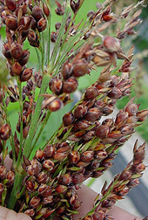
Novel Cytochrome P450 Enzymes from Sorghum Bicolor
Two novel cytochrome P450 genes isolated from sorghum, each gene encoding a protein having pentadecatrienyl resorcinol hydroxylase activity. Expression vectors containing these sequences are made and used to elevate levels of pentadecatrienyl resorcinol hydroxylase in transgenic cells and organisms. Divisional patent application. Parent U.S. patent No. is 9,284,537.
(Life Sciences)
Docket No: 41.16
Contact: Joseph.Lipovsky@ars.usda.gov
Benefits
Modification and expression of the sorghum cytochrome P450 enzymes in plant cells could increase sorgoleone levels, or alternatively, introduce its biosynthesis into species lacking the endogenous sorgoleone biosynthetic enzymes
Applications
Potential use for engineering the production of sorgoleone and related phenolic lipids in crops for enhanced resistance to disease and for the ability to resist weed infestations

Slide 15
Functional Analysis of Lazy1 in Arabidopsis Thaliana and Prunus Trees
A gene called LAZY1 characterized in Prunus trees that can be manipulated to influence branch angles and thus, overall tree architecture. Reduction of LAZY1 gene expression in Prunus species leads to wider branch angles, while increased gene expression leads to narrower and more upright tree growth. Our results establish that manipulation of the gene function results in changes in tree shape and can be used to engineer fruit or ornamental trees with desired branch angles.
(Life Sciences)
Docket No: 168.13
Contact: Jim.Poulos@ars.usda.gov
Benefits
Architectural improvements could lead to high density production, reduce manual labor costs, and reduce the volume of chemical inputs needed
Easier management could translate to cost savings for growers and consumers
Applications
Prunus tree industry including peach, plum, almond, apricot and cherry
Environmental benefit given that less agricultural land and chemical inputs are needed

Slide 16
Pseudomonas Species Having Weed-Supressive Activity and Benign Soil Survival Traits for Annual Grass Weed Management
Weed-suppressive Pseudomonas fluorescens bacterial strains effective for controlling one or more invasive grass weeds such as downy brome (cheatgrass, Bromus tectorum L.), medusahead (Taeniatherum caput medusae (L.) Nevski) and jointed goatgrass (Aegilops cylindrica L.).
(Environmental, Life Sciences)
Docket No: 140.13
Contact: David Nicholson@ars.usda.gov
Benefits
System is designed to reduce berry bruising in machine-harvested fruit
The system could be incorporated into existing commercial over-the-row harvesters and platform-based harvest-aid systems
As a biocontrol for a specific weed to help increase wheat yields, restore rangeland and help in the fight to reduce wildfires
Applications
Cheatgrass, medusahead, jointed goatgrass reduction in cropland and rangeland
Suppresses the growth of a grass weed allowing wheat and natives plants to grow

Slide 17
Novel PPETAC1 Gene and Method to Manipulate Tree Architecture
A gene (PpeTAC1) identified from peach can be manipulated to influence branching angle and thus, overall tree architecture. Silencing or overexpressing the gene controls the branch angles (either upright or spreading).
(Life Sciences)
Docket No: 180.11
Contact: Jim.Poulos@ars.usda.gov
Benefits
Increased planting density
Improved plant water use efficiency
Reduced chemical sprays
Applications
Development of plant or tree varieties with erect growth habit for agriculture or ornamental uses

Slide 18
The Effect of PPEGID1A on Vegetative Growth of Fruit Trees
Benefits
Developing crop trees with different degrees of dwarfing could lead to high density production, reduce manual labor costs, and reduce the volume of chemical inputs needed
Environmental benefit given that less agricultural land and chemical inputs are needed
Applications
Prunus tree industry
Ornamental tree industry
A novel gene for a recessive dwarf trait in peach and its role in controlling tree size. Silencing the gene results in Prunus trees having a dwarf appearance while still retaining normal flower and fruit development. The degree of silencing corresponds to the degree of overall tree size.
(Life Sciences)
Docket No: 169.13
Contact: Jim.Poulos@ars.usda.gov

Slide 19

Sorghum Derived Transcription Regulatory Elements Predominantly Active in Root Hair Cells
Transcription regulatory elements, namely promoter and terminator sequences, obtained from Sorghum bicolor that drive RNA transcription predominately in root hair cells, as well as cassettes, expression vectors, and genetically modified plants containing these transcription regulatory elements. The genetically modified plants can be gymnosperms, dicots, or monocots. Methods of directing transcription of a heterologous polynucleotide under control of these transcription regulatory elements in a genetically modified plant’s root hair cells are also provided.
(Life Sciences)
Docket No: 183.07
Contact: Joseph.Lipovsky@ars.usda.gov
Benefits
The transcription regulatory elements selectively direct gene expression in root hair cells of a plant
Applications
Overexpress transporters in root hairs to increase a plant's ability to extract nutrients from the soil or alternatively as a means of removing soil contaminants
Highly express secretory signal proteins in root hairs which would then be secreted into soil for collection
Use of root hair promoters to express gene products capable of synthesizing pesticidal compounds, which when secreted in soil would reduce the need for synthetic pesticide treatments

Slide 20
Potato Fertility Restoration
Transgenic Bintje potato plants have been developed that restore fertility and seed ball formation in sterile potato plants. The gene used in transgenic development is a family 1 cellulose-binding-domain encoding gene from Phytophthora infestans. Bintje control plants are male and female sterile while the transgenic plants are male sterile and female fertile thus enabling crosses to be made into transgenic Bintje to obtain Bintje potatoes with favorable traits. The P. infestan RB gene for resistance to late blight, and genes responsible for color and tuber shape have been transferred into Bintje germplasm. Selection for the absence of the CBD1 transgene provides null-segregants that are considered non-transgenic, i.e., a non-transgenic potato having the desirable trait of resistance to late blight for example.
(Life Sciences)
Docket No: 162.13
Contact: Jim.Poulos@ars.usda.gov
Benefits
Use of the CBD1 gene in transgenic Bintje will allow for the introduction of new traits into previously infertile cultivar
Applications
The cultivar Bintje is one of the most widely used potatoes in Europe. Bintje has the advantage of having outstanding flavor, but some disadvantages are that it lacks disease resistance and the tubers are short and unsuitable for use commercially in the U.S., for example, where longer French fires are sold by fast food franchises. Thus, the possibility now exists for non-transgenic potatoes resulting from crosses with the transgenic Bintje potato to have the desirable traits of disease resistance and longer length while still maintaining the outstanding flavor of Bintje

Slide 21
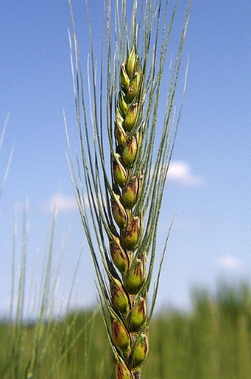
A Transgene Construct to Improve Fusarium Head Blight Resistance in Wheat and Barley
A gene encoding a wheat ethylene-responsive transcription factor was cloned into a plant gene expression vector. This vector when transformed into wheat and barley results in increased resistance to Fusarium head blight and other Fusarium-related diseases. The fungus responsible for this disease produces a mycotoxin that poses a significant threat to the human and animal health.
(Life Sciences)
Docket No: 168.11
Contact: Renee.Wagner@ars.usda.gov
Benefits
To date, no sources of wheat completely resistance to this disease have been found; therefore, fungicides are required for control. The problem is that the currently available registered fungicides only provide partial control (50-60%). Transgenic plants expressing this gene have significant resistance to this disease.
Applications
Fusarium head blight disease results in close to $500 million in damage to the US wheat and barley crop. Transgenic plants expressing this gene results in significant resistance to this disease.

Slide 22
Barley Mutant Lines Having Grain with Ultra-High Beta Glucan Content
Benefits
A lower starch, but not empty endosperm line like other high beta-glucan lines
Could provide high beta-glucan flour that is used in various food products
Plants have normal looking morphology
Applications
Use as an critical parental line to significantly boost beta-glucan content in food barley cultivars
Use as parental line to significantly boost total dietary fiber in food barley development
Directly use it as dietary fiber extraction source
A barley plant having grain with ultra-high beta-glucan content and total fiber.
(Life Sciences, Medical-Health)
Docket No: 53.12
Contact: David.Nicholson@ars.usda.gov

Slide 23
Boron Complexes with Gradual 1-Methylcyclopropene Releasing Capability
Benefits
Quantitative and sensitive test
Results obtained in 3 - 6 hours instead of days or weeks
Controlled delivery of 1-MCP, selective application, cost effective multi-batch treatment option
Potential to be used in open fields to increase crop yields
Applications
Treatment of perishable agricultural commodities such as fruits, flowers and vegetables, to retard ripening and thus prolong shelf-life by blocking the activities of ethylene
Boron derivatives that are stable at ambient conditions and capable of releasing 1-methyl cyclopropene (1-MCP) gradually when in contact with water.
(Life Sciences)
Docket No: 47.14
Contact: Jim.Poulos@ars.usda.gov

Slide 24
Methods For Treating Plants or Fruits
Methods for treating plants or fruits that involves a solid material that stores natural gaseous plant hormones and then releases them at levels between a required ripening concentration and safety allowance.
(Life Sciences)
Docket No: 37.15
Contact: Jim.Poulos@ars.usda.gov
Benefits
Quantitative and sensitive test
Results obtained in 3 - 6 hours instead of days or weeks
Could potentially reduce post-harvest losses of fruits in supply chain
Accelerates the ripening of climacteric fruits
Solid material is easy to transport and can be applied to individual packages and produce containers such as shipping boxes, paper bags and plastic bags
Applications
Could be used by supermarkets and consumers to ripen fruits when desired
Ripening fruits at distribution facilities immediately prior to shipping to local grocery stores.

Slide 25
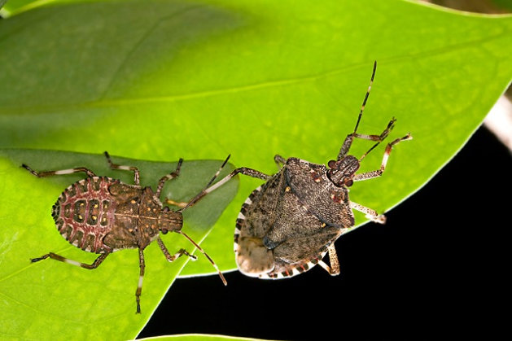
Insecticidal Strain of Serratia for Control of Insects Such as Brown Marmorated Stink Bug (BMSB) Halyomorpha Halys
Benefits
This bacteria strain was isolated in Maryland so they are native pathogens. In addition, the bacteria strain can be grown on standard laboratory media
Applications
This bacteria strain may be able to be used in a bait to control brown marmorated stink bugs
A strain of the Serratia bacteria that has insecticidal properties was identified. This strain can be used be as a novel biocontrol agent and strategy for controlling brown marmorated stink bugs.
(Environmental, Life Sciences)
Docket No: 92.14
Contact: Jim.Poulos@ars.usda.gov

Slide 26
Pseudomonas Fluorescens 2-79 with Genes for Biosynthesis of Pyrrolnitrin Improves Biocontrol Activity
Benefits
There is no resistance in wheat or barley to Rhizoctonia, no fungicides are available, and all crops grow in rotation with wheat and barley are susceptible to Rhizoctonia
Applications
Could be used as a seed treatment to enhance biocontrol activity against Rhizoctonia root rot of wheat
Rhizoctonia solani AG-8 is a disease of direct-seeded wheat and a barrier to wider adoption of conservation tillage, which is needed to control soil erosion
Pseudomonas fluorescens 2-79 bacterial strains with pyrrolnitrin biosynthetic genes have enhanced biocontrol activity against the soil-borne pathogen Rhizoctonia.
(Environmental, Life Sciences)
Docket No: 128.11
Contact: David.Nicholson@ars.usda.gov

Slide 27
Pseudomonas Fluorescens Inhibit Annual Bluegrass and Rough Bluegrass Root Growth and Germination
Benefits
The biocontrol agent does not inhibit the growth of desired grasses, such as turfgrasses, cereal crops and native plants
May be applied to the soil and/or seeds in the fall with inhibition occurring in subsequent years
Can also be used in combination with herbicides and/or fertilizer
Applications
Inhibits the growth of annual bluegrass and/or rough bluegrass when they are most actively growing and out-competing desired plants (e.g., turfgrass, crops, and native plants)
A biocontrol agent effective for controlling annual bluegrass and rough bluegrass root growth and seed germination comprising of one or more Pseudomonas fluorescens strains. Also provided are methods for use of these biocontrol agents to control the growth of annual bluegrass and rough bluegrass.
(Environmental, Life Sciences)
Docket No: 129.11
Contact: David.Nicholson@ars.usda.gov

Slide 28
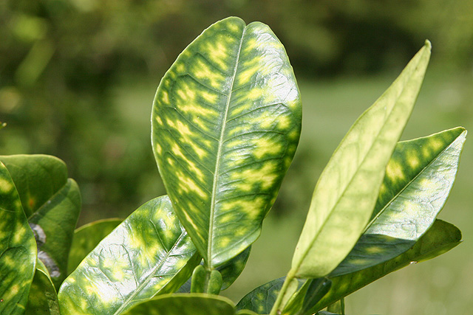
Thionin-D4E1 Chimeric Protein Protects Plants Against Bacterial Infections
Benefits
The chimeric peptides are effective at killing a wide range of gram-negative plant-pathogenic bacteria
Applications
Use of the chimeral peptides through transgenesis may provide immunity to critical citrus diseases
Creation of HLB-immune rootstocks, sweet orange and grapefruit
A chimeric protein containing thionin and D4E1 and genetically altered citrus plants that express the chimeric protein are made. The chimeric protein has the ability to protect citrus plants from citrus greening (Huanglongbing, (HLB)) and citrus canker. When exposed to disease causing bacteria, genetically altered plants expressing/producing the chimeric protein exhibit no symptoms or much reduced symptoms of the diseases.
(Life Sciences)
Docket No: 23.15
Contact: Joseph.Lipovsky@ars.usda.gov

Slide 29
Compositions and Methods for Control of Hemipteran Insect Stylet Sheath Structure Formation
Benefits
Compounds can be applied onto plants by spraying, dripping and/or applied to the soil for uptake by the roots
Many of the compounds are recognized as generally regarded as safe (GRAS)
Applications
These compounds and methods prevent and/or reduce the transmission of vascular associated diseases (caused by hemipteran vector-borne pathogens) to plants
Many hemipteran insects form a stylet sheath each time they pierce and penetrate plant tissue on which they feed. Compounds that inhibit stylet sheath formation or degraded/destabilize stylet sheaths are described, as well as methods of using those compounds. These methods and compounds deter or block hemipteran insects from feeding on plants, especially agriculturally important plants and thus can prevent or reduce transmission of micro-organisms that use the insects as a carrier-host. PCT Application No.: PCT/US16/27824.
(Environmental, Life Sciences)
Docket No: 282.12
Contact: Joseph.Lipovsky@ars.usda.gov

Slide 30
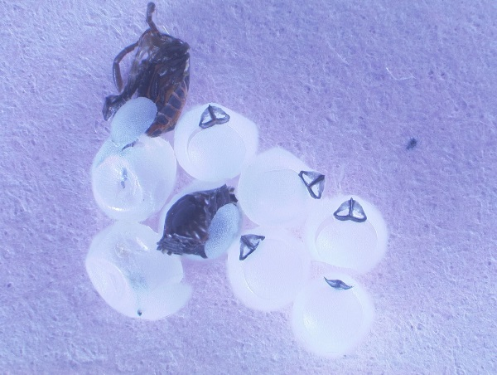
Methods for Killing Insects Using Methyl Benzoate
A method for killing insects involving treating an object or area with an insect killing effective amount of a composition from fermented apple juice and optionally a carrier.
(Environmental, Life Sciences)
Docket No: 53.15
Contact: Jim.Poulos@ars.usda.gov
Benefits
Environmental-friendly green pesticide as an alternative to synthetic pesticides
Applications
Botanical pesticide for controlling spotted wing drosophila, Drosophila suzukii and other pest species including brown marmorated stinkbug Halyomorpha halys, diamondback moth Plutella xylostellaand tobacco hornworm Manduca sext

Slide 31
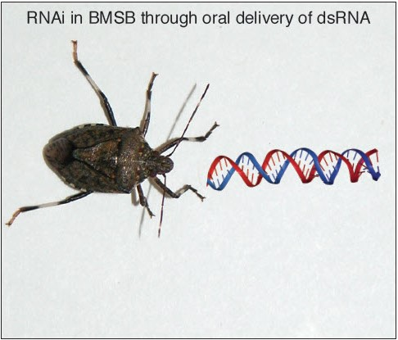
Double Strand RNA Delivery System for Plant-Sap-Feeding Insects
Benefits
RNAi through oral delivery may be beneficial due to the ease in delivery to large number of insects and the delivery system bypasses the need to create transgenic plants
Applications
Control sap-feeding insects such as brown marmorated sink bugs
Compositions and methods of delivering double strand ribonucleic acid (dsRNA) to insects that penetrate plant tissues to feed on sap and other liquid components of plants. Taking advantage of the liquid transport capabilities of plant vascular structures, dsRNA is provided to plant tissues in an aqueous solution that is then transported throughout the tissues. The dsRNA-laden plant material is then presented to sap-feeding insects, such as brown marmorated stink bugs that can ingest the dsRNA by feeding on the plant tissue.
(Environmental, Life Sciences)
Docket No: 129.16
Contact: Jim.Poulos@ars.usda.gov

Slide 32
Transplanter for a Walk-Behind Tractor
The transplanter is a self-propelled walk-behind tractor for no-till and/or organic vegetable small scale market farms and gardens. The transplanter is designed to help small farmers transplant vegetables and other seedling vegetables and to ensure good root system-to-soil contact.
(Environmental, Electronics & Hardware)
Docket No: 187.16
Contact: Joseph.Lipovsky@ars.usda.gov
Benefits
Adapted to small scale tractors
The transplanter is operated by one person who simultaneously operates the transplanter and drives the walk-behind tractor
Auxiliary racks of transplant vegetables can be attached to the tractor to enable the operator to reload the transplanter and thereby continuously transplant multiple plants
The transplanter can be configured to plant more than one row simultaneously
A no till system that mechanically transplants vegetables into cover crop residue
Applications
A walk-behind tractor to help small farmers transplant seedling vegetables

Slide 33
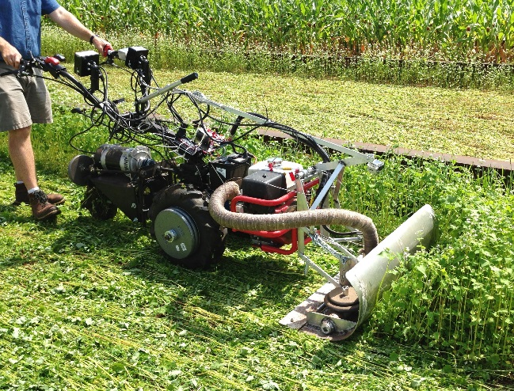
System and Method for Terminating Cover Crops Using Vehicle-Generated Heat
Benefits
Effectively managing cover crops without using synthetic herbicides
Applications
A means to terminate cover crops that is directed to smaller scale organic farming operations
A system and method that uses vehicle-generated heat (which is currently wasted) to terminate cover crops. The cover crop termination system can be mounted on the front of a walk-behind tractor. As the tractor is propelled across a field of cover crops, heat from the vehicle’s exhaust is directed to a perforated manifold positioned adjacent to the cover crop so that the exhaust heat terminates the cover crop.
(Environmental, Electronics & Hardware)
Docket No: 197.13
Contact: Joseph.Lipovsky@ars.usda.gov

Slide 34
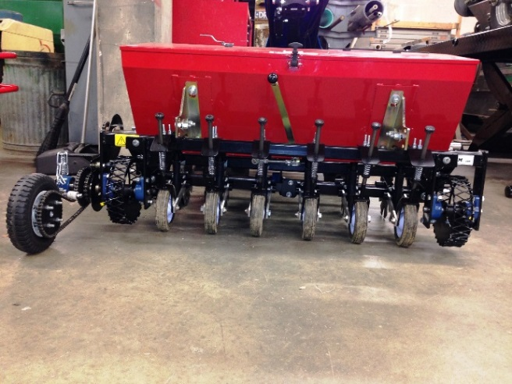
Active Coulter Planting System
A no-till agricultural system that uses a walk-behind tractor for planting seeds. The system comprises of active coulters integrated into a planter apparatus that is connected to a walk-behind tractor. The active coulter blades cut and penetrate cover crop residue on a surface of a field so that seeds are planted in the soil below the surface crop residue.
(Environmental, Electronics & Hardware)
Docket No: 82.14
Contact: Joseph.Lipovsky@ars.usda.gov
Benefits
Novel planter design to plant seeds into soil with residue cover using small walk-behind tractor
Applications
Effective planting system for small farms to achieve no-till planting of cash and cover crops into residue cover

Slide 35
Computer Vision Qualified Infrared Temperature Sensor
An integrated set of sensors, microprocessor, and devices with software that remotely measures surface temperature and simultaneously acquires an image for the purposes of qualifying the sensed temperature. The system can be used to aide in precision irrigation management of center pivot or lateral move irrigation systems by providing surface temperature data for use in irrigation scheduling algorithms and automatic irrigation. The system can also be used in greenhouse environments and in drip irrigated fields to help monitor plant abiotic (drought, chemical) and biotic stresses (disease, insect infestation).
(Environmental, Electronics & Hardware)
Docket No: 288.12
Contact: Jeffrey.Walenta@ars.usda.gov
Benefits
Can detect whether sensor sees plant or soil thus improving data quality immensely
Greatly improved irrigation scheduling
Much cheaper acquisition of data critical for real-time crop management
Improved accuracy in crop yield forecasting
Water conservation
Applications
Crop irrigation scheduling and automation
Detection of crop nutrient deficiencies, pests, weeds, and diseases
Crop yield forecasting

