Slide 1
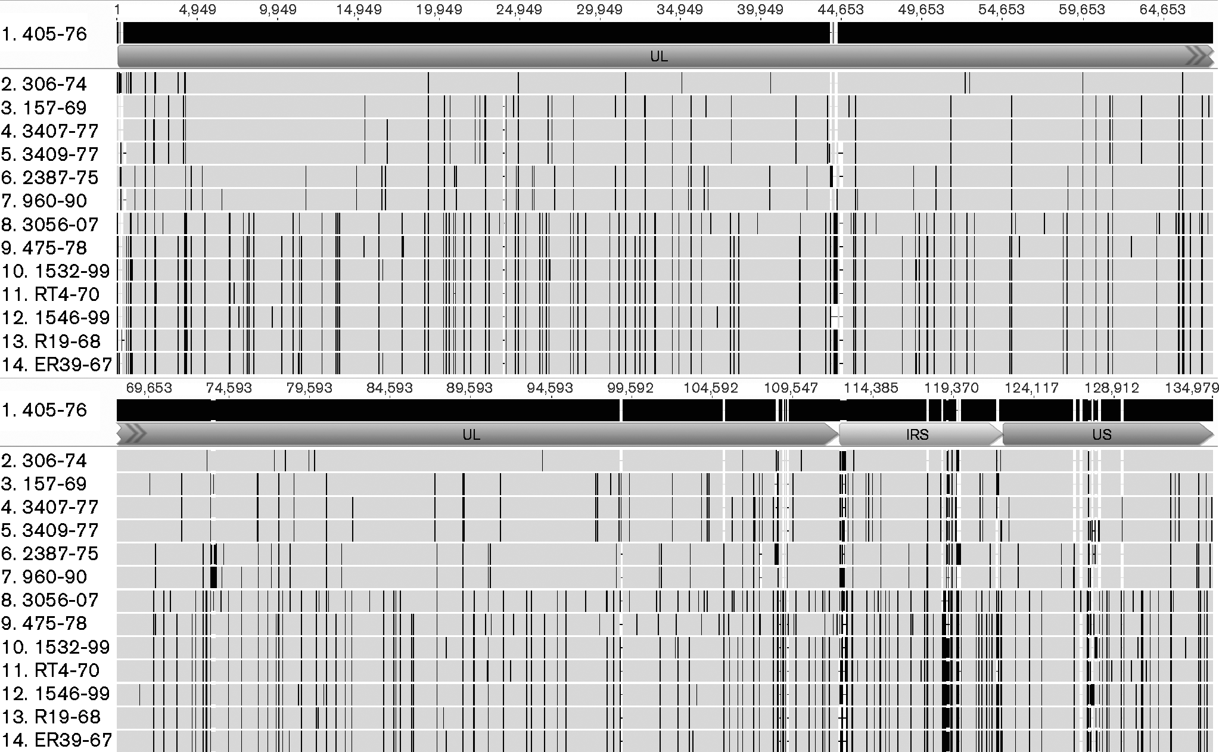
- Fig. 2.
Microbiology Society © 2016

